Slide 1
Surrender School Presents Joe & Charlie Big Book Study Week 10

Slide 2
How to access Surrender School Joe and Charlie Recordings, Homework, and Documents.

Slide 3
Announcement from the surrender school Board
Notes:
Links: Joe & Charlie – Take The 12 (Hand outs)

Slide 4
SET ASIDE PRAYER
God, please set aside everything I think I know about myself, my emotional sobriety, the 12 Steps and You; for an open mind and a new experience of myself, my emotional sobriety, the 12 Steps and especially You!

Slide 5
Joe and Charlie - Big Book Study September 1 – November 3
AA History
The Doctor’s Opinion
Bill’s Story
There is a Solution
More About Alcoholism and We Agnostics
Step 1, Step 2, and Step 3 (HOW IT WORKS)
Step 4 – Part 1 – (How It Works)
Step 4 – Part 2 – (How It Works)
Step 5, Step 6, Step 7, Step 8, and Step 9 (Into Action – Pages 72 – 84)
Step 10, Step 11, Step 12 (Into Action, Working with Others, and A Vision For You)
Source Credits:
YOUTUBE - 12 Step Retro Speakers
AA Big Book Online PDF - AA Netherlands
Link to Handout Source - Take The 12
History and Historical Fact Checks: Silkworth.net

Slide 6
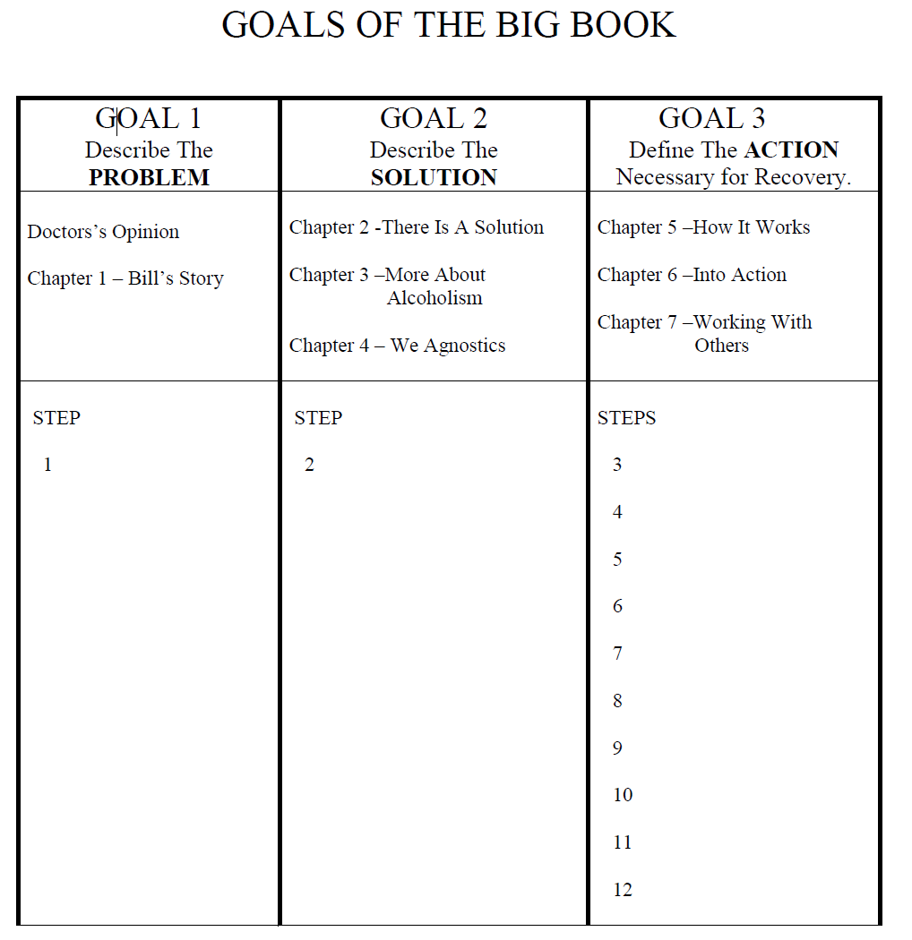
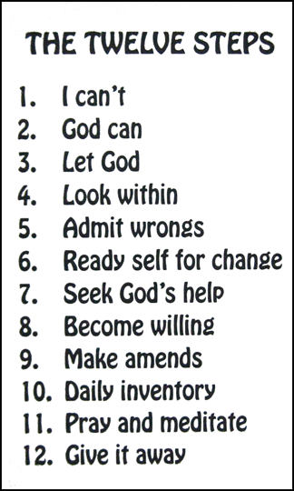
GOALS OF THE BIG BOOK:
1st GOAL - THE PROBLEM
The Dr.’s Opinion
Chapter 1 - Bill’s Story
2nd GOAL - THE SOLUTION
Chapter 2: There Is A Solution
Chapter 3: More About Alcoholism
Chapter 4: We Agnostics
3rd GOAL – ACTION
Chapter 5: How It Works
Chapter 6: Into Action
Chapter 7: Working with Others

Slide 7
Moderator, please start the recording

Slide 8
Surrender School Presents Joe & Charlie Big Book Study Week 10 Steps 10 - 12

Slide 9
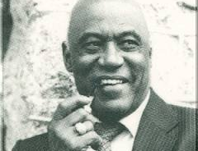
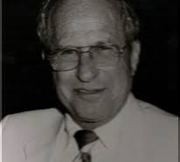
Joe McQ,
Joe McQuany - (AA) (1928-2007, 78 years old) Sober: 1962 - 2007
We are not the gurus of Alcoholic Anonymous!
We do not speak for AA as a whole!
Charlie P.
Charlie Parmley - (AA) (1929-2011, 82 years old)
Sober: 1970 - 2011
Notes:
This Surrender School Big Book Study is based on the recording of Joe M and Charlie P. They have emphatically indicated that they are not the gurus of AA (fellowship or the booK AA). They were alcoholic that got together in the 70s and found they have a common interest in the big book of AA. Additionally, they always start by stating they do not speak for AA.
Nor I am an expert, guru and nor I am speaking for any 12 Step Group. I simply have a passion for the big book of AA and want to do my part in carrying the message of hope.

Slide 10
AA Big book study Week 10 Into Action (Pages 84 & 85) Step 10
Step 10: Continued to take personal inventory and when we were wrong promptly admitted it.

Slide 11
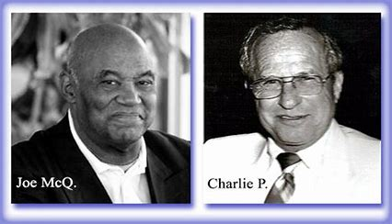
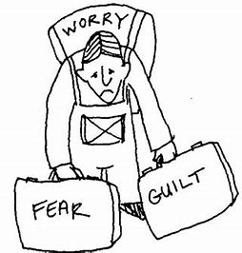
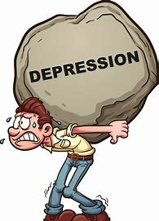
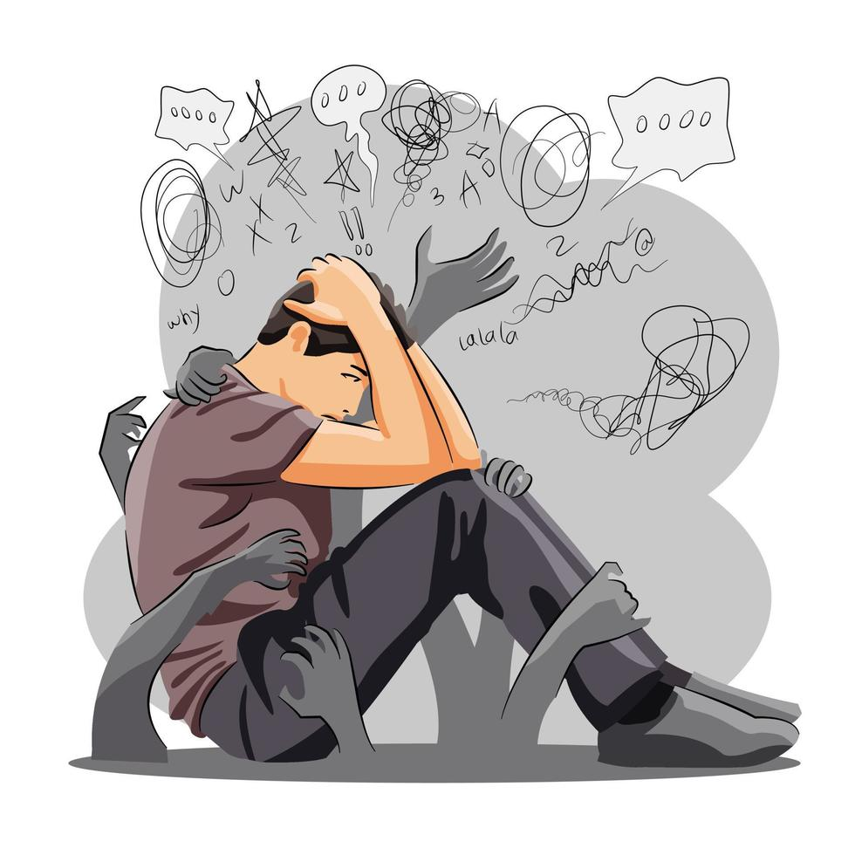
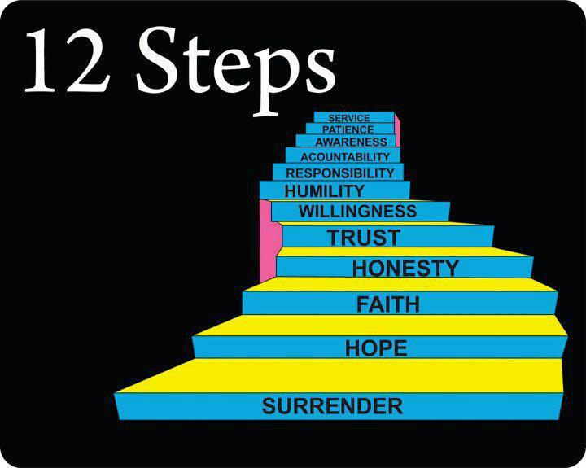
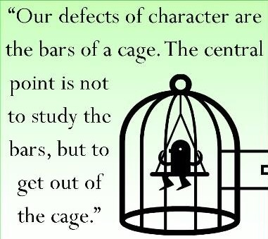
Step 10 - Into Action The Purpose of the Steps 10, 11, and 12
We came here restless, irritable, discontented, filled with shame, fear, guilt, remorse, worry, anger, depression, etc.
We work the steps, we receive the promises.
Certainly we have undergone a change in our personality. We have undergone a spiritual awakening already.
…what is the purpose of the last three steps? And many people will tell us that the last three steps are to maintain our sobriety. I will agree that they will help us stay sober. But the word maintenance itself is a misnomer. To maintain something is means to keep it “as is”.
Let’s look at the last three steps. Not as just maintenance steps. Not just to keep us sober, but to see if we don’t actually continue to grow in our relationship with God, with ourselves and with other human beings.

Slide 12
Step 10 - Into Action
AA Big Book – Into Action (Page 84)
“This thought brings us to Step Ten, which suggests we continue to take personal inventory and continue to set right any new mistakes as we go along. We vigorously commenced this way of living as we cleaned up the past. We have entered the world of the Spirit. Our next function is to grow in understanding and effectiveness. This is not an overnight matter. It should continue for our lifetime. Continue to watch for selfishness, dishonesty, resentment, and fear. When these crop up, we ask God at once to remove them. We discuss them with someone immediately and make amends quickly if we have harmed anyone. Then we resolutely turn our thoughts to someone we can help. Love and tolerance of others is our code.”
Notes:
Big Book, p. 84, par. 2 "This thought brings us to step ten, which suggests we continue to take personal inventory and continue to set right any new mistakes as we go along. We vigorously commenced this way of living as we cleaned up the past. We have entered the world of Spirit. "
J & C We’ve had a spiritual awakening.
Big Book, p. 84, par. 2 cont. "Our next function is to grow " J & C To grow, not maintain, not stay where we are, but to grow.
Big Book, p. 84, par. 2 cont. "in understanding and effectiveness. This is not an overnight matter. It should continue for our lifetime. Continue to watch for selfishness, dishonesty, resentment, and fear. "
J & C What step did we use to look at that in the first place. Anybody remember? Step 4? OK.
Big Book, p. 84, par. 2 cont. "When these crop up, we ask God at once to remove them. "
J & C What steps did we use there? 6 and 7. Alright.
Big Book, p. 84, par. 2 cont. "We discuss them with someone immediately "
J & C And what step was that? 5. OK.
Big Book, p. 84, par. 2 cont. "and make amends quickly if we have harmed anyone. "
J & C What steps did we use there? 8 and 9.
Big Book, p. 84, par. 2 cont. "Then we resolutely turn our thoughts to someone we can help. Love and tolerance of others is our code."

Slide 13
Step 10 - Into Action Questions To Ask Yourself When bothered
Step 10: Continued to take personal inventory and when we were wrong promptly admitted it.
“Who are you mad at?”
“What did they do to you?”
“What part of self is affected?”
“What did you do, if anything, to set it in motion?”
“Which character defect has come back to the surface?”
I can’t get upset unless one of those old character defects has come back.
(Selfish, dishonest, self-seeking, frightened, or inconsiderate.)
Notes:
I can spot it just like that. I say “OK God you know I don’t want to be this way. Please take this away from me.” This selfishness or this dishonesty or whatever it is. I try to discuss it with someone immediately, preferably my sponsor. Sometimes I can sometimes I can’t but I try to. Then I make amends quickly if I hurt anybody in this process. 10-15-20 minutes it’s all gone. The rest of the day is OK. I have wasted all the time that I want to waste in resentments and fear and anger and worry and depression and etc. I don’t have to do that anymore. My God I love to feel good. I just don’t want to waste any more time, what little I've got left in that other kind of jazz. I've got a tool here that works every time. And as you continue to take personal inventory as you continue to look and see who you are mad at and etc and etc and etc you’re going to learn more about yourself. As you ask God to take these things away they become less and less. As you discuss them with another human being, preferably our sponsor, we know more about ourselves. As we make amends quickly our relationship with the world and everybody in it becomes better and better. You can’t do step 10 the way the book says and stay the way you are. You just can’t. Your relationship with God, with yourself, and with your fellow man will become better and better and better and better. A new dimension of living that we never dreamed existed.
Now be careful. This is just like 6 and 7. This is the other changing step. And if you stay fowled up you can’t blame it on anybody else any longer. Cause if you’re fowled up and you use step 10 you can get rid of that stuff. But if you stay fowled up and you stay angry and worried and depressed and selfish and dishonest it’s got to be because that’s the way you want to be.

Slide 14
Step 10 - Into Action Questions To Ask Yourself When bothered
Step 10: Continued to take personal inventory and when we were wrong promptly admitted it.
You just can’t. You can’t do step 10 the way the book says and stay the way you are. Your relationship with God, with yourself, and with your fellow man will become better and better and better and better. A new dimension of living that we never dreamed existed.
Now be careful. This is just like 6 and 7. This is the other changing step. And if you stay fowled up you can’t blame it on anybody else any longer. Cause if you’re fowled up and you use step 10 you can get rid of that stuff. But if you stay fowled up and you stay angry and worried and depressed and selfish and dishonest it’s got to be because that’s the way you want to be. I can’t blame it on anybody or God or anything else any longer.
Notes:
. As we make amends quickly our relationship with the world and everybody in it becomes better and better. You can’t do step 10 the way the book says and stay the way you are. You just can’t. Your relationship with God, with yourself, and with your fellow man will become better and better and better and better. A new dimension of living that we never dreamed existed.
Now be careful. This is just like 6 and 7. This is the other changing step. And if you stay fowled up you can’t blame it on anybody else any longer. Cause if you’re fowled up and you use step 10 you can get rid of that stuff. But if you stay fowled up and you stay angry and worried and depressed and selfish and dishonest it’s got to be because that’s the way you want to be.

Slide 15
Step 10 - Into Action More Promises
AA Big Book – Into Action (Pages 84 & 85)
And we have ceased fighting anything or anyone—even alcohol.
For by this time sanity will have returned.
We will seldom be interested in liquor. If tempted, we recoil from it as from a hot flame.
We react sanely and normally, and we will find that this has happened automatically.
We will see that our new attitude toward liquor has been given us without any thought or effort on our part. It just comes! That is the miracle of it.
Notes:
Remember it said, we came to believe that a power greater than ourselves would restore us to sanity? Well we get our sanity back on page 84 by the way.
And again remember way back on page 45 it said that the main object of this book was to enable me to find a power greater than myself which would solve my problem. And somewhere between there and here we have the first 9 steps or 10 steps of the program of Alcoholics Anonymous. And one day into 6 or 7 or 8 months of sobriety and working these steps I looked up one day and I said what happened to that desire of drink that I used to have. It’s just gone. I mean it was just gone, seemingly without any effort on my part. I found the power and the power solved the problem. It was just gone. That’s the miracle of it.
Now, the next to the last paragraph on page 85.

Slide 16
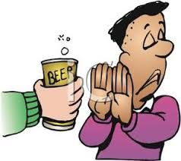
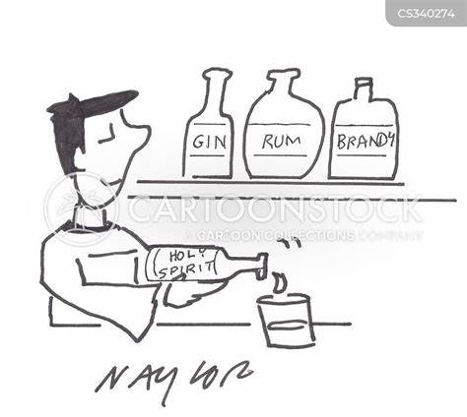
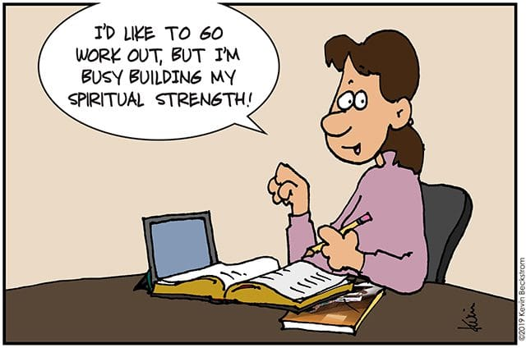
Step 10 - Into Action More Promises
AA Big Book – Into Action (Pages 84 & 85)
We are not fighting it, neither are we avoiding temptation.
We feel as though we had been placed in a position of neutrality—safe and protected.
We have not even sworn off. Instead, the problem has been removed. It does not exist for us.
We are neither cocky nor are we afraid.
That is how we react so long as we keep in fit spiritual condition.
Notes:
In other words what’s happened to us in these steps of 3 through 10 we’ve removed enough self-will that we are now becoming God conscious. And by now we are beginning to receive some directions from God. Now if the book says that God has all power and all direction and I believe he does the book says so. God dwells within each of us and I believe he does because the book says so. Then it really stands to reason that you and I have within ourselves all the knowledge and all the power that we could ever
need to handle any situation which comes up in the future. It’s called a sixth sense of direction. You develop this sixth sense of direction through prayer and meditation.

Slide 17
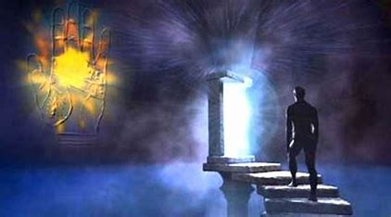
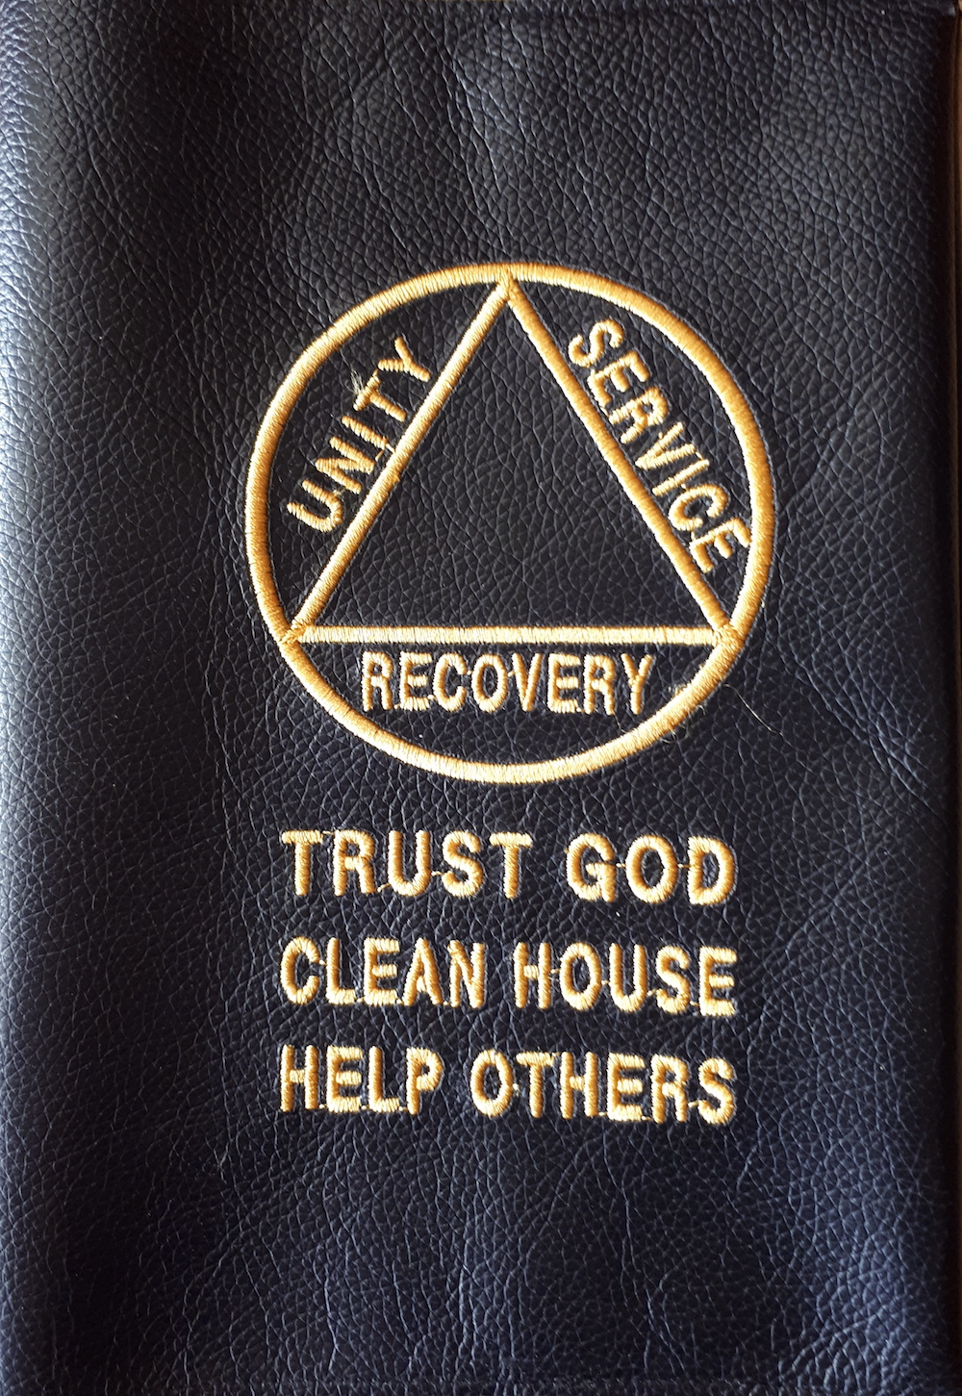
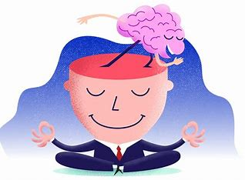
Step 10 - Into Action Sixth Sense of Direction through Prayer and Meditation
AA Big Book – Into Action (Page 85)
Much has already been said about receiving strength, inspiration, and direction from Him who has all knowledge and power. If we have carefully followed directions, we have begun to sense the flow of His Spirit into us. To some extent we have become God-conscious. We have begun to develop this vital sixth sense. But we must go further and that means more action.

Slide 18
AA Big book study Week 10 Into Action (Pages 86 - 88) Step 11
Step 11: Sought through prayer and meditation to improve our conscious contact with God as we understood Him, praying only for knowledge of His will for us and the power to carry that out.

Slide 19
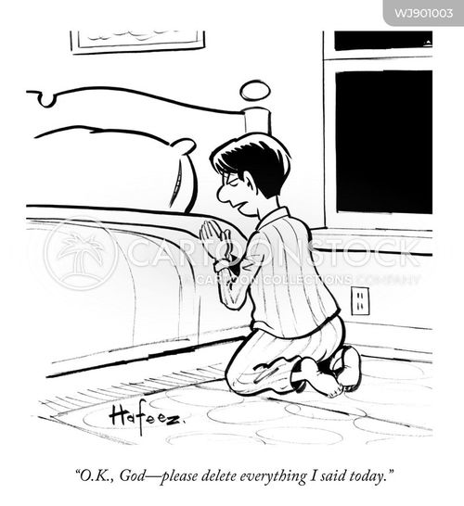
Step 11 - Into Action Prayer and Meditation (At Night)
AA Big Book – Into Action (Page 86)
When we retire at night, we constructively review our day. Were we resentful, selfish, dishonest or afraid? (Step 4)
Do we owe an apology? (Steps 8 & 9)
Have we kept something to ourselves which should be discussed with another person at once? (Step 5)
Were we kind and loving toward all? What could we have done better? Were we thinking of ourselves most of the time? Or were we thinking of what we could do for others, of what we could pack into the stream of life? But we must be careful not to drift into worry, remorse or morbid reflection, for that would diminish our usefulness to others. After making our review we ask God’s forgiveness and inquire what corrective measures should be taken. (Steps 6 & 7)
Notes:
Most of us when we get here, I didn’t know anything about meditation. I though meditation is when you tried to clear you mind of all thought. And I've never been able to do that. When I wake up in the morning that sucker turns on and it will not clear out. I thought maybe it was chanting. Listening to soft music. That’s probably some forms of meditation. But I knew nothing about any of it. I knew very little about prayer. Even raised in church. I only knew two prayers. One went like this.
Now I lay me down to sleep. Pray the Lord my soul to keep. And if I die before I wake.
I'm not into that prayer anymore. That’s dealing with death and I don’t want nothing to do with that. The other prayer that I used and I bet you used it too went like this.
God, if you get me out of this damn mess I swear I’ll never do this again.
Now I'm going to have to develop a life of prayer and meditation. Would seem to be impossible wouldn’t it. Bill Wilson is faced with the job of teaching people who are spiritually bankrupt how to pray and meditate and Bill Wilson don’t know how to do it either. Thank God he didn’t. Cause if he had really been knowledgeable he would have written in such a manner that I could never have understood it. But he didn’t know enough about it to be able to do that. What he did do is what he’s done all the way through the book. He gives us some definite valuable suggestions. And he said if we will use those in our lives today we will develop our own life of prayer and meditation. He couldn’t tell us how to pray and meditate but he could tell us how to develop our own. He starts for just a few moments over on page 86 he tells us what to do when we go to bed at night. Here it is now in step 11. He said

Slide 20
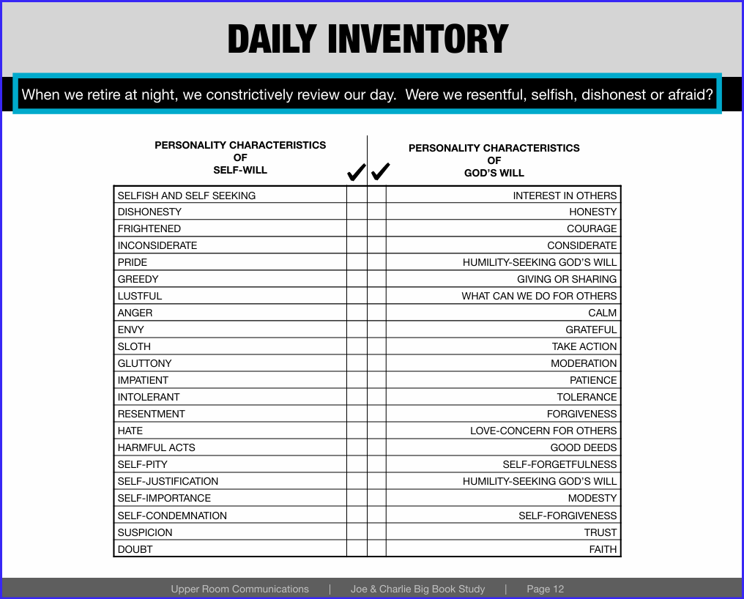
Step 11 - Into Action Daily Inventory
On one side of the sheet we take the basic character defects, selfish, self-seeking, dishonest, frightened, inconsideration. We took all the other defects in the 12 and 12 which are the offshoots of those first four. We put them on the left-hand side of the sheet and called them the personality characteristics of a self-willed person.
We tried to find the opposite and put them on the right hand side of the sheet and called that the personality characteristics of a God willed person. Now all we are trying to do is get from the left hand side of the sheet to the right hand side and I can sit down at night with this little sheet and run down through it making a few check marks that shows me where I've been that day.
Notes:
On one side of the sheet we take the basic character defects, selfish, self-seeking, dishonest, frightened, inconsideration. We took all the other defects in the 12 and 12 which are the offshoots of those first four. We put them on the left-hand side of the sheet and called them the personality characteristics of a self-willed person. We tried to find the opposite and put them on the right hand side of the sheet and called that the personality characteristics of a God willed person. Now all we are trying to do is get from the left hand side of the sheet to the right hand side and I can sit down at night with this little sheet and run down through it making a few check marks that shows me where I've been that day. Shows we what I need to continue to work on

Slide 21
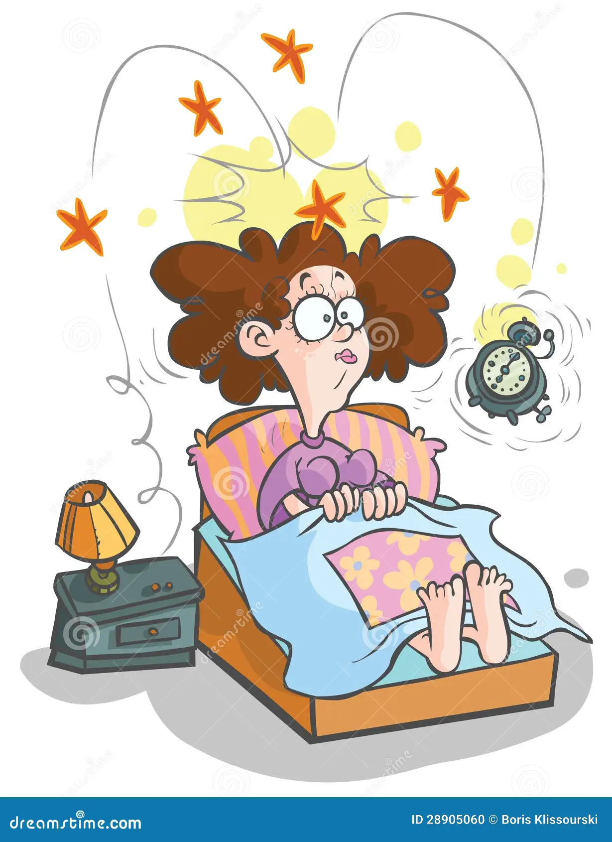
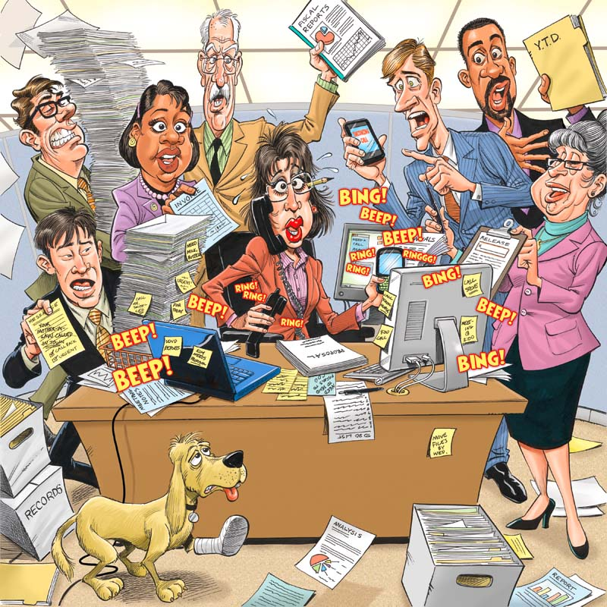
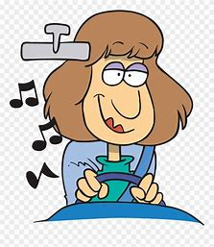
Step 11 - Into Action Prayer and Meditation (On Awakening)
AA Big Book – Into Action (Page 86)
On awakening let us think about the twenty-four hours ahead. We consider our plans for the day. Before we begin, we ask God to direct our thinking, especially asking that it be divorced from self-pity, dishonest or self-seeking motives.
Notes:
Most of us get up in the morning and the first thing we do is go to the bathroom. ”. Then we head for the kitchen. And we get a cup of coffee and maybe a little food, and we feed the body. We get the body taken care of and we go back to the bathroom again. After we get the body all taken care of, we feed the cat or the dog. We start out the door.
We go out to the car and we check the air in the tires and we check the fuel in the fuel tank. We turn the switch, start the motor and we take off down the road.
But what did we do about our minds that morning? We took care of all the material things including our body. What did we do about our minds? Our minds are going to run the whole show all day. Did we check the air there? Did we check the fuel level there? Did we feed the mind a little bit?

Slide 22
Step 11 - Into Action Prayer and Meditation (On Awakening)
AA Big Book – Into Action (Page 86)
In thinking about our day we may face indecision. We may not be able to determine which course to take. Here we ask God for inspiration, an intuitive thought or a decision. We relax and take it easy. We don’t struggle.
Notes:
If we would take 5 to 10 minutes in the morning to ask God to direct our thinking throughout the day. Ask God to give us the right thought and action. Before we even start thinking about today, then chances are our thoughts about today are going to be in better shape. If we spent 5 minutes in the morning there coupled with 5 minutes in the evening when we go to bed, there’s no telling what we could do with our minds. If we spent as much time on our minds as we do on our bodies, my God we could become anything, couldn’t we? If you’ve spent 5 in the morning and 5 in the evening you’ve still got 23 hours and 50 minutes to screw the thing up. It only takes a little bit of time. Very definite valuable suggestion.
This is a form of meditation for busy people. And quite often my mind goes back to that subject and I’ve got information I didn’t have before. It says, “Why don’t you call Bill. Maybe he’ll know.” And I call Bill and Bill’s got the answer. I used to say “My wasn’t it lucky I called Bill.” No, this is a form of tapping into the sixth sense of direction. And if you practice at it, practice at it, practice at it, practice at it, it gets to where it becomes a common thing to do. It’s amazing how this stuff works. Very simple suggestions.

Slide 23
Step 11 - Into Action How to Pray (On Awakening)
AA Big Book – Into Action (Page 87)
We usually conclude the period of meditation with a prayer that we be shown all through the day what our next step is to be, that we be given whatever we need to take care of such problems. We ask especially for freedom from self-will, and are careful to make no request for ourselves only. We may ask for ourselves, however, if others will be helped. We are careful never to pray for our own selfish ends. Many of us have wasted a lot of time doing that and it doesn’t work. You can easily see why.
Notes:
As I said, I use to use God like an errand boy. Send him out to get this done and that done. It didn’t work. He never did come back with nothing. But I learned through doing that, to start praying only for the knowledge of his will for me and the power to carry that out. And today I can’t think of anything that would be better than to have God’s will done in my life, only.
They said to me “Pray only for knowledge of his will and the power to carry that out” I said “How in the hell is he going to know what I want?” And they said “He don’t care what you want.” They said “He's interested in what you need” And he knows more about what you need than you know yourself. And that’s turned out to be exactly true. If I had written a list of things that I thought I needed when I first came to AA. If I’d have said “God give me these things and I will be satisfied for the rest of my life.” I would have cheated myself.

Slide 24
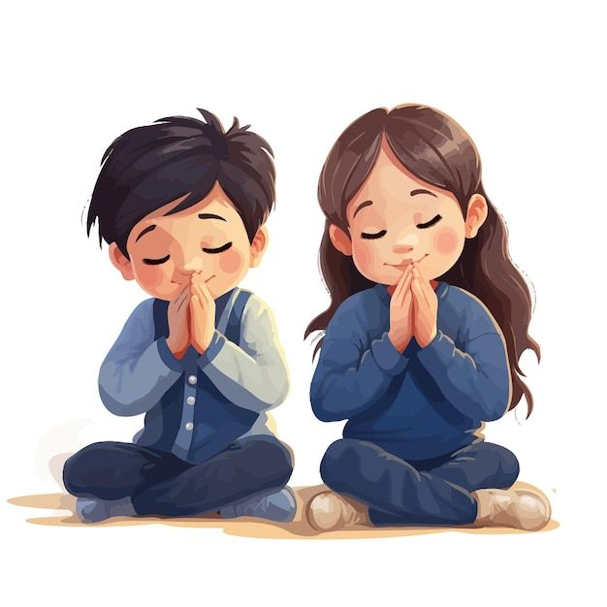
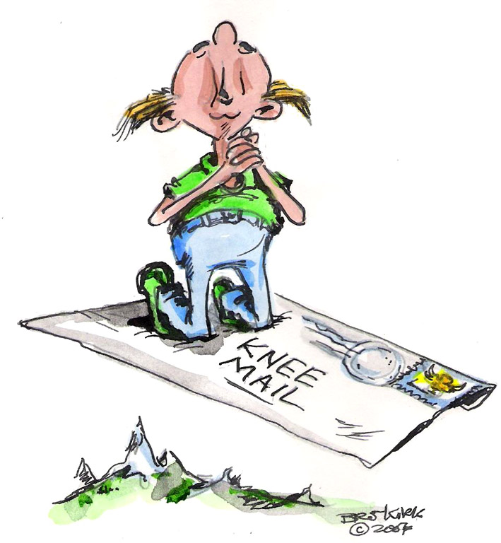
Step 11 - Into Action Prayer and Meditation (On Awakening)
AA Big Book – Into Action (Pages 87 & 88)
If circumstances warrant, we ask our wives or friends to join us in morning meditation.
As we go through the day we pause, when agitated or doubtful, and ask for the right thought or action. We constantly remind ourselves we are no longer running the show, humbly saying to ourselves many times each day “Thy will be done.” We are then in much less danger of excitement, fear, anger, worry, self-pity, or foolish decisions. We become much more efficient. We do not tire so easily, for we are not burning up energy foolishly as we did when we were trying to arrange life to suit ourselves.
Notes:
God knows what we need. He's not interested in what we want.
Big Book, p. 87, par. 2 "If circumstances warrant, we ask our wives or friends to join us in morning meditation. "
Big Book, p. 87, par. 3 "As we go through the day we pause, when agitated or doubtful, and ask for the right thought or action. We constantly remind ourselves we are no longer running the show, humbly saying to ourselves many times each day "Thy will be done." We are then in much less danger of excitement, fear, anger, worry, self-pity, or foolish decisions. We become much more efficient. We do not tire so easily, for we are not burning up energy foolishly as we did when we were trying to arrange life to suit ourselves.
It works - it really does. "
J & C That’s a full paragraph right there.
Big Book, p. 88, par. 2 "We alcoholics are undisciplined. So we let God discipline us in the simple way we have just outlined. “
If you’ll follow these definite and valuable suggestions on page 86, 87 you will develop your own life of prayer and meditation. You'll make your conscious contact. You’ll be able to tap in to that sixth sense of direction and it’s amazing the things that we can learn by doing that.

Slide 25
AA Big book study Week 10 Working With Others (Pages 89 - 103) Step 12
Step 12: Having had a spiritual awakening as the result of these steps, we tried to carry this message to alcoholics, and to practice these principles in all our affairs.

Slide 26
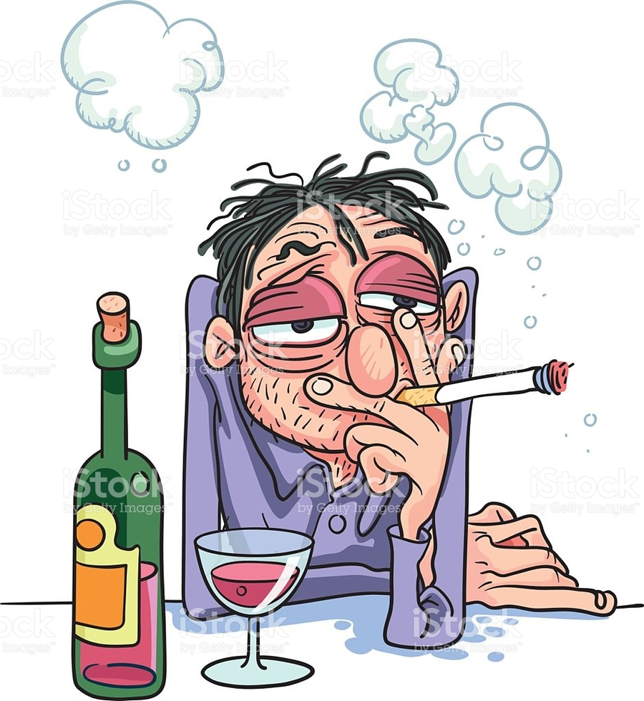
Step 12 - Working With Others How To Carry the Message (Our Story)
AA Big Book – Into Action (Page 92)
Tell him how baffled you were, how you finally learned that you were sick. Give him an account of the struggles you made to stop. Show him the mental twist which leads to the first drink of a spree. We suggest you do this as we have done it in the chapter on alcoholism. If he is alcoholic, he will understand you at once.
He will match your mental inconsistencies with some of his own.
I f you are satisfied that he is a real alcoholic, begin to dwell on the hopeless feature of the malady. Show him, from your own experience, how the queer mental condition surrounding that first drink prevents normal functioning of the will power.

Slide 27
Step 12 - Working With Others How To Carry the Message (Our Story)
AA Big Book – Into Action (Pages 93 & 94)
Let him ask you that question, if he will. Tell him exactly what happened to you. Stress the spiritual feature freely. If the man be agnostic or atheist, make it emphatic that he does not have to agree with your conception of God. He can choose any conception he likes, provided it makes sense to him. The main thing is that he be willing to believe in a Power greater than himself and that he live by spiritual principles.
Outline the program of action, explaining how you made a self-appraisal, how you straightened out your past and why you are now endeavoring to be helpful to him.

Slide 28
Step 12 - Working With Others The 3 parts of the 12 Step
“Having had a spiritual awakening as THE result of these steps...”
…if I apply the first eleven steps in my life to the best of my ability I will have a spiritual awakening. Now what is a spiritual awakening? A personality change sufficient to recover from alcoholism.
“…,we tried to carry this message to alcoholics,…
I am now charged with the responsibility of carrying THIS message to other alcoholics. **- not ‘a’ message, not ‘the’ message, not ‘some’ message, ‘THIS’ message. What is THIS message?
I’m not like I used to be.
“…and to practice these principles in all our affairs.
What are the principles? So this time he’ll call them (the Steps) principles. In another place he’ll call them ‘proposals’. He is referring to the Steps.
Step 12: Having had a spiritual awakening as the result of these steps, we tried to carry this message to alcoholics, and to practice these principles in all our affairs.
Notes:
Now what is a spiritual awakening? A personality change sufficient to recover from alcoholism
Bill tells us in the ‘Twelve and Twelve, there’s as many kinds of spiritual awakenings as there are people in AA, but they’ve all got certain things in common. That is, that we're able to feel, believe and do things that we could never do before on our own strength unaided. (paraphrased from the "Twelve Steps and Twelve Traditions," pp. 106-107) .
I believe things I never believed before. I believe God is a kind and a loving God. I believe He stands ready to help any human being anywhere in the world the instant they’re ready to give up on self will and turn to Him. When I came here I thought He was hell, fire and brimstone. I thought He was a God of justice. Thank God He’s not a God of justice. If He was I wouldn’t be here today would I?
Now I’m charged though with a responsibility. There really are no free rides; you do have to pay for what you receive.
I am now charged with the responsibility of carrying THIS message to other alcoholics.
- not ‘a’ message, not ‘the’ message, not ‘some’ message, ‘THIS’ message. What is THIS message?
“Having had a spiritual awakening as the result of these steps, ...”
The final thing I have to do is practice these principles in all my affairs.
Now what are the principles? We hear arguments about this all the time. The principle of (Step) 1 is this and the principle of (Step) 2 is that and no, no I think he’s referring to the 6th (Step).
He said, “Having had a spiritual awakening as a result of these steps”... he already used ‘steps’ once in Step 12 so he’s not going to use it twice. So this time he’ll call them (the Steps) principles. In another place he’ll call them ‘proposals’. In the front of the Twelve and Twelve he says the 12 Steps of Alcoholics Anonymous are a set of principles. He is referring to the Steps.

Slide 29
Step 12 - Working With Others Questions to ask Yourself
Can I practice these principles, these Steps in my home with my spouse?
Can I realize just how powerless I am over that lady? (Step 1)
Can I realize the insanity in trying to control her knowing full well I can’t? (Step 2)
Can I make a decision and turn her will and her life over to the care of God, as I understand him? (Step 3)
Can I inventory me and find those defects of character that keep me trying to control? (Step 4)
Can I talk about that to another human being? (Step 5)
Can I become willing to have God remove and ask Him to do so and take those away? (Steps 6 & 7)
Can I make amends quickly to her when I’ve harmed her? (Step 8/9/10/11)
You can be just as happy as you want to be.
God is not going to do this for you. Other people are not going to do this for you. But you, with Gods help and the help of other people, can do it for yourself.

Slide 30
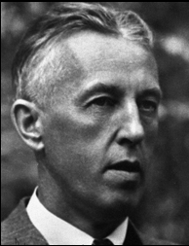
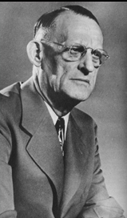
Step 12 - Working With Others The 3 parts of the 12 Step (Part 3)
AA Big Book – A Vision For You (Page 164)
Our book is meant to be suggestive only. We realize we know only a little. God will constantly disclose more to you and to us. Ask Him in your morning meditation what you can do each day for the man who is still sick. The answers will come, if your own house is in order. But obviously you cannot transmit something you haven’t got. See to it that your relationship with Him is right, and great events will come to pass for you and countless others. This is the Great Fact for us.

Slide 31
Step 12 - A Vision For You - Chapter 11
AA Big Book – A Vision For You (Page 164)
Abandon yourself to God as you understand God.
Steps One, Two and Three
Admit your faults to Him and to your fellows.
Steps Four, Five, Six and Seven
Clear away the wreckage of your past.
Steps Eight and Nine
Give freely of what you find and join us.
Steps Ten, Eleven, and Twelve.
We shall be with you in the Fellowship of the Spirit, and you will surely meet some of us as you trudge the Road of Happy Destiny.
May God bless you and keep you—until then.

Slide 32
Step 12 - Working With Others
Video Link: 51:38 - 53:49
Notes:
Turn up the volume

Slide 33
Step 12 - Working With Others
Video Link: 58:38
Notes:
Turn up the volume

Slide 34
Moderator, please stop the recording
Surrender School Closing Announcements?

Slide 35
SERENITY PRAYER
God grant me the serenity to accept the things I can not change, the courage to change the things I can and the wisdom to know the difference.

