Slide 1
Surrender School Presents Joe & Charlie Big Book Study Week 7

Slide 2
How to access Surrender School Joe and Charlie Previous Sessions, Homework and Documents.

Slide 3
messages from the surrender school Board

Slide 4
SET ASIDE PRAYER
God, please set aside everything I think I know about myself, my emotional sobriety, the 12 Steps and You; for an open mind and a new experience of myself, my emotional sobriety, the 12 Steps and especially You!

Slide 5
Joe and Charlie - Big Book Study September 1 – November 3
AA History
The Doctor’s Opinion
Bill’s Story
There is a Solution
More About Alcoholism and We Agnostics
Step 1, Step 2, and Step 3 (HOW IT WORKS)
Step 4 – Part 1 – (How It Works)
Step 4 – Part 2
Step 5, Step 6, and Step 7
Step 8, Step 9, Step 10, Step 11, Step 12
Source Credits:
YOUTUBE - 12 Step Retro Speakers
AA Big Book Online PDF - AA Netherlands
Link to Handout Source - Take The 12
History and Historical Fact Checks: Silkworth.net

Slide 6
Moderator, please start the recording

Slide 7
Surrender School Presents Joe & Charlie Big Book Study Week 7 Step 4 – Part 1

Slide 8
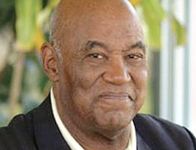
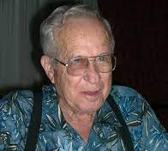
Joe McQ,
Joe McQuany - (AA) (1928-2007, 78 years old) Sober: 1962 - 2007
We are not the gurus of Alcoholic Anonymous!
We do not speak for AA as a whole!
Charlie P.
Charlie Parmley - (AA) (1929-2011, 82 years old)
Sober: 1970 - 2011
Notes:
This Surrender School Big Book Study is based on the recording of Joe M and Charlie P. They have emphatically indicated that they are not the gurus of AA (fellowship or the booK AA). They were alcoholic that got together in the 70s and found they have a common interest in the big book of AA. Additionally, they always start by stating they do not speak for AA.
Nor I am an expert, guru and nor I am speaking for any 12 Step Group. I simply have a passion for the big book of AA and want to do my part in carrying the message of hope.

Slide 9
AA Big book study Week 7
HOW IT WORKS Step 4 - Part 1 (Pages 63 – 67)

Slide 10
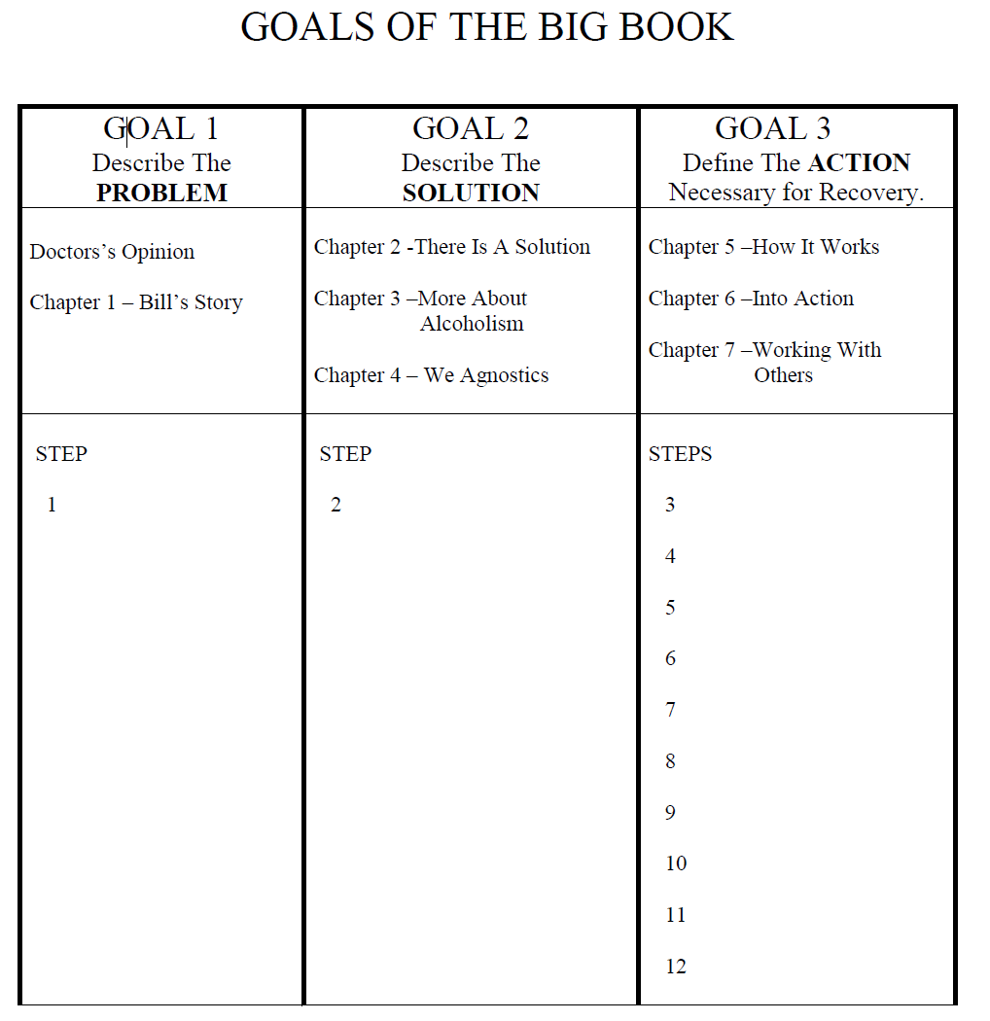
AA Big Book Layout
GOALS OF THE BIG BOOK:
1st GOAL - THE PROBLEM
The Dr.’s Opinion
Chapter 1 - Bill’s Story
2nd GOAL - THE SOLUTION
Chapter 2: There Is A Solution
Chapter 3: More About Alcoholism
Chapter 4: We Agnostics
3rd GOAL – PROGRAM OF ACTION
Chapter 5: How It Works
Chapter 6: Into Action
Chapter 7: Working with Others

Slide 11
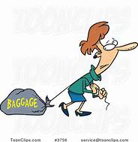
HOW IT WORKS - STEP 4 (Part 1) How it Works – Determining When to take Step 4
AA Big Book – How it Works - Pages 63 & 64
“NEXT WE LAUNCHED out on a course of vigorous action, the first step of which is a personal housecleaning, which many of us had never attempted. Though our decision (Step 3) was vital and crucial step, it could have little permanent effect unless at once followed by a strenuous effort to face, and to be rid of, the things in ourselves which had been blocking us (Step 4). Our liquor was but a symptom. So we had to get down to causes and conditions.”

Slide 12
HOW IT WORKS - STEP 4 (Part 1) How it Works – Determining When to take Step 4
Step Four Made a searching and fearless moral inventory of ourselves.
Step Three Made a decision to turn our will and our lives over to the care of God as we understood Him

Slide 13
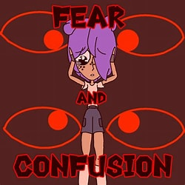
HOW IT WORKS - STEP 4 (Part 1) How it Works – Why would We still Procrastinate?
Now knowing that, and knowing we might get drunk if we don’t get on with Step 4, why would we still tend to procrastinate?
I think one two or three reasons behind it.
Number one is fear.
I think one of the greatest reasons is simply confusion.

Slide 14
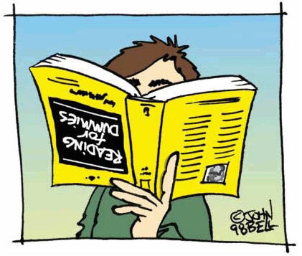
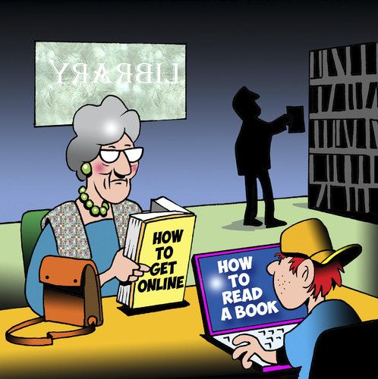
HOW IT WORKS - STEP 4 (Part 1) How it Works – we could not see how to do Step 4 according to the Big Book
For years we could not see how to do Step 4 according to the Big Book. The reason we couldn’t see it is the instructions are there but they are so simple that we alcoholics with our keen, intellectual, alcoholic minds looking for something more complicated, overlooked the simplicity of Step 4.
Notes:
There is so much confusion around how to do the 4th Step in the Big Book. I have tried several different methods of doing the Steps. But by far, this was the simplest way.

Slide 15
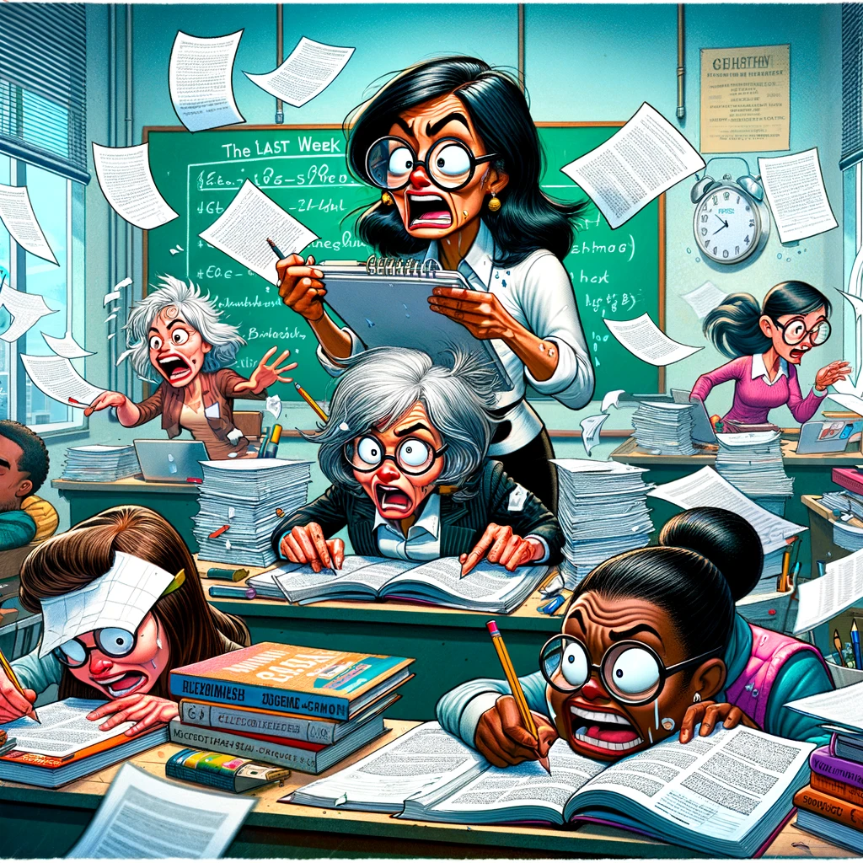
HOW IT WORKS - STEP 4 (Part 1) How it Works – we could not see how to do Step 4 according to the Big Book
So in our desperation, we read over in Step 5 something about sharing your entire life story, and we say that’s what they want us to do in Step 4. Is write our life story so we can share it in Step 5.

Slide 16
HOW IT WORKS - STEP 4 (Part 1) How it Works – Personal Inventory
AA Big Book – How it Works - Page 64
“Therefore, we started upon a personal inventory. This was Step Four. A business which takes no regular inventory usually goes broke.”

Slide 17
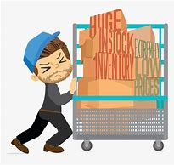
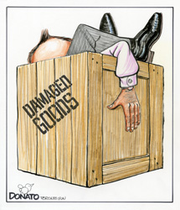
HOW IT WORKS - STEP 4 (Part 1) How it Works – Personal Inventory
It’s the business of finding a way to live where we can have a little peace of mind, serenity and happiness so we don’t have to go back to drinking.
If we don’t inventory in our personal business, chances are we’re not going to find what’s damaged and unsalable in our heads that’s going to cause us to go broke too. And going broke for us is simply going back to drinking!

Slide 18
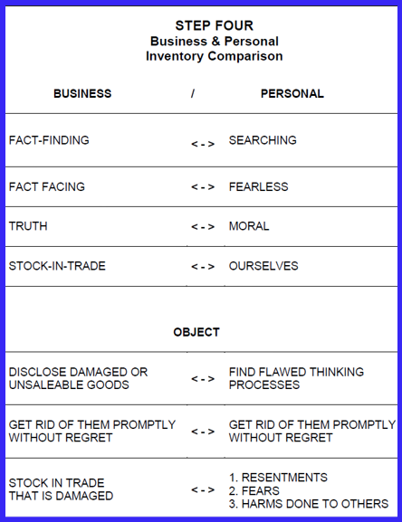
HOW IT WORKS - STEP 4 (Part 1) How it Works – Business Inventory
AA Big Book – How it Works - Page 64
“Taking commercial inventory is a fact-finding and a fact-facing process. It is an effort to discover the truth about the stock-in-trade. One object is to disclose damaged or unsalable goods, to get rid of them promptly and without regret. If the owner of the business is to be successful, he cannot fool himself about values.”

Slide 19
HOW IT WORKS - STEP 4 (Part 1) How it Works – Personal Inventory
AA Big Book – How it Works - Page 64
“We did exactly the same thing with our lives. We took stock honestly.”
Step 4:
Made a searching and fearless moral inventory of ourselves.
We’re going to look inside ourselves, in our minds, and we’re going to find those flawed thinking processes, which is the damaged and unsalable goods, that block us off from God…we’re going to have to get rid of them promptly and without regret.

Slide 20
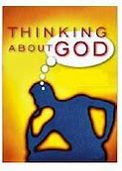
HOW IT WORKS - STEP 4 (Part 1) How it Works – Flawed Thinking
When those flawed thinking processes leave our minds, then our mind is opened up for God’s thinking to enter. But it's only after they are gone that God can enter.
The flawed thinking processes in our mind that blocks God out are our resentments fear, guilt and remorse associated with the harms done to other people. And as long as our mind is occupied with those thoughts then God’s thoughts can't come in.
God dwells in each of us and we know the difference between right and wrong.
If I want God to direct my thinking then I’m going to have to do something about these resentments, fear, guilt and remorse.
And if I do my part, then God can direct my thinking. But until I’ve done my part, God can't, it's just that simple.

Slide 21
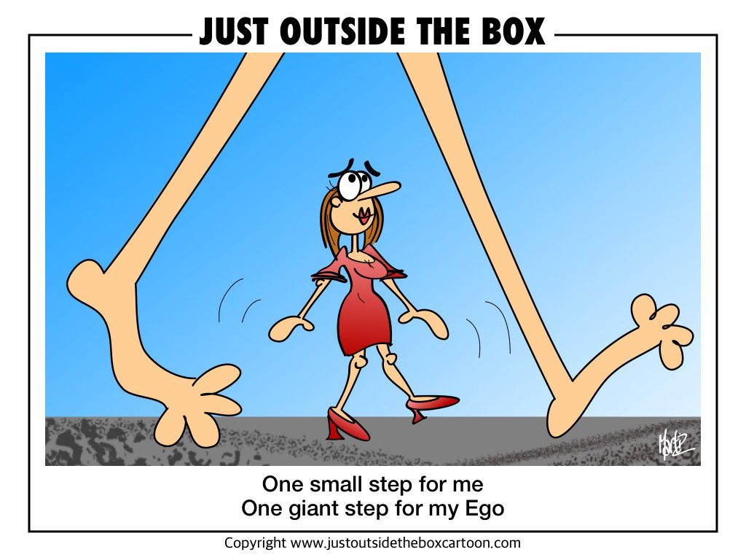
HOW IT WORKS - STEP 4 (Part 1) How it Works – Personal Inventory
AA Big Book – How it Works - Page 64
“We did exactly the same thing with our lives. We took stock honestly. First, we searched out the flaws in our make-up which caused our failure. Being convinced that self, manifested in various ways, was what had defeated us, we considered its common manifestations.”

Slide 22
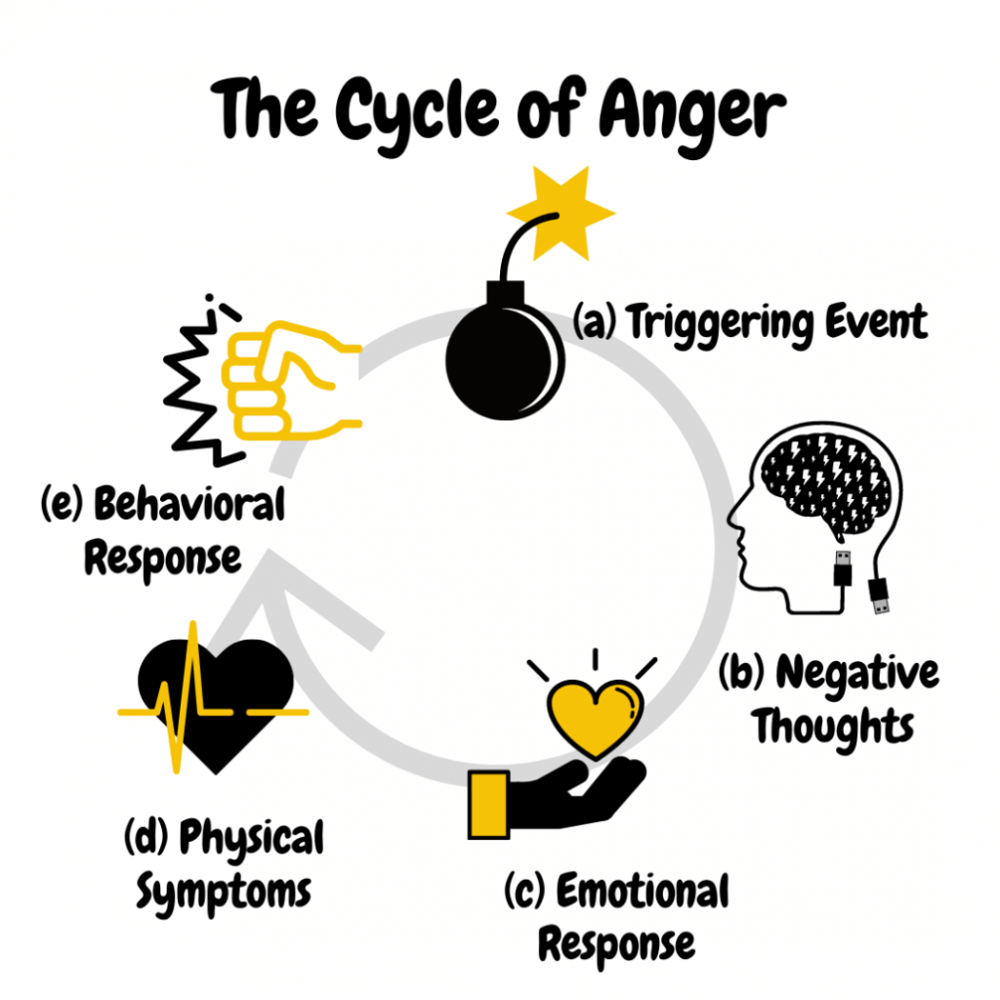
HOW IT WORKS - STEP 4 (Part 1) How it Works – Personal Inventory
AA Big Book – How it Works - Page 64
“Resentment is the “number one” offender. It destroys more alcoholics than anything else. From it stem all forms of spiritual disease, for we have been not only mentally and physically ill, we have been spiritually sick. When the spiritual malady is overcome, we straighten out mentally and physically. In dealing with resentments, we set them on paper.”

Slide 23
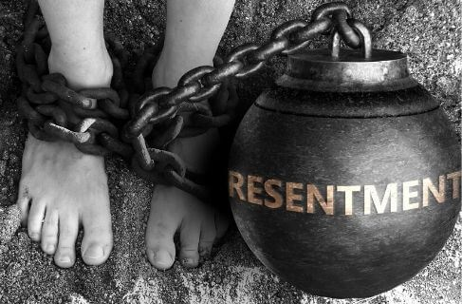
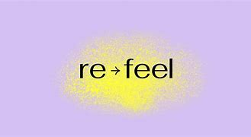
HOW IT WORKS - STEP 4 (Part 1) How it Works – Definition of Resentment
So the first thing we’re going to do is look at these resentments.
The word resentment is made from two old words. First are the letters RE.
When you see RE in front of another words it always means “to do again”; like repaint, replay, redo.
The last part of this word, “SENTMENT” comes from an old word called “sentire”, which means to feel.
Resentment means to re-feel!

Slide 24
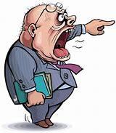
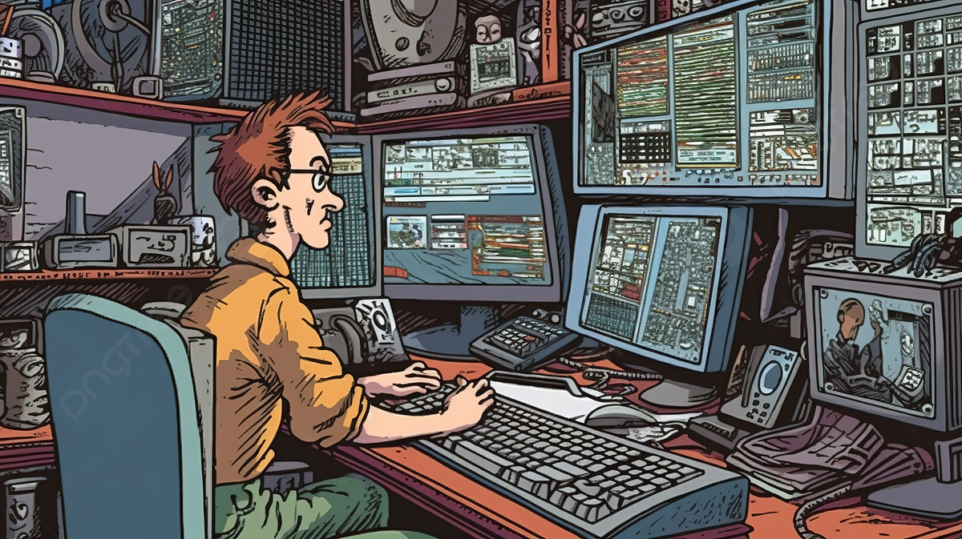
HOW IT WORKS - STEP 4 (Part 1) How it Works – Definition of Resentment
Now when they do that, that’s a wrong on their part for doing so, that’s not a resentment.
It doesn’t become a resentment until … I replay that thing in my mind, and I feel the pain the second time.
The first time they did it to me hurt me, but when I go over it and replay it, and feel the pain the second time then I’m doing it to myself now.
… it seems as though when I replay this thing, each time I tend to change it just a little bit.
I tend to make what they did to me just a little bit worse.
I tend to make what I did just a little bit less. I tend to make the pain just a little bit deeper
Notes:
One of my core values is, I will not stay with a cheater. If I even suspect it, I will not lower my self worth for anyone willing to hurt me in that manner. Another one of my core values, is I will not stay with a person that mistreats service workers. Those were core values until they weren’t. I met and fell in love with a man that was outside of my core values, I found myself compromising my own self worth to be with him. And when his true self emerged, I ignored it. And when the relationship came to the inevitable end, I played that resent over and over until I had no responsibility in accepting the behavior. It wasn’t until I did the steps in the manner did I finally see, that I had to take ownership of my part of the loss of dignity that emerged from resentment. I honestly could not see my part until I did the steps this way.

Slide 25
HOW IT WORKS - STEP 4 (Part 1) How it Works – Self-Resentment and Self-Pity
…alcoholics have up here in our heads a little resentment replay machine!
Now there’s a bad thing about a resentment, each time you play it over in your head, each time you throw it out there, after a while it turns around and comes back at you…When it comes back at you it comes back as self-resentment!
After a while self-resentment turns to self-pity.
God is absolutely, completely blocked out of our mind through these resentments.

Slide 26
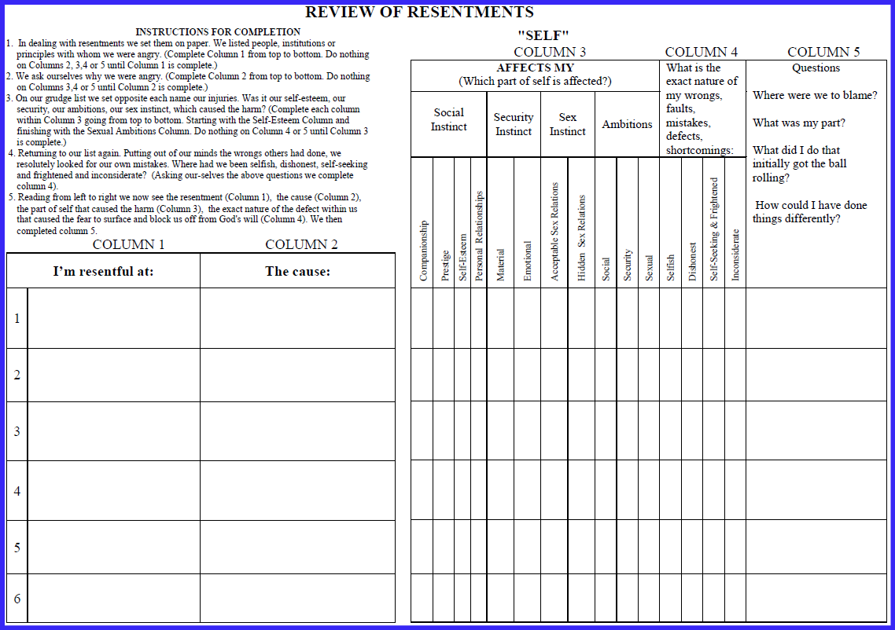
HOW IT WORKS - STEP 4 (Part 1) How it Works –Review of Resentment

Slide 27
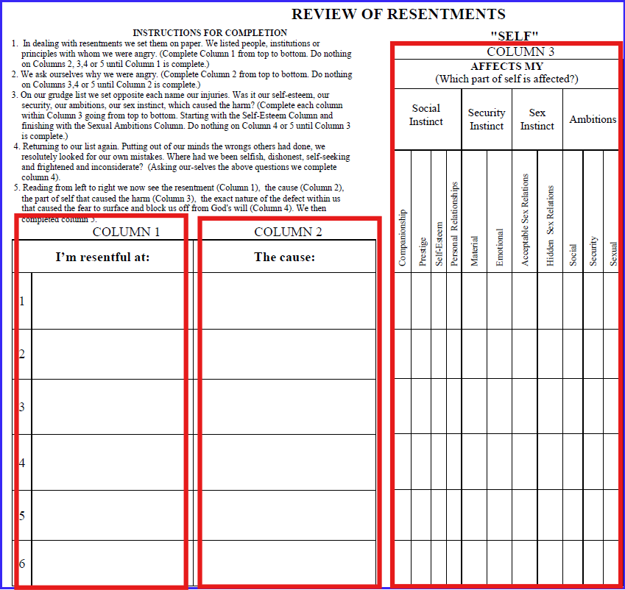
HOW IT WORKS - STEP 4 (Part 1) How it Works –Review of Resentment

Slide 28
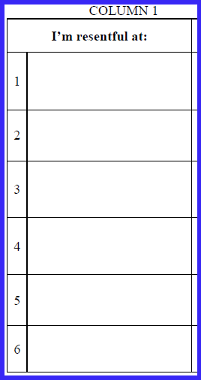
HOW IT WORKS - STEP 4 (Part 1) How it Works –Resentment Form (Column 1)
AA Big Book – How it Works - Page 65
“In dealing with resentments we set them on paper.
We listed people, institutions or
principles with whom we were angry.” (Complete Column 1 from top to bottom.
Do nothing on Columns 2, 3,4 or 5 until Column 1 is complete.)
Mr. Brown
Mrs. Jones
My Employer
My Wife
Notes:
On Page 65 Bill said, Mr. Brown, Mrs. Jones, My employer and My wife. He probably had more than that. I think he just didn’t want to use anymore space in the Big Book.

Slide 29
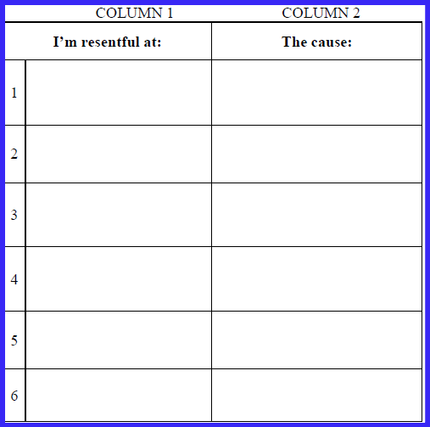
HOW IT WORKS - STEP 4 (Part 1) How it Works –Resentment Form (Columns 1, 2, and 3)
AA Big Book – How it Works - Page 65
“We ask ourselves why we were angry.”
(Complete Column 2 from top to bottom.
Do nothing on Columns 3,4 or 5 until Column 2 is complete.)
Mr. Brown
His attention to my wife.
Told my wife of my mistress.
Brown may get my job at the office.
She’s a nut—she snubbed me. She committed her husband for drinking. He’s my friend. She’s a gossip.
Mrs. Jones
My Employer
Unreasonable—Unjust—Overbearing—Threatens to fire me for drinking and padding my expense account.
My Wife
Misunderstands and nags. Likes Brown. Wants house put in her name.

Slide 30
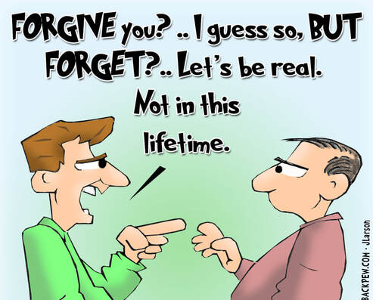
HOW IT WORKS - STEP 4 (Part 1) How it Works –Resentment Form (Columns 1, And 2 - Complete)
….part of that forgiving process can start right here when I begin to realize it's not them, it’s what they’ve done that’s got me upset
I learned how resentful I really am, how much that blocks me from God.
I learned it’s not them I resent; it’s what they’ve done to me that I actually resent.
Notes:
I took me years to understand that it was the person, but rather the action and how that action made me feel.

Slide 31
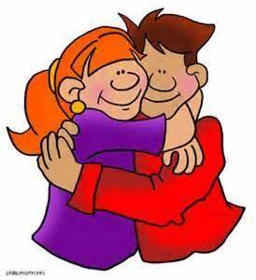
HOW IT WORKS - STEP 4 (Part 1) How it Works –Resentment Form (Column 3)
AA Big Book – How it Works - Pages 64 & 65
“In most cases it was found that our self-esteem, our pocketbooks, our ambitions, our personal relationships (including sex) were hurt or threatened. So we were sore. We were “burned up.”
On our grudge list we set opposite each name our injuries. Was it our self-esteem, our security, our ambitions, our personal, or sex relations, which had been interfered with? We were usually as definite as this example:”

Slide 32
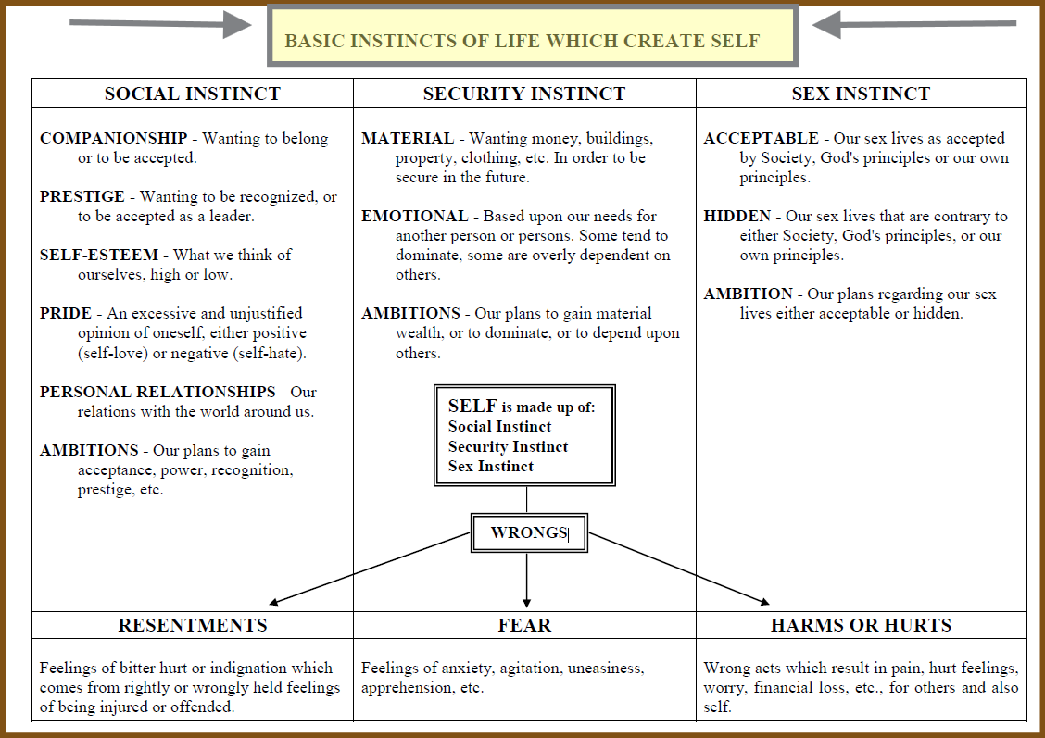
HOW IT WORKS - STEP 4 Basic Instincts of Life
If you threaten my social instinct in any way, my self-esteem, my personal relations, you’re going to upset me, make me angry. If you threaten my security, either material or emotional, you’re going to upset me and make me angry. If you threaten my sex life in anyway, you’re going to upset me and make me angry.
Notes:
I can’t be upset with you unless you’ve done something to threaten one of these basic instincts of life.
If you threaten my social instinct in any way, my self-esteem, my personal relations, you’re going to upset me, make me angry. If you threaten my security, either material or emotional, you’re going to upset me and make me angry. If you threaten my sex life in anyway, you’re going to upset me and make me angry.
And as I begin to fill out the third column and put down the part of self that is affected, in most cases I begin to see a pattern develop.
Maybe beside each name I’m putting down self-esteem. Maybe I begin to see my main problem is self-esteem.

Slide 33
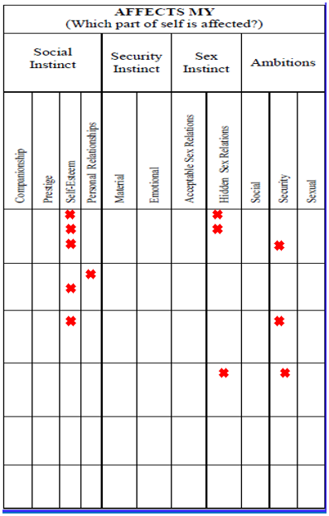
How it Works –Resentment Form (Column 3)
AA Big Book – How it Works - Page 65
On our grudge list we set opposite each name our injuries. Was it our self-esteem, our security, our ambitions, our sex instinct, which caused the harm?
(Complete each column within Column 3 going from top to bottom. Starting with the Self-Esteem Column and finishing with the Sexual Ambitions Column.
Do nothing on Column 4 or 5 until Column 3 is complete.)

Slide 34
HOW IT WORKS - STEP 4 (Part 1) How it Works –Resentment Form (Columns 1, 2, and 3) Review
Column 1
We listed the people we’re angry with, resentful at.
And we realize how resentful we really are, and how much that blocks us off from the sunlight of the spirit.
Column 2
We learned it’s not them we’re resentful at; it’s what they’ve done to us.
Column 3
We learned it’s not even what they’ve done to us. It’s how we choose to react to it based on our relationship with God and whether our instincts are under control or not.
Column 1 - how many resentments we have
Column 2 - the cause of the resentment
Column 3 - the part of self that was affected

Slide 35
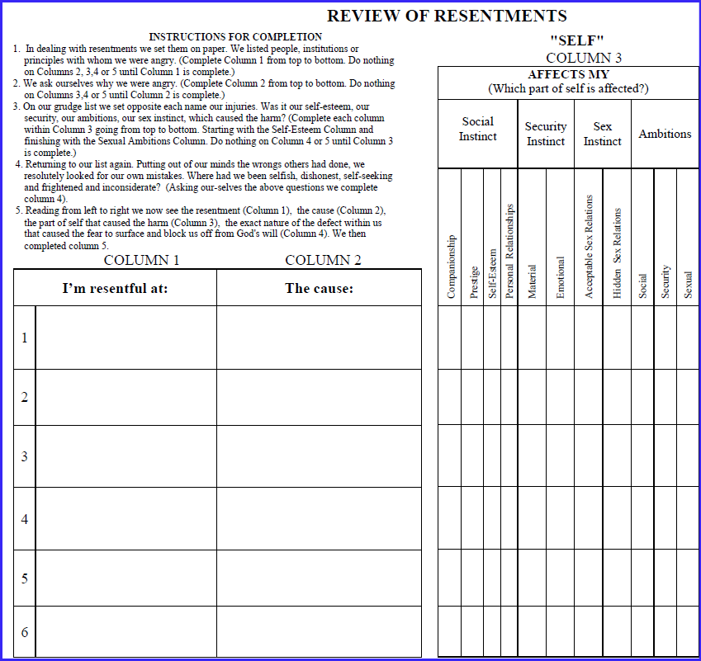
How it Works –Resentment Form (Columns 1, 2, and 3) Completed
His attention to my wife.
Told my wife of my mistress.
Brown may get my job at the office.
Mr. Brown
She’s a nut—she snubbed me. She committed her husband for drinking. He’s my friend. She’s a gossip.
Mrs. Jones
Unreasonable—Unjust—Overbearing—Threatens to fire me for drinking and padding my expense account.
My Employer
Misunderstands and nags. Likes Brown. Wants house put in her name.
My Wife
Notes:
The first 3 columns completed

Slide 36
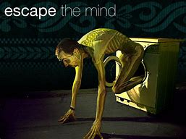
HOW IT WORKS - STEP 4 (Part 1) How it Works –Resentment Form (Step 4 Prayer)
AA Big Book – How it Works - Page 66
“How could we escape? We saw that these resentments must be mastered, but how? We could not wish them away any more than alcohol.
This was our course: We realized that the people who wronged us were perhaps spiritually sick. Though we did not like their symptoms and the way these disturbed us, they, like ourselves, were sick too. We asked God to help us show them the same tolerance, pity, and patience that we would cheerfully grant a sick friend. When a person offended we said to ourselves, “This is a sick man. How can I be helpful to him? God save me from being angry. Thy will be done.”

Slide 37
HOW IT WORKS - STEP 4 (Part 1) How it Works –Resentment Form (Column 4)
AA Big Book – How it Works - Page 67
“Referring to our list again. Putting out of our minds the wrongs others had done, we resolutely looked for our own mistakes. Where had we been selfish, dishonest, self-seeking and frightened? Though a situation had not been entirely our fault, we tried to disregard the other person involved entirely. Where were we to blame? The inventory was ours, not the other man’s. When we saw our faults we listed them. We placed them before us in black and white. We admitted our wrongs honestly and were willing to set these matters straight.”

Slide 38
HOW IT WORKS - STEP 4 (Part 1) How it Works –Resentment Form (Column 4)
What did you do, if anything, to set that in motion?”
…if I hadn’t been out there screwing around she probably wouldn’t have caught me. And she probably wouldn’t have filed for divorce in the first place.
…if I hadn’t been sneaking around behind her back lying to her all the time, completely dishonest with her, she probably wouldn’t have filed for divorce in the first place
…if I hadn't been blowing all of her money on booze and what I think was important she probably wouldn’t have filed for divorce in the first place.
…you see when I could concentrate on her filing for divorce and play that over and over and over and over in my head, gradually distorting the picture every time I played it over making what she did a little bit worse and what I did a little bit less. And let me play it long enough I could gradually transfer all blame to her and make myself as pure as the driven snow.
I thought my God Charlie, have you done that with any other resentments here?

Slide 39
HOW IT WORKS - STEP 4 (Part 1) How it Works –Resentment Form (Column 5)
Where had I been selfish, dishonest, self-seeking, frightened or inconsiderate? All other character defects stem from these.
But just think, if I could become a little less selfish, oh I don’t have to get perfect I never will. But if I could become a little less selfish, if I could become a little less dishonest, if I could become less frightened and self-seeking, if I could become a little more considerate of other people, and their needs and their wants maybe I wouldn’t have to do some of that kind of stuff. Maybe I wouldn’t hurt people and maybe they wouldn’t retaliate and I wouldn’t have to resent. And just maybe I wouldn’t have to get drunk over it.

Slide 40
Moderator, please stop the recording
Surrender School Closing Announcements?

Slide 41
SERENITY PRAYER
God grant me the serenity to accept the things I can not change, the courage to change the things I can and the wisdom to know the difference.

Slide 42
Questions
Are you constitutionally incapable of being honest with yourself?
Constitutionally incapable of being honest with self, would mean at the core being one is not able to see the truth about themselves.
Are you powerless?
Do you believe there is a Power greater than you that can restore you to sanity?
Have you decided (“…made a decision…) to take action?
The Basic Instincts of Life: Twelve Steps and Twelve Traditions:(AA Netherlands)
Joe and Charlie Handouts

