Slide 1
Surrender School Presents Joe & Charlie Big Book Study Week 4

Slide 2
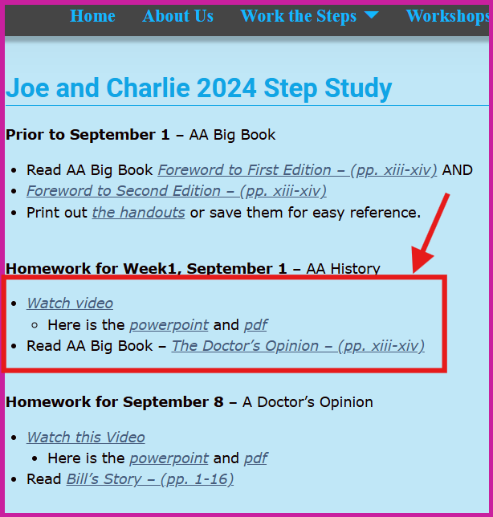
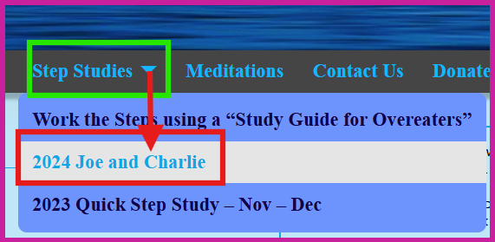
How to access Surrender School Joe and Charlie Previous Sessions, Homework and Documents.

Slide 3
messages from the surrender school Board
This is session will be recorded
Each session is approximately 1 hour 15 min
Updates/Announcements from Surrender School

Slide 4
SET ASIDE PRAYER
God, please set aside everything I think I know about myself, my emotional sobriety, the 12 Steps and You; for an open mind and a new experience of myself, my emotional sobriety, the 12 Steps and especially You!

Slide 5
Joe and Charlie - Big Book Study September 1 – November 3
AA History
The Doctor’s Opinion
Bill’s Story
There is a Solution
More About Alcoholism and We Agnostics
Step 1, Step 2, and Step 3
Step 4 – Part 1
Step 4 – Part 2
Step 5, Step 6, and Step 7
Step 8, Step 9, Step 10, Step 11, Step 12
Source Credits:
YOUTUBE: 12 Step Retro Speakers
AA Big Book Online PDF - AA Netherlands
Link to Handout Source - Take The 12
Links to Joe and Charlie biography – The Big Book Seminar

Slide 6
Moderator, please start the recording

Slide 7
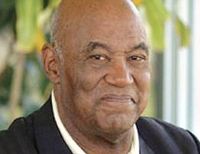
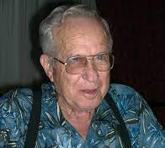
There Is A Solution
Joe McQ,
Joe McQuany - (AA) (1928-2007, 78 years old) Sober: 1962 - 2007
We are not the gurus of Alcoholic Anonymous!
We do not speak for AA as a whole!
Charlie P.
Charlie Parmley - (AA) (1929-2011, 82 years old)
Sober: 1970 - 2011
Notes:
This Surrender School Big Book Study is based on the recording of Joe M and Charlie P. They have emphatically indicated that they are not the gurus of AA (fellowship or the booK AA). They were alcoholic that got together in the 70s and found they have a common interest in the big book of AA. Additionally, they always start by stating they do not speak for AA. Nor I am an expert, guru and nor I am speaking for any 12 Step Group. I simply have a passion for the big book of AA and want to do my part in carrying the message of hope.

Slide 8
Chapter 2 – There Is A Solution Two Powers
1. Dr.’s Opinion
The Problem
2. Bill’s Story,
identify with another alcoholic
seen him go from fun drinking to drinking because of absolute necessity
to the sickest of all, complete oblivion.
seen him recover from that condition
“And in this chapter There Is A Solution; we’re going to talk about two powers.
(1) the power of the fellowship (2) the power of the vital spiritual experience
And if we, who are powerless, could get both of these powers in our lives, then maybe we could overcome alcoholism also.”
Notes:
There

Slide 9
Chapter 2 – There Is A Solution There is ONE Solution!
AA Big Book – Chapter 2 – Page 17
“WE, OF ALCOHOLICS ANONYMOUS, know thousands of men and women who were once just as hopeless as Bill. Nearly all have recovered. They have solved the drink problem.
We are average Americans. All sections of this country and many of its occupations are represented, as well as many political, economic, social, and religious backgrounds. We are people who normally would not mix. But there exists among us a fellowship, a friendliness, and an understanding which is indescribably wonderful.”
Moderator: Please post the following question in chat:
Are you staying sober / abstinent on the power of the fellowship? Or are you actively pursuing the power of the vital spiritual experience?
Notes:
Are you staying sober / abstinent on the power of the fellowship? Or are you actively pursuing the power of the vital spiritual experience? Many people ask, what does the vital spiritual experience look like? To that I say, “the personality change sufficient to bring about recovery …”

Slide 10
Chapter 2 – There Is A Solution “Even though we are so different from each other, we are still bound together.”
AA Big Book – Chapter 2 – Page 17
“We are like the passengers of a great liner the moment after rescue from shipwreck when camaraderie, joyousness and democracy pervade the vessel from steerage to Captain’s table.”

Slide 11
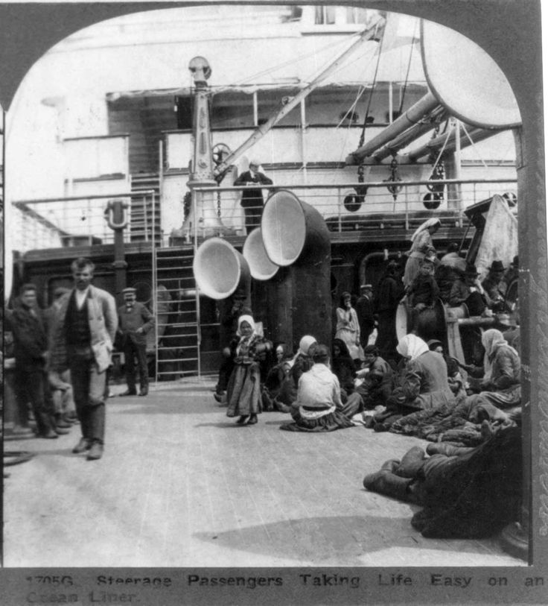
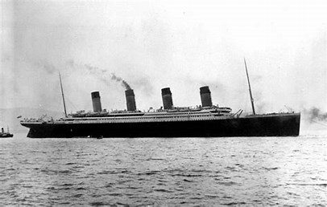
The Titanic
The Steerage Section of the Titanic

Slide 12
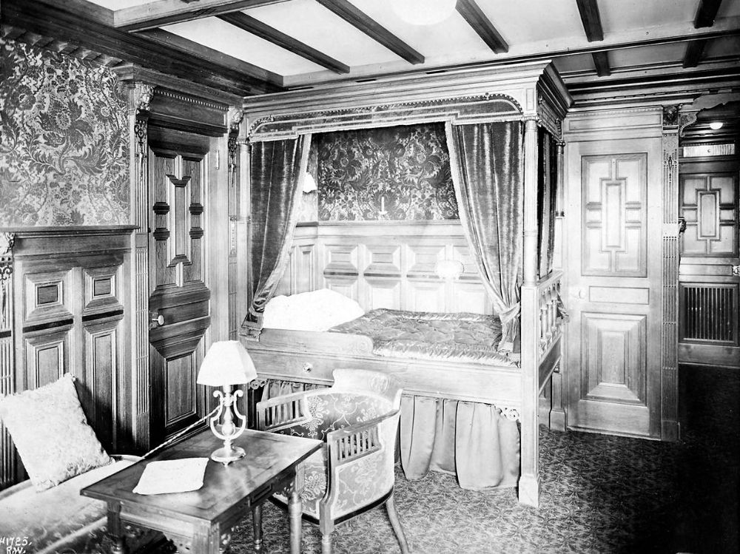
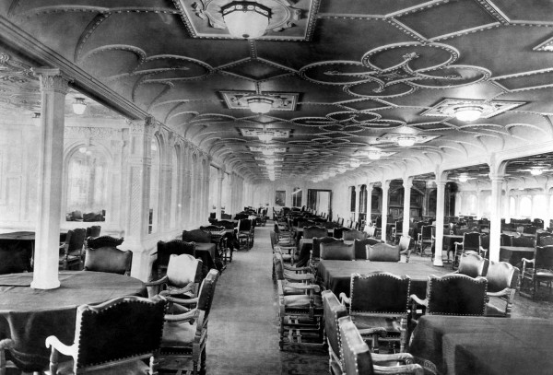
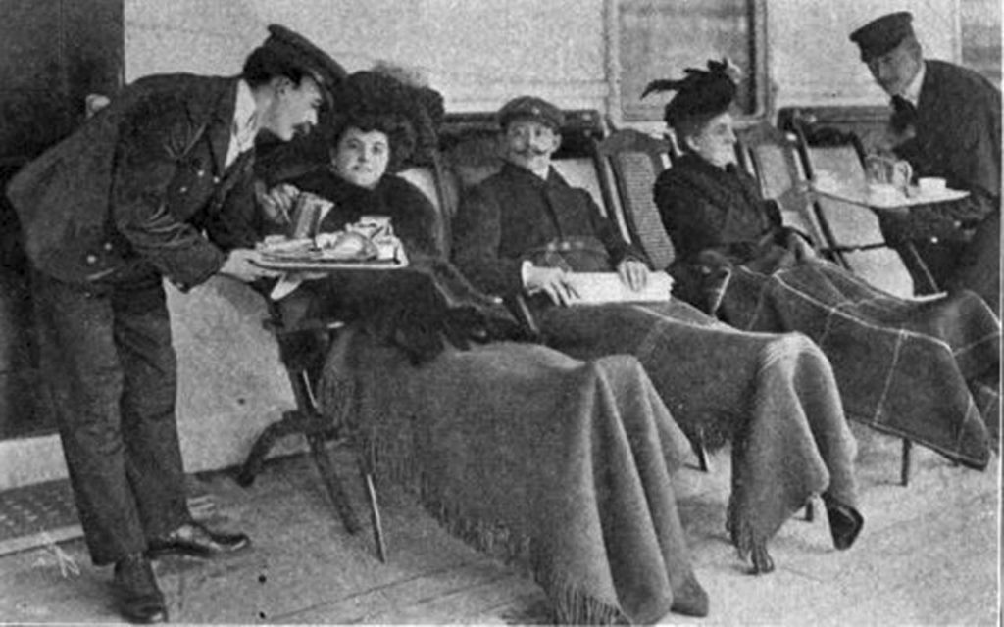
The Titanic – Upper Class State Room
The Titanic – Upper Class Dining Room
The Titanic – Upper Class Deck

Slide 13
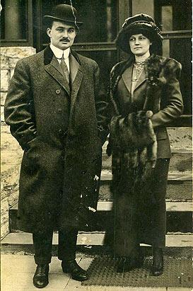
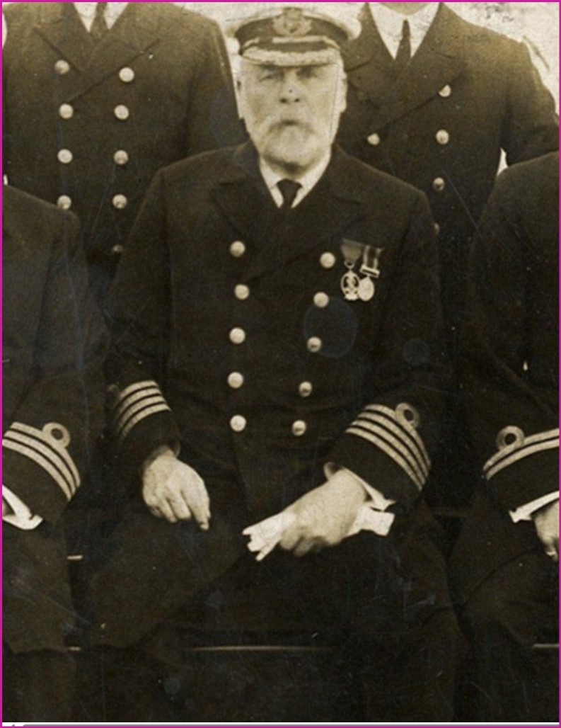
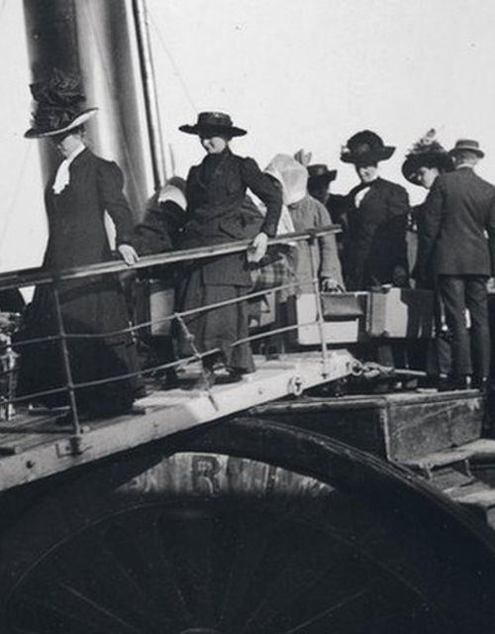
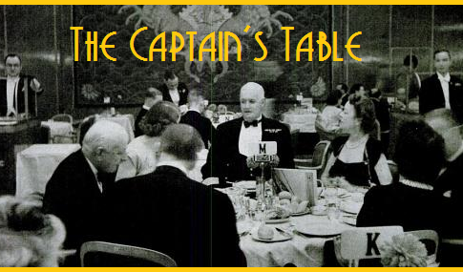
The Titanic – Upper Class Passengers Boarding
The Titanic – Upper Class Passengers

Slide 14
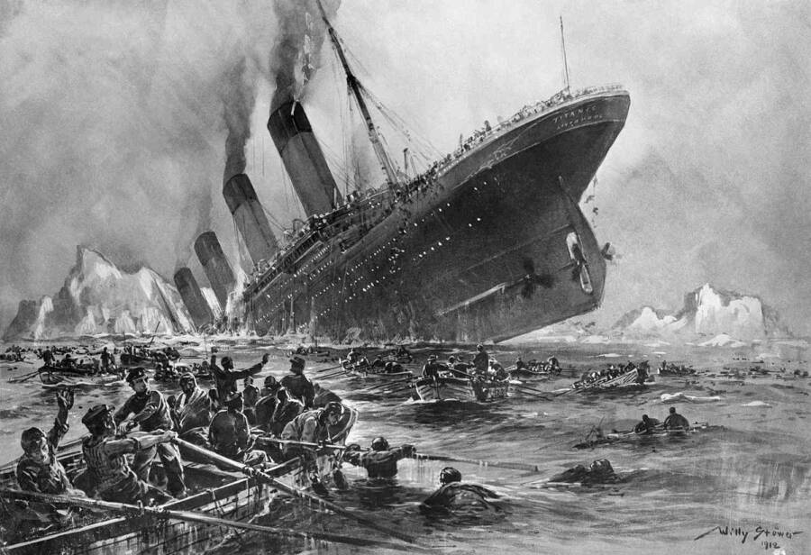
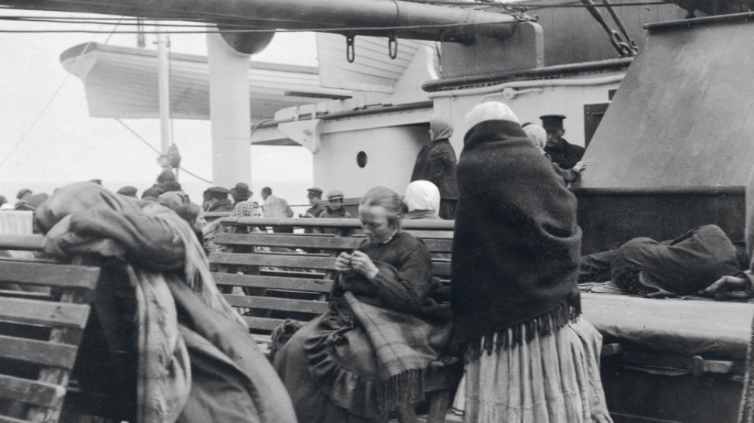
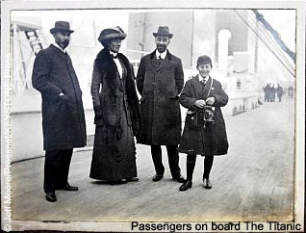
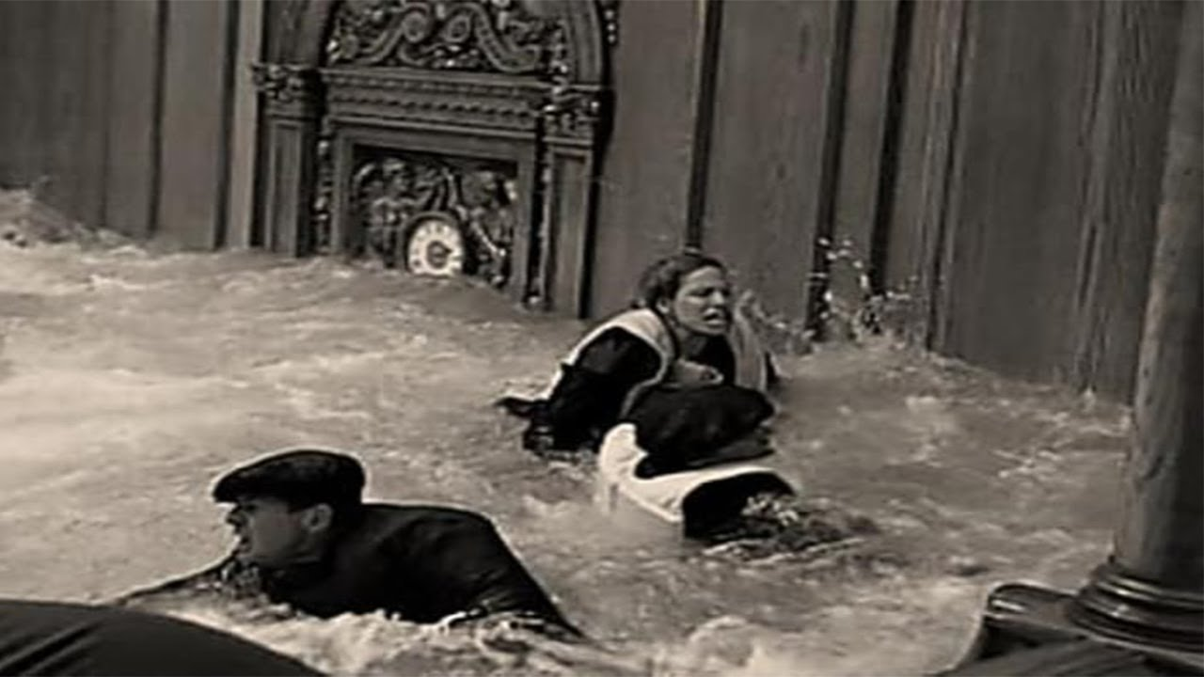
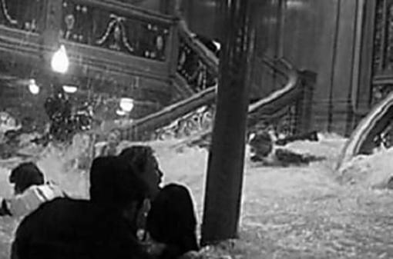
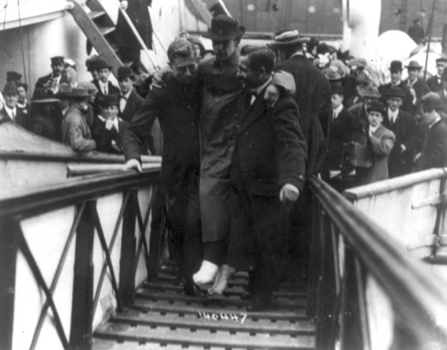
The Titanic – Upper Class Passengers
The Titanic – Steerage Class Passengers
The Titanic – Steerage Passengers
The Titanic – Upper Class Passengers
The Titanic – Surviving Passengers

Slide 15
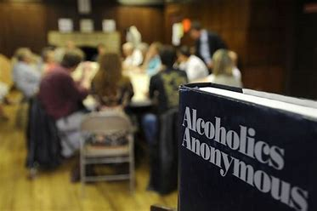
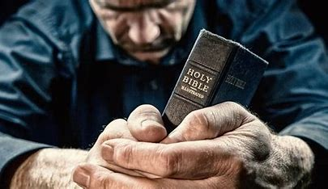

Slide 16
Chapter 2 – There Is A Solution The Prescription for Recovery
AA Big Book – Chapter 2 – Page 17
“Unlike the feelings of the ships passengers, however, our joy in escape from disaster does not subside as we go our individual ways. The feeling of having shared in a common peril is one element in the powerful cement which binds us. But that in itself would never have held us together as we are now joined.
The tremendous fact for every one of us is that we have discovered a common solution. We have a way out on which we can absolutely agree, and upon which we can join in brotherly and harmonious action. This is the great news this book carries to those who suffer from alcoholism.”

Slide 17
Chapter 2 – There Is A Solution The Prescription for Recovery
“… the common solution is the spiritual experience brought about through the program of action.”
“If we can get the POWER of the fellowship - which supports us and helps us, and if we can get the power of the spiritual experience - which changes us, and add the two together then that will be enough power to overcome our powerlessness over alcohol and we can recover from that condition.”

Slide 18
Chapter 2 – There Is A Solution The Prescription for Recovery
“… It’s our responsibility to see that every newcomer knows about page 17 and knows there are two powers a) the power of the fellowship b) the power of the spiritual experience.
And we’re not going to recover without both of them.
Now we might stay sober for a while, but we’re not going to recover from alcoholism without both of them.”
Notes:
If you are anything like me, the first time you heard the phrase “vital spiritual experience” I thought about a jealous God, the punitive God that the preacher in my church spoke of. And I simply could not understand how a GOD that I feared would help me stop using.
I found that if I show up to my meetings (the fellowship), I shut my mouth and listened and then I participate in my meetings, and I help others…something miraculous happened. At first I stopped using because of the accountability to the fellowship, then I didn’t use because of the tools of the program, and then I just wasn’t using. It was several months before I realized, the obsession of the mind had eased. The disease of alcoholism and addiction is progressive but so is recovery.

Slide 19
Chapter 2 – There Is A Solution Why Fellowship Alone is NOT Sufficient
AA Big Book – Chapter 2 – Page 20
“You may already have asked yourself why it is that all of us became so very ill from drinking. Doubtless you are curious to discover how and why, in the face of expert opinion to the contrary, we have recovered from a hopeless condition of mind and body. If you are an alcoholic who wants to get over it, you may already be asking - “What do I have to do?”

Slide 20
Chapter 2 – There Is A Solution Why Fellowship Alone is NOT Sufficient
AA Big Book – Chapter 2 – Page 20
“It is the purpose of this book to answer such questions specifically. We shall tell you what we have done. Before going into a detailed discussion, it may be well to summarize some points as we see them.”

Slide 21
Chapter 2 – There Is A Solution Why Fellowship Alone is NOT Sufficient
AA Big Book – Chapter 2 – Page 20
“How many times people have said to us: “I can take it or leave it alone. Why can’t he?” “Why don’t you drink like a gentleman or quit?” “That fellow can’t handle his liquor.” “Why don’t you try beer and wine?” “Lay off the hard stuff.” “His will power must be weak.” “He could stop if he wanted to.” “She’s such a sweet girl; I should think he’d stop for her sake.” “The doctor told him that if he ever drank again it would kill him, but there he is all lit up again.”
Now these are commonplace observations on drinkers which we hear all the time. Back of them is a world of ignorance and misunderstanding. We see that these expressions refer to people whose reactions are very different from ours.”
Moderator: Please post the following questions in chat:
Are you convinced that fellowship alone is not sufficient for your recovery? What are some of the commonplace observations people have had about your disease?
Notes:
Some of the Commonplace Observations /misconceptions I have heard about food addiction:
Lack of Willpower: food addiction is simply a matter of willpower, but it’s often more complex, involving psychological, biological, and environmental factors.
Only Overweight People Are Affected: Food addiction can affect individuals of any weight. It’s about the relationship with food.
It’s Not a Real Addiction: Some people think food addiction isn’t as serious as other addictions
Dieting Alone Can Fix It:

Slide 22
Chapter 2 – There Is A Solution Types of Drinkers – Moderate Drinker
AA Big Book – Chapter 2 – Page 20
“Moderate drinkers have little trouble in giving up liquor entirely if they have good reason for it. They can take it or leave it alone.”

Slide 23
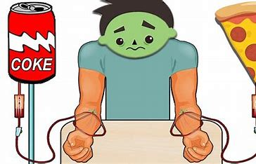
Chapter 2 – There Is A Solution Types of Drinkers – Hard/Heavy Drinker
AA Big Book – Chapter 2 – Page 20 & 21
“Then we have a certain type of hard drinker. He may have the habit badly enough to gradually impair him physically and mentally. It may cause him to die a few years before his time. If a sufficiently strong reason—ill health, falling in love, change of environment, or the warning of a doctor—becomes operative, this man can also stop or moderate, although he may find it difficult and troublesome and may even need medical attention.”
“They drink like we alcoholics drink, but they are not alcoholic.
If a good enough reason presents itself to them, they’ll do one of two things. They may learn to moderate their drinking; they do not have the physical allergy. They may quit drinking entirely and stay quit; they do not have the obsession of the mind.
They drink like us, but they’re not alcoholic.

Slide 24
Chapter 2 – There Is A Solution Types of Drinkers – The Real Alcoholic
AA Big Book – Chapter 2 – Page 20 & 21
“But what about the real alcoholic? He may start off as a moderate drinker; he may or may not become a continuous hard drinker; but at some stage of his drinking career he begins to lose all control of his liquor consumption, once he starts to drink.
Here is a fellow who has been puzzling you, especially in his lack of control. He does absurd, incredible, tragic things while drinking. He is a real Dr. Jekyll and Mr. Hyde. He is seldom mildly intoxicated. He is always more or less insanely drunk. His disposition while drinking resembles his normal nature but little.”

Slide 25
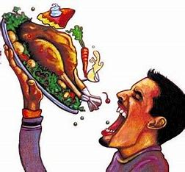
Chapter 2 – There Is A Solution Types of Drinkers – The Real Alcoholic
AA Big Book – Chapter 2 – Page 21
“He may be one of the finest fellows in the world. Yet let him drink for a day, and he frequently becomes disgustingly, and even dangerously anti-social. He has a positive genius for getting tight at exactly the wrong moment, particularly when some important decision must be made or engagement kept. He is often perfectly sensible and well balanced concerning everything except liquor, but in that respect he is incredibly dishonest and selfish.”

Slide 26
Chapter 2 – There Is A Solution Types of Drinkers – Hard/Heavy Drinker
AA Big Book – Chapter 2 – Page 21 “He often possesses special abilities, skills, and aptitudes, and has a promising career ahead of him. He uses his gifts to build up a bright outlook for his family and himself, and then pulls the structure down on his head by a senseless series of sprees.”
AA Big Book – Chapter 2 – Page 21 & 22 “He is the fellow who goes to bed so intoxicated he ought to sleep the clock around. Yet early next morning he searches madly for the bottle he misplaced the night before. If he can afford it, he may have liquor concealed all over his house to be certain no one gets his entire supply away from him to throw down the wastepipe.”

Slide 27
Chapter 2 – There Is A Solution Types of Drinkers – Hard/Heavy Drinker
AA Big Book – Chapter 2 – Page 22
“As matters grow worse, he begins to use a combination of high-powered sedative and liquor to quiet his nerves so he can go to work. Then comes the day when he simply cannot make it and gets drunk all over again. Perhaps he goes to a doctor who gives him morphine or some sedative with which to taper off. Then he begins to appear at hospitals and sanitariums. This is by no means a comprehensive picture of the true alcoholic, as our behavior patterns vary. But this description should identify him roughly.”
Notes:
How do you identify?
He may start off as a moderate drinker; he may or may not become a continuous hard drinker; but at some stage of his drinking career he begins to lose all control
He may be one of the finest fellows in the world. Yet let him drink for a day, and he frequently becomes disgustingly, and even dangerously anti-social.
He is often perfectly sensible and well balanced concerning everything except liquor, but in that respect he is incredibly dishonest and selfish
He is the fellow who goes to bed so intoxicated he ought to sleep the clock around.

Slide 28
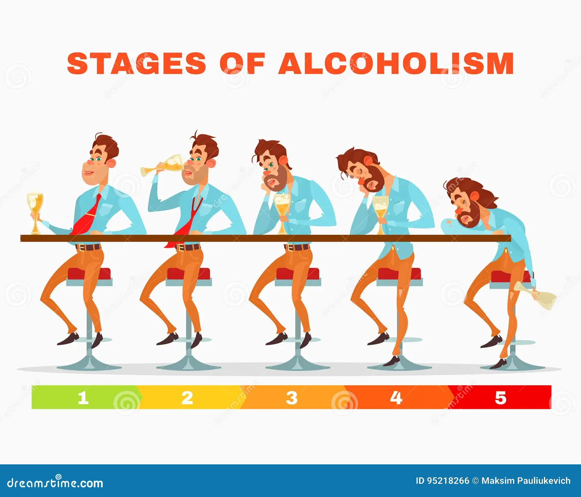
Chapter 2 – There Is A Solution The Real Problem Centers in the Mind, NOT the Body
AA Big Book – Chapter 2 – Page 22
“Why does he behave like this? If hundreds of experiences have shown him that one drink means another debacle with all its attendant suffering and humiliation, why is it he takes that one drink? Why can’t he stay on the water wagon?”

Slide 29
Chapter 2 – There Is A Solution The Real Problem Centers in the Mind, NOT the Body
AA Big Book – Chapter 2 – Page 22
“What has become of the common sense and will power that he still sometimes displays with respect to other matters?
Perhaps there never will be a full answer to these questions. Opinions vary considerably as to why the alcoholic reacts differently from normal people. We are not sure why, once a certain point is reached, little can be done for him. We cannot answer the riddle.
We know that while the alcoholic keeps away from drink, as he may do for months or years, he reacts much like other men. We are equally positive that once he takes any alcohol whatever into his system, something happens, both in the bodily and mental sense, which makes it virtually impossible for him to stop. The experience of any alcoholic will abundantly confirm this. These observations would be academic and pointless if our friend never took the first drink, thereby setting the terrible cycle in motion. Therefore, the main problem of the alcoholic centers in his mind, rather than in his body.”

Slide 30
Chapter 2 – There Is A Solution The Obsession of the Mind
“An obsession of the mind is an idea that overcomes all ideas to the contrary.
An obsession of the mind is an idea that is so strong it can make you believe something that is not true.”

Slide 31
Chapter 2 – There Is A Solution The Obsession of the Mind
AA Big Book – Chapter 2 – Page 24 & 25
“When this sort of thinking is fully established in an individual with alcoholic tendencies, he has probably placed himself beyond human aid, and unless locked up, may die or go permanently insane.
AA Big Book – Chapter 2 – Page 25
There is a solution. Almost none of us liked the self-searching, the leveling of our pride, the confession of shortcomings which the process requires for its successful consummation. But we saw that it really worked in others, and we had come to believe in the hopelessness and futility of life as we had been living it. When, therefore, we were approached by those in whom the problem had been solved, there was nothing left for us but to pick up the simple kit of spiritual tools laid at our feet. We have found much of heaven and we have been rocketed into a fourth dimension of existence of which we had not even dreamed.”

Slide 32
Chapter 2 – There Is A Solution The Obsession of the Mind
AA Big Book – Chapter 2 – Page 25
“The great fact is just this, and nothing less: That we have had deep and effective spiritual experiences which have revolutionized our whole attitude toward life, toward our fellows and toward God’s universe. The central fact of our lives today is the absolute certainty that our Creator has entered into our hearts and lives in a way which is indeed miraculous. He has commenced to accomplish those things for us which we could never do by ourselves.”

Slide 33
Chapter 2 – There Is A Solution Spiritual Experience
AA Big Book – Appendices II - Spiritual Experience page 569 (page 567 in the 4th edition)
“The terms “spiritual experience” and “spiritual awakening” are used many times in this book which, upon careful reading, shows that the personality change sufficient to bring about recovery from alcoholism has manifested itself among us in many different forms.”
“A change in the way we think and the way we feel and our attitude.
spiritual experience
spiritual awakening
personality change
psychic change
Spiritual experience happens suddenly, like it did with Bill and some of the people in back of the stories in the first book, and then we have the spiritual awakening, which develops slowly over a period of a long time.”

Slide 34
Chapter 2 – There Is A Solution Spiritual Experience
AA Big Book – Appendices II - Spiritual Experience
“Yet it is true that our first printing gave many readers the impression that these personality changes, or religious experiences, must be in the nature of sudden and spectacular upheavals. Happily for everyone, this conclusion is erroneous.
In the first few chapters a number of sudden revolutionary changes are described. Though it was not our intention to create such an impression, many alcoholics have nevertheless concluded that in order to recover they must acquire an immediate and overwhelming “God-consciousness” followed at once by a vast change in feeling and outlook.
Among our rapidly growing membership of thousands of alcoholics such transformations, though frequent, are by no means the rule. Most of our experiences are what psychologist William James calls the “educational variety” because they develop slowly over a period of time.”

Slide 35
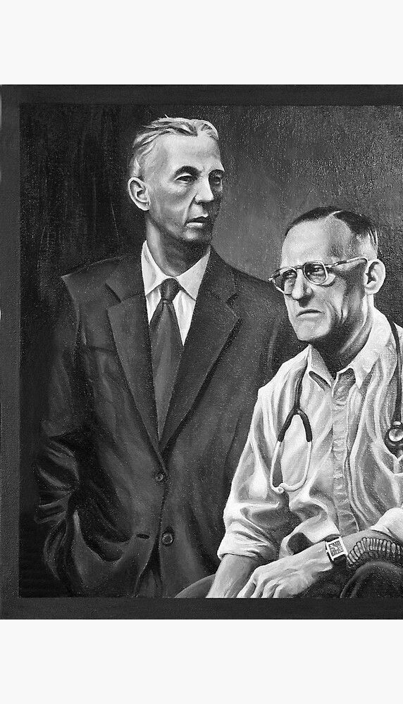
Chapter 2 – There Is A Solution Contempt Prior to Investigation
AA Big Book – Appendices II - Spiritual Experience
“Quite often friends of the newcomer are aware of the difference long before he is himself. He finally realizes that he has undergone a profound alteration in his reaction to life; that such a change could hardly have been brought about by himself alone. What often takes place in a few months could seldom have been accomplished by years of self-discipline. With few exceptions our members find they have tapped an unsuspected inner resource which they presently identify with their own conception of a Power greater than themselves.
Most of us think this awareness of a Power greater than ourselves is the essence of spiritual experience. Our more religious members call it “God-consciousness.” Most emphatically we wish to say that any alcoholic capable of honestly facing his problems in the light of our experience can recover, provided he does not close his mind to all spiritual concepts. He can only be defeated by an attitude of intolerance or belligerent denial.”

Slide 36
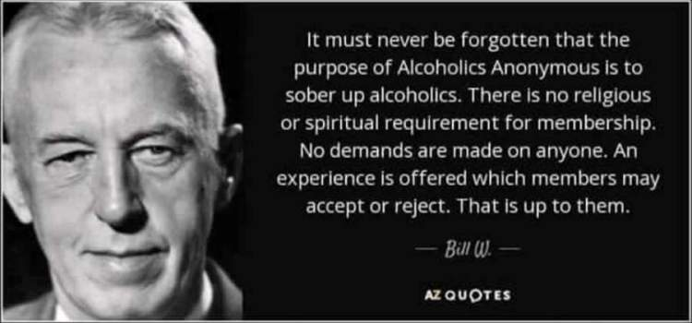
Chapter 2 – There Is A Solution Contempt Prior to Investigation
AA Big Book – Appendices II - Spiritual Experience
“We find that no one need have difficulty with the spirituality of the program. Willingness, honesty and open mindedness are the essentials of recovery. But these are indispensable.”
“There is a principle which is a bar against all information, which is proof against all arguments and which cannot fail to keep a man in everlasting ignorance—that principle is contempt prior to investigation.” —Herbert Spencer

Slide 37
Chapter 2 – There Is A Solution
AA Big Book – Chapter 2 – Page 25
Step 1
If you are as seriously alcoholic as we were, we believe there is no middle-of-the-road solution. We were in a position where life was becoming impossible, and if we had passed into the region from which there is no return through human aid, we had but two alternatives: One was to go on to the bitter end, blotting out the consciousness of our intolerable situation as best we could;
Step 2
and the other, to accept spiritual help. This we did because we honestly wanted to, and were willing to make the effort.

Slide 38
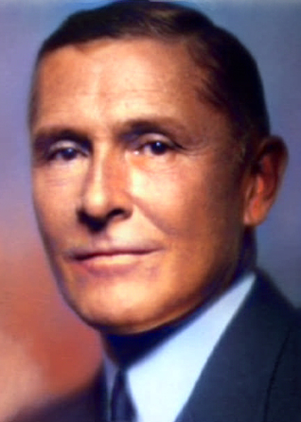
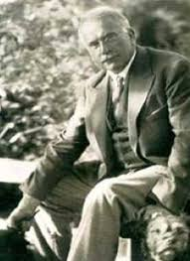
Chapter 2 – There Is A Solution
Rowland Hazard (1881-1945) Rowland Hazard was the sober alcoholic who brought the spiritual message of The Oxford Group to Ebby Thatcher. Thatcher carried the message to Bill Wilson.
Rowland requested help for his alcoholism from Dr. Carl Jung in 1926.
But, surprisingly, the great doctor had no psychological advice for him—he was told that his problem was not treatable from a medical standpoint. Dr. Carl Jung informed Rowland that his only hope was a vital spiritual experience. Although Rowland did not remain continually sober, we AA’s are benefiting from it today.
Rowland Hazard III
AA Big Book – Chapter 2 – Page 26
“A certain American business man had ability, good sense, and high character. For years he had floundered from one sanitarium to another. He had consulted the best known American psychiatrists. Then he had gone to Europe, placing himself in the care of a celebrated physician (the psychiatrist, Dr. Jung) who prescribed for him. Though experience had made him skeptical, he finished his treatment with unusual confidence.”
Dr. Carl Jung

Slide 39
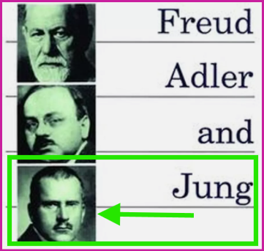
Chapter 2 – There Is A Solution
AA Big Book – Chapter 2 – Page 26
“His physical and mental conditions were unusually good. Above all, he believed he had acquired such a profound knowledge of the inner workings of his mind and its hidden springs that relapse was unthinkable. Nevertheless, he was drunk in a short time. More baffling still, he could give himself no satisfactory explanation for his fall.
So he returned to this doctor, whom he admired, and asked him point-blank why he could not recover. He wished above all things to regain self-control. He seemed quite rational and well-balanced with respect to other problems. Yet he had no control whatever over alcohol. Why was this?
He begged the doctor to tell him the whole truth, and he got it. In the doctor’s judgment he was utterly hopeless; he could never regain his position in society and he would have to place himself under lock and key or hire a bodyguard if he expected to live long.”

Slide 40
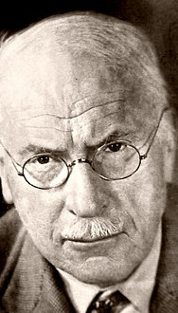
Chapter 2 – There Is A Solution
AA Big Book – Chapter 2 – Page 26 & 27
“That was a great physician’s opinion.
But this man still lives, and is a free man. He does not need a bodyguard nor is he confined. He can go anywhere on this earth where other free men may go without disaster, provided he remains willing to maintain a certain simple attitude.
Some of our alcoholic readers may think they can do without spiritual help. Let us tell you the rest of the conversation our friend had with his doctor. The doctor said: “You have the mind of a chronic alcoholic. I have never seen one single case recover, where that state of mind existed to the extent that it does in you.” Our friend felt as though the gates of hell had closed on him with a clang.”
Dr. Carl Jung

Slide 41
Chapter 2 – There Is A Solution
AA Big Book – Chapter 2 – Page 27
“He said to the doctor, “Is there no exception?”
”Yes,” replied the doctor, “there is. Exceptions to cases such as yours have been occurring since early times. Here and there, once in a while, alcoholics have had what are called vital spiritual experiences. To me these occurrences are phenomena. They appear to be in the nature of huge emotional displacements and rearrangements. Ideas, emotions, and attitudes which were once the guiding forces of the lives of these men are suddenly cast to one side, and a completely new set of conceptions and motives begin to dominate them. In fact, I have been trying to produce some such emotional rearrangement within you. With many individuals the methods which I employed are successful, but I have never been successful with an alcoholic of your description.*” (See Appendices II - AA Big Book – Appendices II - Spiritual Experience)

Slide 42
Chapter 2 – There Is A Solution
“Now they tell us that Rowland tried to get to Freud first. And Freud wasn’t taking any more patients. He tried to get to Adler and Adler was too busy.
Jung was the third choice. Now Adler and Jung were both students of Freud. And Jung had fallen out with Adler and Jung (Freud) on one thing only. Adler and Jung (Freud) thought all answers would lie within the mind. I mean Adler and Freud.
Jung thought some people might be able to be helped through spirituality. And thank God that Rowland didn’t get to Freud or Adler. We’d be sitting around today psychoanalyzing ourselves rather than depending upon spirituality.”
“I think we need to stop once in a while and remember where they came from.
• Step 1 came from a nonalcoholic neurologist in New York City named Dr. Silkworth
• Step 2 came from a nonalcoholic psychiatrist from the other side of the world named Dr. Jung
• The last ten steps came from a group of people called the Oxford groupers who were nonalcoholic practicing first century Christianity to the best of their ability.”

Slide 43
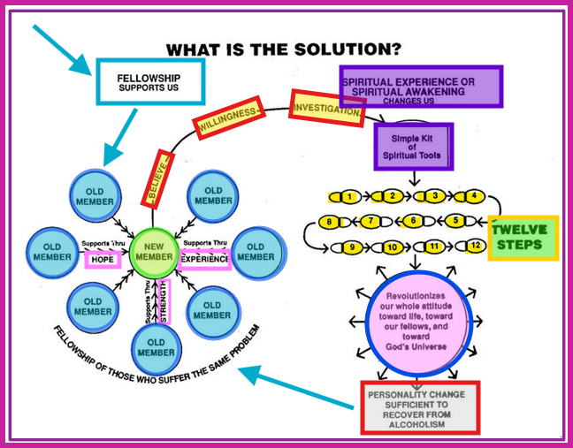
Chapter 2 – There Is A Solution
Last Slide – Week 4

Slide 44
Moderator, please stop the recording
Surrender School Closing Announcements?

Slide 45
SERENITY PRAYER
God grant me the serenity to accept the things I can not change, the courage to change the things I can and the wisdom to know the difference.

Slide 46
Questions
Are you staying sober / abstinent on the power of the fellowship?
Or are you actively pursuing the power of the vital spiritual experience
Are you convinced that fellowship alone is not sufficient for your recovery? What are some of the commonplace observations people have had about your disease?

