Slide 1
Surrender School Presents Joe & Charlie Big Book Study Week 3

Slide 2
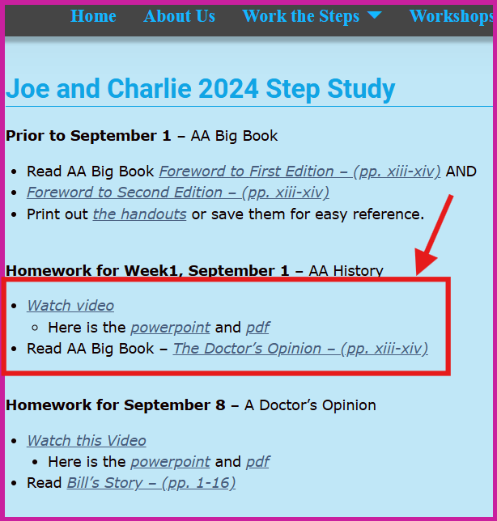
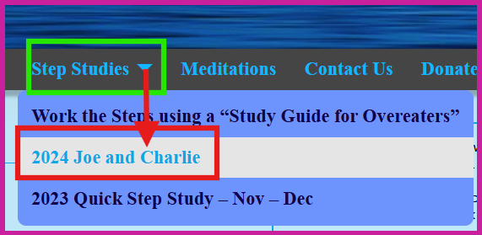
How to access Surrender School Joe and Charlie Previous Sessions, Homework and Documents.

Slide 3
messages from the surrender school Board
This is session will be recorded
Each session is approximately 1 hour 15 min
Updates/Announcements from Surrender School

Slide 4
SET ASIDE PRAYER
God, please set aside everything I think I know about myself, my emotional sobriety, the 12 Steps and You; for an open mind and a new experience of myself, my emotional sobriety, the 12 Steps and especially You!

Slide 5
Joe and Charlie - Big Book Study September 1 – November 3
AA History
The Doctor’s Opinion
Bill’s Story
There is a Solution
More About Alcoholism and We Agnostics
Step 1, Step 2, and Step 3
Step 4 – Part 1
Step 4 – Part 2
Step 5, Step 6, and Step 7
Step 8, Step 9, Step 10, Step 11, Step 12
Source Credits:
YOUTUBE: 12 Step Retro Speakers
AA Big Book Online PDF - AA Netherlands
Link to Handout Source - Take The 12
Links to Joe and Charlie biography – The Big Book Seminar

Slide 6
Moderator, please start the recording

Slide 7
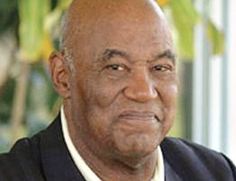
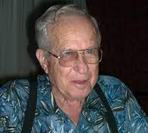
AA History – Introduction
Joe McQ,
Joe McQuany - (AA) (1928-2007, 78 years old) Sober: 1962 - 2007
We are not the gurus of Alcoholic Anonymous!
We do not speak for AA as a whole!
Charlie P.
Charlie Parmley - (AA) (1929-2011, 82 years old)
Sober: 1970 - 2011
Notes:
This Surrender School Big Book Study is based on the recording of Joe M and Charlie P. The have emphatically indicated that they are not the gurus of AA (fellowship or the boo AA). The were alcoholic that got together in the 70s and found they have a common interest in the big book of AA. Additionally, they always start by stating they do not speak for AA. Nor I am an expert, guru and nor I am speaking for any 12 Step Group. I simply have a passion for the big book of AA and want to do my part in caring hope.

Slide 8
REVIEW – Week 1 – AA History (Link to Surrender School Website)
Introduction to Joe M and Charlie P
AA History
Bill W.
Ebby Thacher
Vital Spiritual Experience
Dr. Silkworth
The Oxford Group
Spiritual Matters
Dr. Bob
Bill Dodson (AA #3)
How Alcoholic Anonymous got its name
AA Big Book Layout
Step Review
Notes:
1st GOAL - THE PROBLEM (Step 1 – Powerless)
The Dr.’s Opinion
Chapter 1 - Bill’s Story
2nd GOAL - THE SOLUTION (Step 2 - Define the Power)
Chapter 2: There Is A Solution
Chapter 3: More About Alcoholism
Chapter 4: We Agnostics
3rd GOAL – ACTION (Steps 3 – 12 – How to find the Power)
Chapter 5: How It Works
Chapter 6: Into Action
Chapter 7: Working with Others

Slide 9
REVIEW – Week 2
Week 2: The Doctor’s Opinion(Link to Surrender School Website)
AA History Continued
The Doctor’s Opinion History
The Problem – Physical Body
Powerlessness
Physical Craving
Abnormal Reaction vs. Normal Reaction
The Allergy
Phenomenon of Craving
The 5 type of drinker
The Problem – Mental Obsession – (The Mind)
Will Power
“… if you can’t safely drink without getting drunk; and if you can’t keep from drinking; then you’ve become absolutely powerless over alcohol!

Slide 10
Chapter 1 – Bill’s Story The Beginning of Hope
But if we look for the way Bill thinks, and the way Bill acts and the way Bill drinks, if we’re a real alcoholic there’s not an alcoholic in this room that can’t identify with Bill Wilson.
…look for identification, the progression of alcoholism him drinking finally for the sickest reason of all, complete oblivion. …then well look and see how Bill recovered from alcoholism and if we’ve identified with him then we begin to believe that if he could do it just maybe we could it too…identification, the beginning of believe, the beginning of hope.
Notes:
Many may have trouble identifying with Bill Wilson.

Slide 11
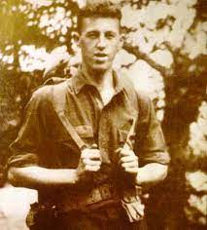
Chapter 1 – Bill’s Story
Big Book p. 1, par. 1
“War fever ran high in the New England town to which we new, young officers from Plattsburg were assigned, and we were flattered when the first citizens took us to their homes, making us feel heroic. Here was love, applause, war; moments sublime with intervals hilarious”
I was part of life at last, and in the midst of the excitement I discovered liquor. I forgot the strong warnings and the prejudices of my people concerning drink. In time we sailed for "Over There." I was very lonely and again turned to alcohol.
We landed in England. I visited Winchester Cathedral. Much moved, I wandered outside. My attention was caught by a doggerel on an old tombstone:
"Here lies a Hampshire Grenadier
Who caught his death
Drinking cold small beer.
A good soldier is ne'er forgot Whether he dieth by musket
Or by pot."
Bill Wilson approximately 18 – 22 years old
Notes:
The tombstone was of Thomas Thetcher, who Bill thought might be an ancestor of his friend Ebby Thacher.
William Griffith Wilson was born in East Dorset, Vermont on November 26, 1895 to Gilman and Emily Griffith Wilson.
They divorced when Bill was 11. The trauma of his parent's divorce was subsequently followed by depression when his father moved to British Columbia and his mother moved to Boston to go to Harvard University. He and is younger sister was then raised by his grand parents (mother's parents).

Slide 12
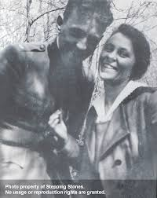
Chapter 1 – Bill’s Story
AA Big Book Page 1 - 2
“My work took me about Wall Street and little by little I became interested in the market. Many people lost money—but some became very rich. Why not I? I studied economics and business as well as law. Potential alcoholic that I was, I nearly failed my law course. At one of the finals I was too drunk to think or write. Though my drinking was not yet continuous, it disturbed my wife. We had long talks when I would still her forebodings by telling her that men of genius conceived their best projects when drunk; that the most majestic construction of philosophic thought were so derived.
By the time I had completed the course, I knew the law was not for me. The inviting maelstrom of Wall Street had me in its grip. Business and financial leaders were my heroes. Out of this alloy of drink and speculation, I commenced to forge the weapon that one day would turn in its flight like a boomerang and all but cut me to ribbons. Living modestly, my wife and I saved $1,000. It went into certain securities, then cheap and rather unpopular. I rightly imagined that they would some day have a great rise. I failed to persuade my broker friends to send me out looking over factories and managements, but my wife and I decided to go anyway. I had developed a theory that most people lost money in stocks through ignorance of markets. I discovered many more reasons later on.”
Bill W and Lois (Wife)
Notes:
Bill met Lois Burnham while she was “summering” in Vermont. They married 5 years later on Jan 24, 1918. Lois was 4 year older than Bill.

Slide 13
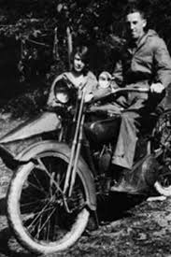
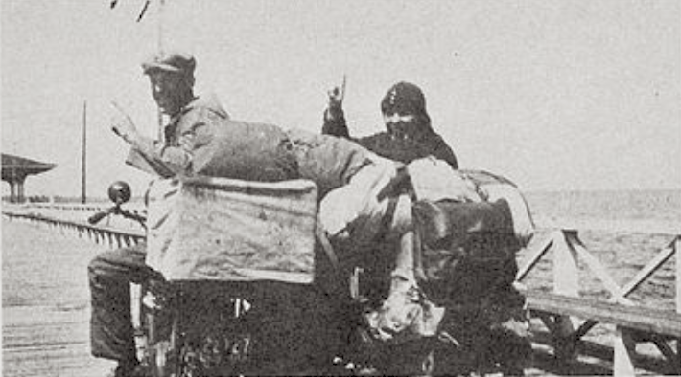
Chapter 1 – Bill’s Story “I had arrived.”
AA Big Book Page 1 - 2
“We gave up our positions and off we roared on a motorcycle, the sidecar stuffed with tent, blankets, a change of clothes, and three huge volumes of a financial reference service. Our friends thought a lunacy commission should be appointed. Perhaps they were right. I had had some success at speculation, so we had little money, but we once worked on a farm for a month to avoid drawing on our small capital. That was the last honest manual labor on my part for many a day. We covered the whole eastern United States in a year. At the end of it, my reports to Wall Street procured me a position there and the use of a large expense account. The exercise of an option brought in more money, leaving us with a profit of several thousand dollars for that year.
For the next few years fortune threw money and applause my way. I had arrived.”
Bill W and wife Lois 1925

Slide 14
Chapter 1 – Bill’s Story “The Progression”
AA Big Book – Page 3
“Drink was taking an important and exhilarating part in my life.”
“My drinking assumed more serious proportions, continuing all day and almost every night. The remonstrances of my friends terminated in a row and I became a lone wolf. There were many unhappy scenes in our sumptuous apartment. There had been no real infidelity, for loyalty to my wife, helped at times by extreme drunkenness, kept me out of those scrapes.”
Notes:
I can identify with this part of Bills Story. How many time did I hear, Girl, you are eating too much. Just push away from the table, if you exercise more and eat less…. There were times I wasn’t invited because my behavior around my substance of choice was embarrassing for my so called friends.

Slide 15
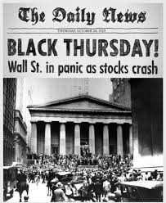
Chapter 1 – Bill’s Story “I went back to the bar.”
AA Big Book Page 4
“Abruptly in October 1929 hell broke loose on the New York stock exchange. After one of those days of inferno, I wobbled from a hotel bar to a brokerage office. It was eight o’clock—five hours after the market closed. The ticker still clattered. I was staring at an inch of the tape which bore the inscription XYZ-32. It had been 52 that morning. I was finished and so were many friends. The papers reported men jumping to death from the towers of High Finance. That disgusted me. I would not jump. I went back to the bar. My friends had dropped several million since ten o’clock—so what? Tomorrow was another day. As I drank, the old fierce determination to win came back.”
Notes:
Remember last week when Charlie said, our MIND RECORDS the solution for future use. Bill went to the bar because he was low and depressed, how he had dealt with depression in the past was to drink to forget.

Slide 16
Chapter 1 – Bill’s Story
It gets worse!
AA Big Book Page 4
“Next morning I telephoned a friend in Montreal. He had plenty of money left and thought I had better go to Canada.
By the following spring we were living in our accustomed style. I felt like Napoleon returning from Elba. No St. Helena for me! But drinking caught up with me again and my generous friend had to let me go. This time we stayed broke.
We went to live with my wife’s parents. I found a job; then lost it as a result of a brawl with a taxi driver. Mercifully, no one could guess that I was to have no real employment for five years, or hardly draw a sober breath. My wife began to work in a department store, coming home exhausted to find me drunk. I became an unwelcome hanger-on at brokerage places.”
Lois Wilson’s Parents Home Dr. Clark and Matilda Burnham
Notes:
Bill is really starting to feel the consciences of his drinking. His drinking is getting worse. We can see he can no longer control it

Slide 17
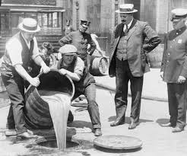
Chapter 1 – Bill’s Story “Liquor ceased to be a luxury;”
AA Big Book Page 5
“Liquor ceased to be a luxury; it became a necessity. “Bathtub” gin, two bottles a day, and often three, got to be routine. Sometimes a small deal would net a few hundred dollars, and I would pay my bills at the bars and delicatessens. This went on endlessly, and I began to waken very early in the morning shaking violently. A tumbler full of gin followed by half a dozen bottles of beer would be required if I were to eat any breakfast. Nevertheless, I still thought I could control the situation, and there were periods of sobriety which renewed my wife’s hope.
Gradually things got worse. The house was taken over by the mortgage holder, my mother-in-law died, my wife and father-in-law became ill.
Then I got a promising business opportunity. Stocks were at the low point of 1932, and I had somehow formed a group to buy. I was to share generously in the profits. Then I went on a prodigious bender, and that chance vanished.”
Prohibition Era:
On November 18, 1918, prior to ratification of the Eighteenth Amendment, the U.S. Congress passed the temporary Wartime Prohibition Act, which banned the sale of alcoholic beverages having an alcohol content of greater than 1.28%.^{[13]}
Notes:
Anytime there’s a battle going on between the willpower and the obsession of the mind, the obsession of the mind is stronger than willpower and it always wins

Slide 18
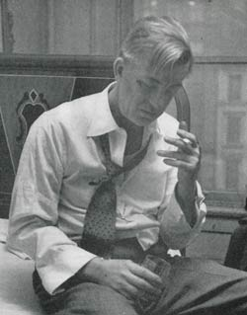
Chapter 1 – Bill’s Story “Was I crazy?”
AA Big Book Page 5 & 6
“I woke up. This had to be stopped. I saw I could not take so much as one drink. I was through forever. Before then, I had written lots of sweet promises, but my wife happily observed that this time I meant business. And so I did.
Shortly afterward I came home drunk. There had been no fight. Where had been my high resolve? I simply didn’t know. It hadn’t even come to mind. Someone had pushed a drink my way, and I had taken it. Was I crazy? I began to wonder, for such an appalling lack of perspective seemed near being just that.
Renewing my resolve, I tried again. Some time passed, and confidence began to be replaced by cocksureness. I could laugh at the gin mills. Now I had what it takes! One day I walked into a cafe to telephone. In no time I was beating on the bar asking myself how it happened. As the whisky rose to my head I told myself I would manage better next time, but I might as well get good and drunk then. And I did.”
Notes:
Anytime there’s a battle going on between the willpower and the obsession of the mind, the obsession of the mind is stronger than willpower and it always wins

Slide 19
Chapter 1 – Bill’s Story “The remorse – Complete Oblivion”
AA Big Book Page 6 & 7
“The remorse, horror and hopelessness of the next morning are unforgettable.”
“The mind and body are marvelous mechanisms, for mine endured this agony two more years.”
“Then came the night when the physical and mental torture was so hellish I feared I would burst through my window, sash and all. Somehow I managed to drag my mattress to a lower floor, lest I suddenly leap. A doctor came with a heavy sedative. Next day found me drinking both gin and sedative. This combination soon landed me on the rocks. People feared for my sanity. So did I. I could eat little or nothing when drinking, and I was forty pounds under weight.”
Notes:
…look for identification, the progression of alcoholism him drinking finally for the sickest reason of all, complete oblivion.

Slide 20
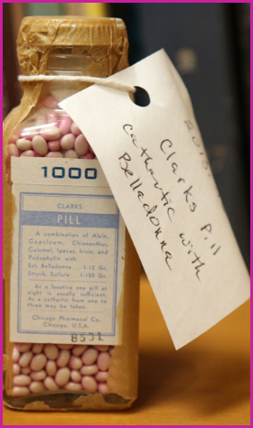
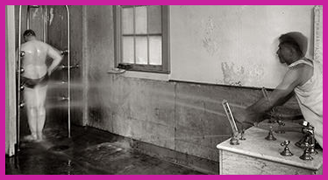
Chapter 1 – Bill’s Story Self Knowledge
AA Big Book Page 7
“My brother-in-law is a physician, and through his kindness and that of my mother I was placed in a nationally-known hospital for the mental and physical rehabilitation of alcoholics. Under the so-called belladonna treatment my brain cleared. Hydrotherapy and mild exercise helped much. Best of all, I met a kind doctor who explained that though certainly selfish and foolish, I had been seriously ill, bodily and mentally.
It relieved me somewhat to learn that in alcoholics the will is amazingly weakened when it comes to combating liquor, though it often remains strong in other respects. My incredible behavior in the face of a desperate desire to stop was explained. Understanding myself now, I fared forth in high hope. For three or four months the goose hung high. I went to town regularly and even made a little money. Surely this was the answer—self-knowledge.”
Belladonna Pills
Hydrotherapy

Slide 21
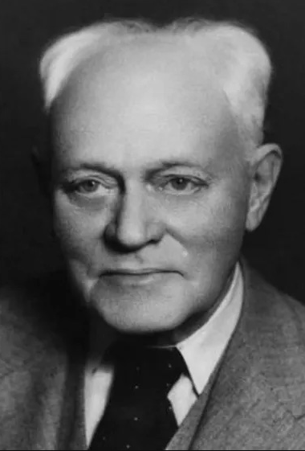
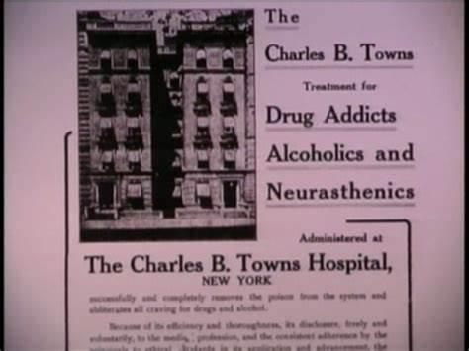
Chapter 1 – Bill’s Story Hopeless
AA Big Book Page 7 & 8
“But it was not, for the frightful day came when I drank once more. The curve of my declining moral and bodily health fell off like a ski-jump. After a time I returned to the hospital. This was the finish, the curtain, it seemed to me. My weary and despairing wife was informed that it would all end with heart failure during delirium tremens, or I would develop a wet brain, perhaps within a year. She would soon have to give me over to the undertaker or the asylum.
They did not need to tell me. I knew, and almost welcomed the idea. It was a devastating blow to my pride. I, who had thought so well of myself and my abilities, of my capacity to surmount obstacles, was cornered at last. Now I was to plunge into the dark, joining that endless procession of sots who had gone on before. I thought of my poor wife. There had been much happiness after all. What would I not give to make amends? But that was over now.”
Notes:
As a reminder Self Knowledge was not a solution for alcoholism.

Slide 22
Chapter 1 – Bill’s Story “Alcohol was my Master”
AA Big Book Page 8
“No words can tell of the loneliness and despair I found in that bitter morass of self-pity. Quicksand stretched around me in all directions. I had met my match. I had been overwhelmed. Alcohol was my master.
Trembling, I stepped from the hospital a broken man. Fear sobered me for a bit. Then came the insidious insanity of that first drink, and on Armistice Day 1934, I was off again. Everyone became resigned to the certainty that I would have to be shut up somewhere, or would stumble along to a miserable end. How dark it is before the dawn! In reality that was the beginning of my last debauch. I was soon to be catapulted into what I like to call the fourth dimension of existence. I was to know happiness, peace, and usefulness, in a way of life that is incredibly more wonderful as time passes.”
Step 1: We admitted we were powerless over alcohol—that our lives had become unmanageable.
Notes:
For those of you who have recovered from a seemingly hopeless state of mind and body, do you feel happiness, peace, and usefulness. What are you doing to stay sober/abstinent today?

Slide 23
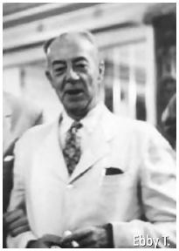
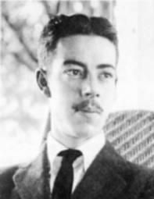
Chapter 1 – Bill’s Story Ebby Thacher visits Bill
AA Big Book Page 8 & 9
“With a certain satisfaction I reflected there was enough gin concealed about the house to carry me through that night and the next day. My wife was at work. I wondered whether I dared hide a full bottle of gin near the head of our bed. I would need it before daylight.
My musing was interrupted by the telephone. The cheery voice of an old school friend asked if he might come over. He was sober. It was years since I could remember his coming to New York in that condition. I was amazed. Rumor had it that he had been committed for alcoholic insanity. I wondered how he had escaped.”
Edwin Throckmorton Thacher (29 April 1896 – 21 March 1966), was in hot water for disturbing the peace (shooting pigeons in an elegant neighborhood in Manchester, Vermont) and was facing a sentence of confinement.
Ebby T.) was an old drinking friend and later the sponsor of Alcoholics Anonymous co-founder Bill Wilson. He is credited with introducing Wilson to the initial principles that AA would soon develop, such as "one alcoholic talking to another,…"

Slide 24
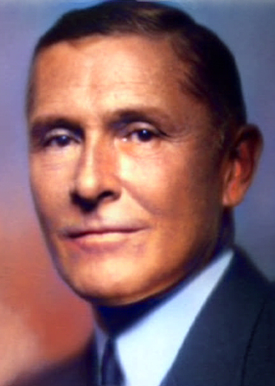
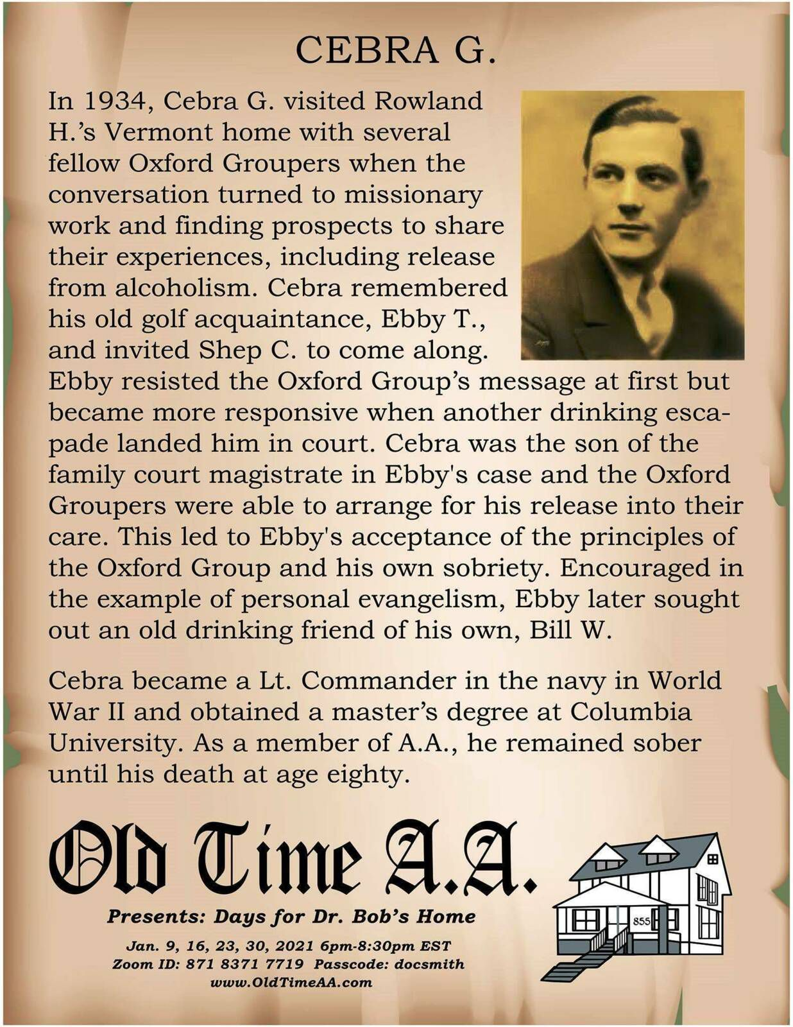
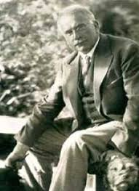
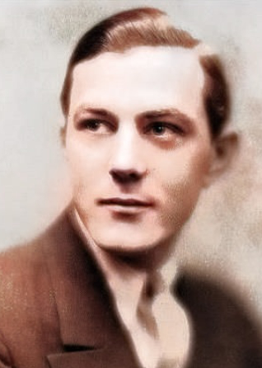
Rowland Hazard (1881-1945) Rowland Hazard was the sober alcoholic who brought the spiritual message of The Oxford Group to Ebby Thatcher. Thatcher carried the message to Bill Wilson.
Rowland Hazard was the first in the chain of events leading to AA founding moments of the fellowship of Alcoholics Anonymous. Rowland requested help for his alcoholism from Dr. Carl Jung in 1926.
But, surprisingly, the great doctor had no psychological advice for him—he was told that his problem was not treatable from a medical standpoint. Dr. Carl Jung informed Rowland that his only hope was a vital spiritual experience.
Although Rowland did not remain continually sober, we AA’s are benefiting from it today.
Rowland Hazard III
Dr. Carl Jung
Cebra Quackenbush Graves 26 Aug 1898 - 1 Jan 1979. Cebra walking up asked "You having fun yet?" with Ebby's reply "Go to hell".
Cebra answered "You don't have to live like this anymore".
The two took Ebby down to Manchester Center, found a tailor to clean Ebby's only
suit, got Ebby cleaned up, and took him to a restaurant where they shared their
experiences in the Oxford Group. Ebby agreed to go to NYC, move into Calvary House, and start attending meetings. Although Cebra carried the message to Ebby, he still continued to struggle with his drinking. In 1940 he came to AA but did not get sober until 1954.

Slide 25
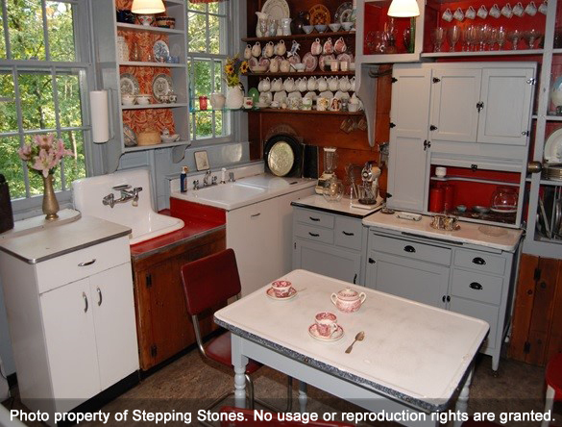
Chapter 1 – Bill’s Story “I’ve Got Religion.”
AA Big Book Page 9
“Unmindful of his welfare, I thought only of recapturing the spirit of other days.”
The door opened and he stood there, fresh-skinned and glowing. There was something about his eyes. He was inexplicably different. What had happened?
I pushed a drink across the table. He refused it. Disappointed but curious, I wondered what had got into the fellow. He wasn’t himself.
“Come, what’s all this about?” I queried. He looked straight at me. Simply, but smilingly, he said, “I’ve got religion.”
“I was aghast. So that was it—last summer an alcoholic crackpot; now, I suspected, a little cracked about religion. He had that starry-eyed look. Yes, the old boy was on fire all right. But bless his heart, let him rant! Besides, my gin would last longer than his preaching. But he did no ranting. In a matter of fact way he told how two men appeared in court, persuading the judge to suspend his commitment. They had told of a simple religious idea and a practical program of action. That was two months ago and the result was self-evident. It worked!”
Bill Wilson’s Kitchen

Slide 26
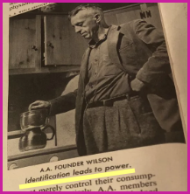
Chapter 1 – Bill’s Story The Importance of Identification
AA Big Book Page 11
“But my friend sat before me, and he made the pointblank declaration that God had done for him what he could not do for himself. His human will had failed. Doctors had pronounced him incurable. Society was about to lock him up. Like myself, he had admitted complete defeat. Then he had, in effect, been raised from the dead, suddenly taken from the scrap heap to a level of life better than the best he had ever known!
Had this power originated in him? Obviously it had not. There had been no more power in him than there was in me at that minute; and this was none at all. ”
This is why the identification process is so important. Bill knew about Ebby. He knew how Ebby drank. And he knew that if Ebby had been sober two months, some power greater than Ebby had to be working in Ebby’s life. Whether Bill likes it or not, is absolutely beside the point; Ebby is living proof of it.

Slide 27
Chapter 1 – Bill’s Story “Why don’t you choose your own conception of God?”
AA Big Book Page 12
“Despite the living example of my friend there remained in me the vestiges of my old prejudice. The word God still aroused a certain antipathy. When the thought expressed that there might be a God personal to me this feeling was intensified. I didn’t like the idea. I could go for such conceptions as Creative Intelligence, Universal Mind or Spirit of Nature, but I resisted the thought of a Czar of the Heavens, however loving His sway might be. I have since talked with scores of men who felt the same way.
My friend suggested what then seemed a novel idea. He said, “Why don’t you choose your own conception of God?”
That statement hit me hard. It melted the icy intellectual mountain in whose shadow I had lived and shivered many years. I stood in the sunlight at last.”

Slide 28
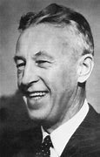
Chapter 1 – Bill’s Story “Why don’t you choose your own conception of God?” Complete Willingness!
AA Big Book Page 12
“It was only a matter of being willing to believe in a power greater than myself. Nothing more was required of me to make my beginning. I saw that growth could start from that point. Upon a foundation of complete willingness I might build what I saw in my friend. Would I have it? Of course I would!
Step 2: Came to believe that a Power greater than ourselves could restore us to sanity.

Slide 29
Chapter 1 – Bill’s Story Surrender
AA Big Book Page 12
“At the hospital I was separated from alcohol for the last time. Treatment seemed wise, for I showed signs of delirium tremens.
There I humbly offered myself to God, as I then understood Him, to do with me as He would. I placed myself unreservedly under His care and direction. I admitted for the first time that of myself I was nothing; that without Him I was lost.
Step 3: Made a decision to turn our will and our lives over to the care of God as we understood Him.
I ruthlessly faced my sins
Step 4: Made a searching and fearless moral inventory of ourselves.
and became willing to have my new-found Friend take them away, root and branch. I have not had a drink since.
Step 6: Were entirely ready to have God remove all these defects of character.
Step 7: Humbly asked Him to remove our shortcomings.
My schoolmate visited me, and I fully acquainted him with my problems and deficiencies.
Step 5: Admitted to God, to ourselves, and to another human being the exact nature of our wrongs.
We made a list of people I had hurt or toward whom I felt resentment. I expressed my entire willingness to approach these individuals, admitting my wrong. Never was I to be critical of them. I was to right all such matters to the utmost of my ability.”
Step 8: Made a list of all persons we had harmed, and became willing to make amends to them all. Step 9: Made direct amends to such people wherever possible, except when to do so would injure them or others.
Four Practical Steps (developed in the late 1920’s – early 1930’s)
Surrender - of our life, past, present, and future, into God’s keeping and direction.
Sharing - of our sins and temptations with another Christian, and to use ‘Sharing as Witness’ to help others, still unchanged, to recognize and acknowledge their sins.
Restitution - to all whom we have wronged directly or indirectly.
Continuance - Listening, accepting, and relying on God’s guidance, and carrying it out in everything we do and say, great or small.

Slide 30
Chapter 1 – Bill’s Story Relief
AA Big Book Page 13 & 14
“I was to test my thinking by the new God-consciousness within. Common sense would thus become uncommon sense. “
“Step 10: Continue to take personal inventory and when we were wrong promptly explained it, I mean admitted it.
“I was to sit quietly when in doubt, asking only for direction and strength to meet my problems as He would have me. Never was I to pray for myself, except as my requests bore on my usefulness to others. Then only might I expect to receive. But that would be in great measure.”
Step 11: Sought through prayer and meditation to improve our conscious contact with God, as we understood Him, praying only for knowledge of His will for us and the power to carry that out.
“My friend promised when these things were done I would enter upon a new relationship with my Creator; that I would have the elements of a way of living which answered all my problems.”
Step 12: Having had a spiritual awakening as the result of these Steps, we tried to carry this message to alcoholics, and to practice these principles in all our affairs.
“Belief in the power of God, plus enough willingness, honesty and humility to establish and maintain the new order of things, were the essential requirements. Simple, but not easy; a price had to be paid. It meant destruction of self-centeredness. I must turn in all things to the Father of Light who presides over us all.”

Slide 31
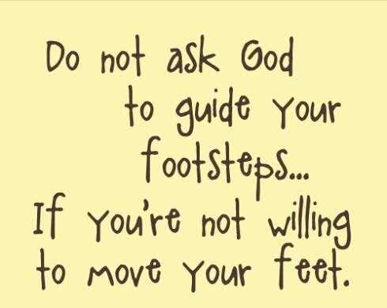
Chapter 1 – Bill’s Story "Faith without works is dead.”
AA Big Book Page 13 & 14
“While I lay in the hospital the thought came that there were thousands of hopeless alcoholics who might be glad to have what had been so freely given me. Perhaps I could help some of them. They in turn might work with others.
My friend had emphasized the absolute necessity of demonstrating these principles in all my affairs. Particularly was it imperative to work with others as he had worked with me. Faith without works was dead, he said. And how appallingly true for the alcoholic! For if an alcoholic failed to perfect and enlarge his spiritual life through work and self-sacrifice for others, he could not survive the certain trials and low spots ahead. If he did not work, he would surely drink again, and if he drank, he would surely die. Then faith would be dead indeed. With us it is just like that.”

Slide 32
Moderator, please stop the recording
Surrender School Closing Announcements

Slide 33
SERENITY PRAYER
God grant me the serenity to accept the things I can not change, the courage to change the things I can and the wisdom to know the difference.

Slide 34
Questions

