Slide 1
Surrender School Presents Joe & Charlie Big Book Study Week 2

Slide 2
messages from the surrender school Board
This is session will be recorded
Each session is approximately 1 hour 15 min
Updates/Announcements from Surrender School

Slide 3
SET ASIDE PRAYER
God, please set aside everything I think I know about myself, my emotional sobriety, the 12 Steps and You; for an open mind and a new experience of myself, my emotional sobriety, the 12 Steps and especially You!

Slide 4
Joe and Charlie Big Book Study September 1 – November 3
AA History
The Doctor’s Opinion
Bill’s Story
There is a Solution
More About Alcoholism and We Agnostics
Step 1, Step 2, and Step 3
Step 4 – Part 1
Step 4 – Part 2
Step 5, Step 6, and Step 7
Step 8, Step 9, Step 10, Step 11, Step 12
Source Credits:
YOUTUBE: 12 Step Retro Speakers
AA Big Book Online PDF - AA Netherlands
Link to Handout Source - Take The 12
Links to Joe and Charlie biography – The Big Book Seminar

Slide 5
Moderator, please start the recording

Slide 6
REVIEW
Introduction to Joe M and Charlie P
AA History
Bill W.
Ebby Thacher
Vital Spiritual Experience
Dr. Silkworth
The Oxford Group
Spiritual Matters
Dr. Bob
Bill Dodson (AA #3)
How Alcoholic Anonymous got its name
AA Big Book Layout
Step Review
Notes:
1st GOAL - THE PROBLEM (Step 1 – Powerless)
The Dr.’s Opinion
Chapter 1 - Bill’s Story
2nd GOAL - THE SOLUTION (Step 2 - Define the Power)
Chapter 2: There Is A Solution
Chapter 3: More About Alcoholism
Chapter 4: We Agnostics
3rd GOAL – ACTION (Steps 3 – 12 – How to find the Power)
Chapter 5: How It Works
Chapter 6: Into Action
Chapter 7: Working with Others

Slide 7
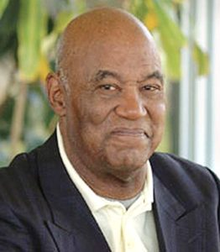
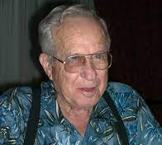
AA History – Introduction
Joe McQ,
Joe McQuany - (AA) from Little Rock, Arkansas. (1928-2007, 78 years old) Sober: 1962 - 2007
Charlie P.
Charlie Parmley - (AA) of Maysville, Arkansas (1929-2011, 82 years old) Sober: 1970 - 2011

Slide 8
AA History
Preface – Video Link
Preface - AA Big Book
Algebra Problem - Video Link
Preface - AA Big Book
Recovery Section
Foreword to the First Edition
Week 2 – The Doctors Opinion
Link to Video Link to AA Big Book Online

Slide 9
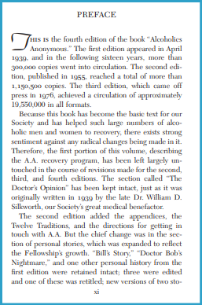
AA History – Preface
AA Big Book (Preface) – pp. xi
“Because this book has become the basic text for our Society and has helped such large numbers of alcoholic men and women to recovery, there exists a sentiment against any radical changes being made in it. Therefore, the first portion of this volume, describing the A.A. recovery program, has been left largely untouched…”
Notes:
Roman Numeral 11 – The first 164 pages. (As we will find out today, the doctor’s opinion was changed after the 1955.

Slide 10
AA History – Problem
I think the greatest mistake being made in A.A. today, the newcomer comes to the door we hand him the book and we say go to Chapter Five (How it Works) and do what it says; and you'll be okay.
And they go to Chapter Five and they run into a series of algebra problems.
Step One says, “We admitted we were powerless over alcohol -- that our lives had become unmanageable.”
The newcomer says, man I'm not powerless over anything. They have no idea what we mean by that statement (because we’ve directed them to Chapter 5 (Step 3).
Step Two says, “We came to believe that a power greater than ourselves could restore us to sanity”.
The newcomer says, don't tell me I'm crazy. Yeah, I do stupid things when I'm drunk, but when I’m sober, I'm like other people. They have no idea what we mean by that statement.(because we’ve directed them to Chapter 5 (Step 3).
But if you're not powerless and you're not nuts, then you don't need (Chapter 5) Step Three to be thinking about turning your will and your life over to the care of something you don’t understand in the first place. We present them with an impossible situation.
If we can do nothing else this weekend, I hope we’re going to be able to get over (realize) the idea of the value of
The Doctor’s Opinion and the first four chapters. There is where we learn what the problem is. There is where we learn what the solution is. That prepares us for Chapter 5. You see Chapter 5 starts with Step 3.
It’s very difficult to start with (Step) 3, unless you’ve got (Step) 1 and (Step) 2 behind you.
Notes:
1st GOAL - THE PROBLEM (Step 1 – Powerless)
The Dr.’s Opinion
Chapter 1 - Bill’s Story
2nd GOAL - THE SOLUTION (Step 2 - Define the Power)
Chapter 2: There Is A Solution
Chapter 3: More About Alcoholism
Chapter 4: We Agnostics
3rd GOAL – ACTION (Steps 3 – 12 – How to find the Power)
Chapter 5: How It Works

Slide 11
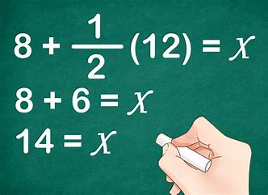
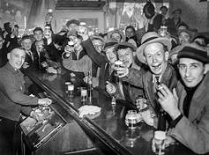
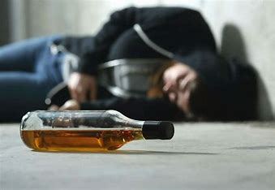
AA History – Algebra Problem
Now, I think what’s so important for me today is whether I’m reading a first, second, or third edition--we have never changed the recovery section. I wonder why we’ve never found it necessary to change it. Because it works, doesn’t it, yeah you betcha. And why does it work? Three reasons, I think.
Alcoholics haven’t changed a bit.
Alcohol hasn’t changed.
Human nature never changes.
Everybody that’s ever read it’s certainly has re-written it at least twice in their minds. Collectively though, we’ve never found it necessary.
Notes:
Why hasn’t the book been updated!?

Slide 12
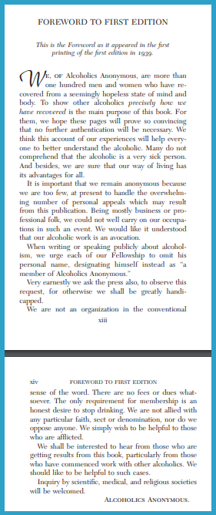
AA History – Recovery Section
Foreword to the First Edition - Big Book p. xiii, par. 1
“We, of Alcoholics Anonymous, are more than one hundred men and women who have recovered from a seemingly hopeless state of mind and body.”
“To show other alcoholics precisely how we have recovered is the main purpose of this book.”
…any time you see italics in this book it becomes very, very important, probably ought to read it again. And it says “precisely”. Later on in the book we’re going to find words such as specifically, exactly, with clear-cut directions. So, this book is not a book on just about how to recover from alcoholism, this book is going to tell us precisely, specifically, exactly, with clear-cut directions on how to recover from alcoholism.
And if I want to recover from alcoholism, guess what, I need to do it precisely, specifically, and exactly, and try to follow the clear-cut directions best I can, otherwise I may not recover from alcoholism.
Notes:
This slide present why the book was written.

Slide 13
The Doctor’s Opinion
It wasn’t until after I got into listening to the description of Dr. Silkworth’s opinion on alcoholism that I began to understand what I had here, and it wasn’t that I was a no-good rotten SOB.
I had an illness called alcoholism; a physical allergy coupled with an obsession of the mind and somehow or other that information helped me overcome some of these ideas that I had.
…the very first sixteen printings of this book, “Alcoholics Anonymous”, The Dr.'s Opinion is on Page 1. 1955 in the second edition, they moved the Dr.'s Opinion out of the Page 1 and put it into the Roman numeral sections.
But the information in The Dr.’s Opinion is so important to me and to the fellowship of Alcoholics Anonymous because the rest of the book is going to tell us how to recover from the condition of the body and the mind that Dr. Silkwood described.
And I said, I was alcoholic for about two years and I didn’t even know what an alcoholic was really.
Notes:
Joe tells a little more history – of the book of the Doctors opinion.

Slide 14
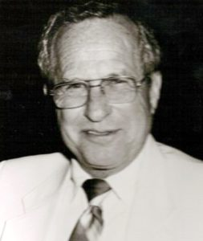
The Doctor’s Opinion
I’m convinced in my mind that God got tired of seeing people like us die from alcoholism and he took various, different people from around the world and gave us these pieces of information that allows us to recover from that condition today.
And I think one of the first persons that he used was this little doctor called Dr. Silkworth.
Charlie P.

Slide 15
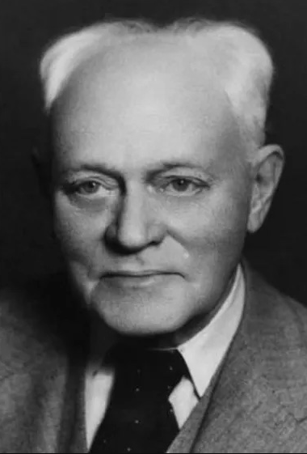
The Doctor’s Opinion – The Problem
… he began to develop this little idea that when you put alcohol in your body it produces an actual physical craving that makes it impossible for us to stop drinking.
But he also said even in those days, that’s not the real problem of the alcoholic, he said the real problem is that the alcoholic cannot keep from drinking.
Dr. William D. Silkworth
Notes:
As a reminder, Dr. Silkworth has been working with Alcoholic for years, and seeing heartbreaking trends.

Slide 16
The Doctor’s Opinion - Powerless
He said people who are heavy drinkers, people who are moderate drinkers, if they want to quit drinking they just quit, and it don’t bother them at all.
But he said it seems as though the alcoholic, after they quit, the mind begins to play tricks on them; and begins to think about one or two drinks and how it makes them feel.
And he said that idea becomes so powerful that it overcomes the idea that they can’t drink, and they take a drink and end up drunk every time.
He said now if you can’t drink safely, and if you can’t keep from drinking, then you’re powerless over alcohol
Dr. William D. Silkworth
Notes:
He defines the alcoholic and problem drinker.

Slide 17
The Doctor’s Opinion
Now we don’t know whether Bill Wilson was the first one he told that to or not, but we know Bill was probably the first one to act on that information.
Then after Bill got sober, and after Dr. Bob got sober, and after Bill Dobson (A.A. Number Three - Into Action - p.182 Big Book) got sober and after the first 40 got sober based on that information and decided to write the book, they went to see Dr. Silkworth and said will you let us put that information in the book so that other alcoholics can see what their problem is too. And they said will you write some of it for us, and the Doctor said yeah, you can use it and I’ll write some of it under one condition, that we will call it “The Doctor’s Opinion”.
He said I can’t prove it, there’s no facts behind it, so we’ll just have to call it an opinion. And he said, by the way, don’t use my name. He said they’ll throw me completely out of the medical profession if you use my name on this deal.
In 1956 when they came out with a Second Edition, 1955 and 1956 they came out with a Second Edition, by that time the Medical Association, the American Psychiatric Association had recognized the fact that Alcoholism is an illness. And Dr. Silkworth said in the Second Edition, you can put my name in it now.

Slide 18
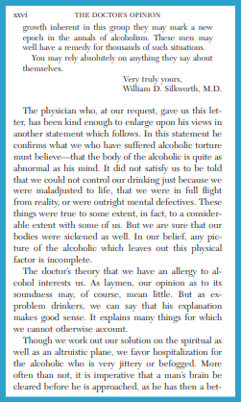
The Doctor’s Opinion – Abnormal Reaction
Big Book “The Doctor’s Opinion”
“The physician who, at our request, gave us this letter, has been kind enough to enlarge upon his views in another statement which follows. In this statement he confirms what we who have suffered alcoholic torture must believe---that the body of the alcoholic is quite as abnormal as his mind.”
Big Book “The Doctor’s Opinion”
“We must believe---that the body of the alcoholic is quite as abnormal as his mind.”
Now this is the first time we can find anywhere in written history, the reference to the fact that the body is affected as well as the mind.
Everything up until this time, they had talked about the mind only. Weak will, moral character, sin and etc. But here we see a statement that says the body is quite as abnormal as the mind. I think he’s telling us two things,
1. That the body is affected also, and I think he’s also saying
2. The mind is abnormal, when it comes to alcohol.
We react to it different physically and also mentally in an abnormal manner.
Notes:
Roman Numeral Page 24 – Second Paragraph.

Slide 19
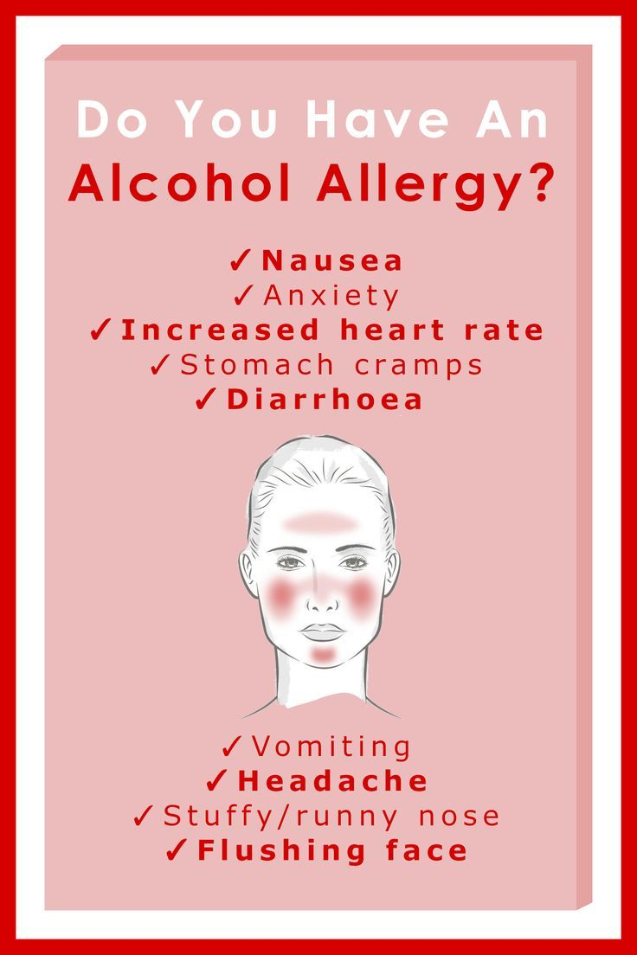
The Doctor’s Opinion – Abnormal Reaction
Big Book p. xxiv, par. line 13
“It did not satisfy us to be told that we could not control our drinking just because we were maladjusted to life, that we were in full flight from reality, or were outright mental defectives. These things were true to some extent, in fact, to a considerable extent with some of us. But we are sure that our bodies were sickened as well. In our belief, any picture of the alcoholic, which leaves out this physical factor, is incomplete.
The doctor's theory that we have an allergy to alcohol interests us. As laymen, our opinion to its soundness may, of course, mean little. But as ex-problem drinkers, we can say that his explanation makes good sense. It explains many things for which we cannot otherwise account.”

Slide 20
The Doctor’s Opinion – Allergy
Well most of us when we come here we assume already we know what an allergy is, I know I did.
I knew if you were allergic to something and you got around it or you ate it or you drank it or something like that, that there would be some physical manifestation or indicator of that allergy.
So I knew if you were allergic to something there would be something there that you could see.
So they came to me and they said Charlie, you got an allergy to alcohol and you’ll never be able to safely drink it again. And I said how in the hell can I be allergic to alcohol; I’m drinking a quart a day. How can you possibly drink that much of something you’re allergic to?
And one day in sheer desperation I went to a source of information that has never failed me since that time. I went to the dictionary and I looked up the word allergy and I found several different definitions of it (the way you do with any word depending on how you use it). But I think I found the one that fit me exactly when it said
An allergy is an ’abnormal’ reaction to any food, beverage, or substance of any kind.

Slide 21
The Doctor’s Opinion – What’s Normal
So to find out what’s normal to see if I’m abnormal, I have to go to the normal, social, temperate moderate drinker; those that drink alcohol and do not get in trouble with it.
Alcohol is a toxic substance; a destroyer of human tissue. When you put it in your body, your mind and body is supposed to react to it with nausea and say puke it up and get it out of here. When I put it in my body, instead of my body experiencing the feeling of nausea, my body experiences an actual physical craving which demands more of the same. Their body said puke it up, mine said put some more in here. So not only do I react to it differently mentally, but I also react to it differently physically.
Now the only difference between normal and abnormal is what the majority of people do.
If the majority, nine out of ten, react that way, one out of ten reacts the way I do, then my reaction is considered to be abnormal, therefore I’m considered to be allergic to alcohol.
You can’t see it, you can only feel it, and only alcoholics feel it.

Slide 22
The Doctor’s Opinion – Phenomenon of Craving
Big Book “The Doctor’s Opinion”
“We believe, and so suggested a few years ago, that the action of alcohol on these chronic alcoholics is a manifestation of an allergy*; that the phenomenon of craving is limited to this class and never occurs in the average temperate drinker. These allergic types can never safely use alcohol in any form at all and once having formed the habit and found they cannot break it, once having lost their self-confidence, their reliance upon things human, their problems pile up on them and become astonishingly difficult to solve.”
The action of alcohol on one who is allergic to alcohol, is manifested by, the phenomenon of craving.
…it is manifested by an actual physical craving in the body that demands more of the same after we have started.
Now I hear people today say well I came to A.A. and I craved a drink for four years. No, in the context of the Big Book that’s the wrong use of the word craving. The only way an alcoholic can crave alcohol is to first put it the body, then the physical craving develops and then we can’t stop and we end up drunk.
So in the “recovery section … - when you see the word “craving” it’s always referring to the body, never to the mind, we’ll use the word ’obsession’ for the mind, the word craving is for the body.
Notes:
it is manifested by an actual physical craving in the body that demands more of the same after we have started. (Pause) – Craving VS Obsession

Slide 23
The Doctor’s Opinion – Types of Drinkers
Big Book “The Doctor’s Opinion”
Type 1: “The classification of alcoholics seems most difficult, and in much details outside the scope of this book. There are, of course, the psychopaths who are emotionally unstable. We are all familiar with this type. They are always "going on the wagon for keeps." They are over-remorseful and make many resolutions, but never a decision.”
Type 2: “'There is the type of man who is unwilling to admit that he cannot take a drink. He plans various ways of drinking. He changes his brand or his environment.”
Type 3: “There is the type who always believes that after being entirely free from alcohol for a period of time he can take a drink without danger.”
Type 4: “There is the manic-depressive type, who is, perhaps, the least understood by his friends, and about whom a whole chapter could be written.”
Type 5: “Then there are types entirely normal in every respect except in the effect alcohol has upon them. They are often able, intelligent, friendly people.”
“All these, and many others, have one symptom in common: they cannot start drinking without developing the phenomenon of craving. This phenomenon, as we have suggested, may be the manifestation of an allergy which differentiates these people, and sets them apart as a distinct entity. It has never been, by any treatment with which we are familiar, permanently eradicated. The only relief we have to suggest is entire abstinence.”
Notes:
Roman Numeral 28

Slide 24
No, sugar and flour do not break down in the same way as alcohol. Here’s a brief overview of how each is metabolized:
Alcohol Metabolism
Ethanol (alcohol) is first converted into acetaldehyde by the enzyme alcohol dehydrogenase.
Acetaldehyde is then converted into acetic acid (or acetate) by the enzyme aldehyde dehydrogenase.
Acetic acid is further broken down into carbon dioxide and water through the citric acid cycle.
Sugar and Flour Metabolism
Sugars (like glucose and fructose) and starches (from flour) are broken down into simpler sugars (mainly glucose) through digestion.
Glucose is then used in cellular respiration to produce energy, carbon dioxide, and water.
Key Differences
Alcohol is metabolized primarily in the liver and involves specific enzymes like alcohol dehydrogenase and aldehyde dehydrogenase.
Sugars and starches are broken down by digestive enzymes (like amylase) and then metabolized in cells through glycolysis and the citric acid cycle.
Sugar Cravings and Metabolism
Blood Sugar Levels: When you consume sugar, it quickly raises your blood glucose levels, providing a rapid energy boost. This can lead to a cycle of spikes and crashes, which often results in cravings for more sugar to regain that energy¹.
Insulin Response: High sugar intake can cause your body to release a lot of insulin to manage the glucose. Over time, this can lead to insulin resistance, making it harder for your body to regulate blood sugar levels and potentially increasing cravings².
Brain Chemistry: Sugar consumption triggers the release of dopamine, a neurotransmitter associated with pleasure and reward. This can create a cycle of craving sugar to experience that dopamine release again².
Acetone and Ketosis
Ketosis: When your body is in a state of ketosis (breaking down fat for energy due to low carbohydrate intake), it produces ketones, including acetone. This is common in low-carb diets or fasting³.
Acetone Breath: High levels of ketones can lead to a fruity or acetone-like smell on your breath³. However, this is more related to fat metabolism rather than sugar metabolism.
Alcohol and Sugar Cravings
Alcohol’s Impact: Chronic alcohol consumption can disrupt normal glucose metabolism and increase insulin resistance, which may indirectly lead to sugar cravings as your body seeks quick energy sources⁴.
In summary, while acetone itself doesn’t cause sugar cravings, the metabolic processes involving sugar and alcohol can influence how your body and brain respond to sugar, potentially leading to cravings.

Slide 25
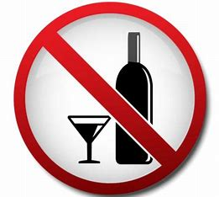
The Doctor’s Opinion – The Mind
Big Book p. xxviii,line 29
“It has never been, by any treatment with which we are familiar, permanently eradicated. The only relief we have to suggest is entire abstinence.”
Big Book p.xxvi, par. 5
“Men and women drink essentially because they like the effect produced by alcohol.”

Slide 26
The Doctor’s Opinion – Psychic Change (Mind)
Big Book p. xxvi, par. 5
“The sensation is so elusive that, while they admit it is injurious, they cannot after a time differentiate the true from the false. To them their alcoholic life seems the only normal one.”
Big Book, top of p. xxvii
“They are restless, irritable and discontented, unless they can again experience the sense of ease and comfort which comes at once by taking a few drinks—drinks which they see others taking with impunity. After they have succumbed to the desire again, as so many do, and the phenomenon of craving develops, they pass through the well-known stages of a spree, emerging remorseful, with a firm resolution not to drink again. This is repeated over and over, and unless this person can experience an entire psychic change there is very little hope of his recovery.”

Slide 27
The real problem centers in the mind telling us we can drink, rather than in the body that ensures that we can’t drink.
The mind destroying the body, and the body destroying the mind!

Slide 28
The Doctor’s Opinion – Will Power - Powerless
Big Book “The Doctor’s Opinion”
“On the other hand—and strange as this may seem to those who do not understand—once a psychic change has occurred, the very same person who seemed doomed, who had so many problems he despaired of ever solving them, suddenly finds himself easily able to control his desire for alcohol, the only effort necessary being that required to follow a few simple rules.”
So the first thing we alcoholics do, to do something about our drinking is,
We decide we’re going to control our drinking while drinking.
We trot out the most useful tool we have and we put it right there, and it’s called WILLPOWER.
The body destroying the body over here (left hand side), the mind over here causing us to drink more and more (right hand side).
If you can’t safely drink because of the body and if you can't quit because of the mind, then you’ve become absolutely powerless over alcohol.

Slide 29
SERENITY PRAYER
God grant me the serenity to accept the things I can not change, the courage to change the things I can and the wisdom to know the difference.

Slide 30
Moderator, please stop the recording
Surrender School Closing Announcements

Slide 31
Questions

