Slide 1
Surrender School Presents Joe & Charlie Big Book Study

Slide 2
Agenda
Logistics and Introductions
Prayers and Opening
About Joe and Charlie
AA History and Big Book Study
Prayers and Closing

Slide 3
*Announcements* surrender school Board
This is session will be recorded
Each session is approximately 1 hour 15 min
Updates/Announcements from Surrender School

Slide 4
Joe and Charlie Big Book Study September 1 – November 3
Week 1 - AA History
Week 2 - A Doctor’s Opinion
Week 3 - Bill’s Story
Week 4 - There is a Solution
Week 5 - More About Alcoholism and We Agnostics
Week 6 - Step 1, Step 2, and Step 3
Week 7 - Step 4 – Part 1
Week 8 - Step 4 – Part 2
Week 9 - Step 5, Step 6, and Step 7
Week 10 - Step 8, Step 9, Step 10, Step 11, Step 12
Source Credits:
YOUTUBE: 12 Step Retro Speakers
AA Big Book Online PDF - AA Netherlands
Link to Handout Source - Take The 12
Links to Joe and Charlie biography – The Big Book Seminar

Slide 5
Moderator, please start the recording

Slide 6
SET ASIDE PRAYER
God, please set aside everything I think I know about myself, my emotional sobriety, the 12 Steps and You; for an open mind and a new experience of myself, my emotional sobriety, the 12 Steps and especially You!

Slide 7
About Joe and Charlie

Slide 8
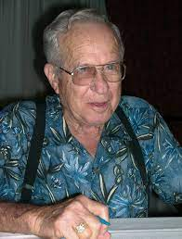
About Joe and Charlie
Joe McQ. & Charlie P. met in 1973 when Joe introduced Charlie as the AA speaker at an Al-Anon Convention.
They instantly discovered their mutual fascination with AA’s basic text “The Big Book”. What interested them most was that The Big Book was written in a particular sequence to convey certain ideas. That interest began a close friendship which has lasted to this day. They would frequently meet to discuss the book, often driving 225 miles to meet in each other’s homes.
Soon they were planning meetings in hotel rooms at AA conventions in Oklahoma and Arkansas, and within a few years, the meetings grew in popularity. In 1977, some members met in a Tulsa, OK hotel room for a discussion of the Big Book. One asked Joe & Charlie to come to his home group to present a program on the book. An AA taper made a four tape set of their presentation and called it “The Big Book Study”. The tapes were gradually circulated throughout the fellowship and invitations were received for Joe & Charlie to present the study at AA conventions, roundups and special events.
As was always Charlie’s hope other members in different areas have picked up where Joe and Charlie, Willie and John left off. Won’t you be the next to pass it on?

Slide 9
AA History and Big Book Study

Slide 10
AA History – Links to recording
Introduction
The Vital Spiritual Experience
Dr. Silkworth
Oxford Group
Spiritual Matters
The Bar
Mothers Day
Bill and Bob
Spiritual Experience
Bill Dodson
The Drunk Squad
New York City
The Big Book
The Treatment Centers
The Newcomer
Laying out the Book
The Steps
Preface (We will not cover)
Algebra Problem (We will not cover)
Recovery Section (We will not cover)

Slide 11
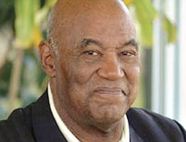
AA History – Introduction
Joe McQ,
Joe McQuany - (AA) from Little Rock, Arkansas. (1928-2007, 78 years old) Sober: 1962 - 2007
Charlie P.
Charlie Parmley - (AA) of Maysville, Arkansas (1929-2011, 82 years old) Sober: 1970 - 2011

Slide 12
AA History – Introduction AA Big Book Layout
[Bill] “he does this and most all of his writings:”
He'll always tell us what the problem is
Then he'll just tell us the solution to that problem
And then he’ll give us a practical program of action to implement the solution

Slide 13
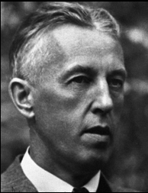
AA History - Introduction
Foreword to Second Edition – (pp. xv-xxi)
The spark that was to flare into the first A.A. group was struck at Akron, Ohio, in June 1935, during a talk between a New York stockbroker and an Akron physician.
Bill Wilson
William Griffith Wilson (November 26, 1895 – January 24, 1971), also known as Bill Wilson or Bill W., was the co-founder of Alcoholics Anonymous (AA). Link: Wikipedia

Slide 14
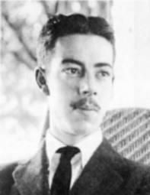
AA History – The Vital Spiritual Experience
Foreword to Second Edition – (pp. xv-xxi)
Six months earlier, the broker had been relieved of his drink obsession by a sudden spiritual experience, following a meeting with an alcoholic friend who had been in contact with the Oxford Groups of that day.
Ebby Thacher
Edwin Throckmorton Thacher (29 April 1896 – 21 March 1966) (commonly known as Ebby Thacher or Ebby T.) was an old drinking friend and later the sponsor of Alcoholics Anonymous co-founder Bill Wilson. He is credited with introducing Wilson to the initial principles that AA would soon develop, such as "one alcoholic talking to another,…" Link: Wikipedia

Slide 15
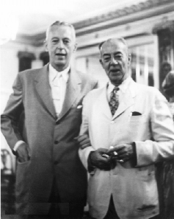
AA History – The Vital Spiritual Experience
He said Bill, people like you and I who have become absolutely POWERLESS over alcohol, if we’re going to have to recover from that condition, we’re going to have to have the aid of a power greater than human power.
He said the doctors, and the ministers and the psychiatrists have tried to help people like us but human power doesn’t seem to be able to do the job. And he said, we’ll have to have the aid of a power greater than human power. And he said I’ve been attending meetings with a group of people called the Oxford Groupers and they told me if I could have a spiritual experience*, that during that spiritual experience I would be able to find that power, and I would be able to recover from alcoholism. He said also they have given me a practical program of action (now the 12 Steps).
They (the Oxford Groupers) GUARANTEED me if I would follow that program of action:
I would have the spiritual experience*,
I would find the power and
I would be able to recover from alcoholism.
Bill Wilson & Ebby Thacher
Ebby Thacher
Edwin Throckmorton Thacher (29 April 1896 – 21 March 1966) (commonly known as Ebby Thacher or Ebby T.) was an old drinking friend and later the sponsor of Alcoholics Anonymous co-founder Bill Wilson. Link: Wikipedia

Slide 16
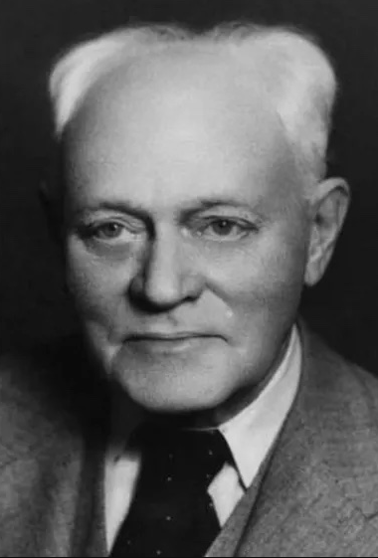
AA History – Dr. William D. Silkworth
Foreword to Second Edition – (pp. xv-xxi)
He had also been greatly helped by the late Dr. William D. Silkworth, a New York specialist in alcoholism who is now accounted no less than a medical saint by A.A. members, and whose story of the early days of our Society appears in the next pages. From this doctor, the broker had learned the grave nature of alcoholism.
Dr. William D. Silkworth
William Duncan Silkworth (July 22, 1873 – March 22, 1951) was an American physician and specialist in the treatment of alcoholism. He was director of the Charles B. Towns Hospital for Drug and Alcohol Addictions in New York City in the 1930s, during which time William Griffith Wilson, a future co-founder of Alcoholics Anonymous (A.A.), was admitted on four occasions for alcoholism. Dr. Silkworth had a profound influence on Wilson and encouraged him to realize that alcoholism was more than just an issue of moral weakness. He introduced Wilson to the idea that alcoholism had a pathological, disease-like basis. Link: Wikipedia

Slide 17
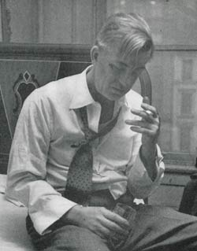
AA History –Dr. William D. Silkworth
I do not believe that alcoholism is a matter of willpower;
I do not believe it’s a matter of moral character, and
I don’t think sin has got anything to do with it.
I believe people like you are suffering from an illness. He said it seems to be a very peculiar illness; it’s a two-fold illness, an illness of the body as well as an illness of the mind.
Illness of the Body
And he said I think what has happened to people like you is you’ve become absolutely physically allergic to alcohol. And it seems to me as though anytime you put any alcohol whatsoever into your system,
it develops an actual physical craving which makes it virtually impossible for you to stop drinking after you have once started. And he said because of that allergy which produces that physical craving you’ll never be able to safely drink alcohol again.
Obsession of the mind
And he said you also have developed what we refer to as an obsession of the mind. And he said an obsession of the mind is an idea that overcomes all other ideas to the contrary. He said it really doesn’t make any difference how badly you want to stop drinking. From time to time your obsession of the mind to drink will be so strong that it will overcome any ideas not to drink
and your mind will actually lead you to believing it's okay to take a drink. And he said then you’ll take that drink, and then you’ll trigger that allergy and you’ll be unable to stop.
He said you can’t safely drink because of your body, you can’t stay sober because of your mind,
therefore you’ve become absolutely powerless over alcohol.
Dr. William D. Silkworth
Bill W's Last Drink | The Saturday Evening Post

Slide 18
AA History –The Oxford Group
Now Bill knew that in the summer of 1933, BUT KNOWING THE PROBLEM DIDN’T SOLVE IT, because shortly after that his mind told him it was okay to drink. And he took a drink, and triggered the allergy and drank for another year.
In the summer of 1934 he was placed back in the hospital again to be withdrawn from alcohol by Dr. Silkwood. And this time Dr. Silkworth pronounced him incurable and told Bill’s wife Lois that this guy is either going to die from DT’s or he’s going to be completely insane from a wet brain and you’re going to have to lock him up or hire a bodyguard if you expect him to live.
And Bill overheard that and he said this time fear sobered him for a bit. But then on Armistice Day 1934 his mind told him it was okay to drink. And he took a drink and triggered the allergy and couldn’t stop drinking.
It’s ONLY AFTER Ebby came to see him and gave him the solution to that problem and gave him a program of action that Bill was able to recover.
So basically, he had to know three things,
(1) HE HAD TO KNOW THE PROBLEM he got that from Dr. Silkwood, (p. 7, par. 2),
(2) HE HAD TO KNOW THE SOLUTION (p. 12, par. 4; p. 27, par. 5),
(3) AND THE PROGRAM OF ACTION - that came to him from Ebby (Oxford Group) (p. xvi, par. 1-2) THEN BILL WAS ABLE TO HAVE HIS SPIRITUAL EXPERIENCE AND RECOVER FROM ALCOHOLISM.
Bill W's Last Drink | The Saturday Evening Post

Slide 19
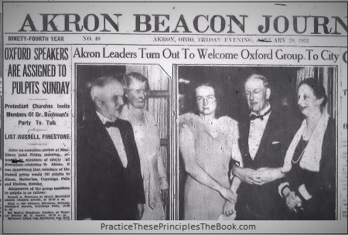
AA History –The Oxford Group
Foreword to Second Edition – (pp. xv-xxi)
Though he could not accept all the tenets of the Oxford Groups, he was convinced of the need for moral inventory, confession of personality defects, restitution to those harmed, helpfulness to others, and the necessity of belief in and dependence upon God.
Prior to his journey to Akron, the broker had worked hard with many alcoholics on the theory that only an alcoholic could help an alcoholic, but he had succeeded only in keeping sober himself.
…he [Bill] went over to talk to Dr. Silkworth…
He [Dr. Silkworth] said you know Bill, you’re staying sober, so obviously trying to help other people is helping you stay sober. And he said, you’re talking to those drunks about that great spiritual experience that you’ve had, and a drunk just won’t accept that. He said why don’t you do for them what I did for you. Why don’t you:
talk to them about the illness of alcoholism,
talk to them about the physical allergy, and the obsession of the mind. (two-fold illness)
Show them through your experience how that worked for you and if they will accept that, then maybe you can talk to them about spiritual matters.
The Oxford Group was a Christian organization founded by American Lutheran minister Frank Buchman in 1921. Buchman believed that fear and selfishness were the root of all problems. He also believed that the solution to living without fear and selfishness was to "surrender one's life over to God's plan". Link: Wikipedia

Slide 20
AA History –Spiritual Matters
He said Bill; every alcoholic I know has two questions:
Why can’t I drink like I used to without getting drunk all the time,
Explain to them the exact nature of the illness,
tell them about the physical allergy of the body and the obsession of the mind (two-fold illness), you’ll get their attention.
Then after you get their attention you can talk to them about spirituality.
TELL THEM WHAT THE PROBLEM IS FIRST
Why can’t I quit drinking now that I want to?
Dr. William D. Silkworth
The broker had gone to Akron on a business venture which had collapsed, leaving him greatly in fear that he might start drinking again. He suddenly realized that in order to save himself he must carry his message to another alcoholic. That alcoholic turned out to be the Akron physician.
Bill W's Last Drink | The Saturday Evening Post

Slide 21
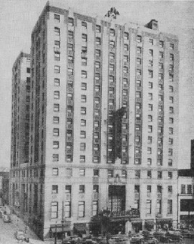
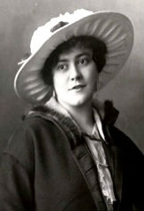
AA History –The Bar / Mother’s Day
And we all know the story of Bill going to Akron. He and some other guys had put a business deal together. They were going to take over one of the companies there in Akron just through a proxy fight. And while there the whole thing blew up in the face, and his friends all deserted him and left him there in Akron, standing in the lobby of the Mayflower Hotel. Low, sad and depressed, counting the money in his pocket realized he didn’t even have enough money to pay his hotel bill. He happened to look through a door off the lobby, into the bar. And I would assume probably the lights were low in the bar, the music was probably playing in the bar, the laughter was great and the smoke was thick, and Bill’s mind said I believe I’ll go in there and be with people of my kind and I’ll feel better. And as he started through the door his mind began to think about taking a drink.
And Bill suddenly realized that if he went in that bar he was going to end up drunk. But he remembered how back in New York City, every time he had tried to help another alcoholic, even though he had failed with them, every time he had tried he himself had felt better. So he said to himself, what I had better do is find me a drunk here in Akron to talk to. Made a few phone calls and came in contact with a lady named Henrietta Seiberling. And Henrietta said, yeah, I know a guy that you can talk to. She said, let me call him and see if I can’t set up a meeting for you.
So she calls Dr. Bob’s house and got hold of Anne Smith, Bob’s wife. And said there’s a fellow here from New York City that says he may have a possible means that Dr. Bob could recover from alcoholism. Can you bring Dr. Bob over for a visit? And Anne said well I’d like to but she said you know this is the day before Mother's Day, and he brought me home a potted plant, and it’s sitting on the table and he’s potted underneath the table. She said let me wait until the morning and see if I can get him to come over. So of course the next morning as soon as Dr. Bob woke up she set in on him to go over to Henrietta’s and see this guy, and to talk to this guy from New York City. Now you know Dr. Bob didn’t feel very good the next morning. Hung over and felt bad and he said I’m not going. And Anne kept after him and kept after him and kept after him and finally, finally Dr. Bob said I’ll go over there and give that guy fifteen minutes of my time, and then I’m coming back home. So Anne took him over there, and Bill and Bob went into a room by themselves and they stayed in that room for literally hours. And Dr. Bob came out of that room and he said this is the first man I’ve ever met that knows what he’s talking about when he talks about alcoholism.
The Mayflower Hotel –
(AA’s most important telephone call)
Bill realized that he needed to speak with another drunk.
Henrietta McBrayer Buckler Seiberling (March 18, 1888 – December 5, 1979) was a member of a Christian fellowship group named the Oxford Group. Seiberling is well-known for connecting the two men who would found Alcoholics Anonymous.
Notes:
J & C And we all know the story of Bill going to Akron. He and some other guys had put a business deal together. They were going to take over one of the companies there in Akron just through a proxy fight. And while there the whole thing blew up in the face, and his friends all deserted him and left him there in Akron, standing in the lobby of the Mayflower Hotel. Low, sad and depressed, counting the money in his pocket realized he didn’t even have enough money to pay his hotel bill. He happened to look through a door off the lobby, into the bar. And I would assume probably the lights were low in the bar, the music was probably playing in the bar, the laughter was great and the smoke was thick, and Bill’s mind said I believe I’ll go in there and be with people of my kind and I’ll feel better. And as he started through the door his mind began to think about taking a drink.
And Bill suddenly realized that if he went in that bar he was going to end up drunk. But he remembered how back in New York City, every time he had tried to help another alcoholic, even though he had failed with them, every time he had tried he himself had felt better. So he said to himself, what I had better do is find me a drunk here in Akron to talk to. Made a few phone calls and came in contact with a lady named Henrietta Seiberling. And Henrietta said, yeah, I know a guy that you can talk to. She said, let me call him and see if I can’t set up a meeting for you. So she calls Dr. Bob’s house and got hold of Anne Smith, Bob’s wife. And said there’s a fellow here from New York City that says he may have a possible means that Dr. Bob could recover from alcoholism. Can you bring Dr. Bob over for a visit? And Anne said well I’d like to but she said you know this is the day before Mother's Day, and he brought me home a potted plant, and it’s sitting on the table and he’s potted underneath the table. She said let me wait until the morning and see if I can get him to come over. So of course the next morning as soon as Dr. Bob woke up she set in on him to go over to Henrietta’s and see this guy, and to talk to this guy from New York City. Now you know Dr. Bob didn’t feel very good the next morning. Hung over and felt bad and he said I’m not going. And Anne kept after him and kept after him and kept after him and finally, finally Dr. Bob said I’ll go over there and give that guy fifteen minutes of my time, and then I’m coming back home. So Anne took him over there,
and Bill and Bob went into a room by themselves and they stayed in that room for literally hours. And Dr. Bob came out of that room and he said this is the first man I’ve ever met that knows what he’s talking about when he talks about alcoholism. Let's see what happened to him

Slide 22
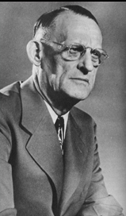
AA History – Bill and Bob
Foreword to Second Edition – (pp. xv-xxi)
“This physician had repeatedly tried spiritual means to resolve his alcoholic dilemma but had failed.”
Bill was surprised to find out Dr. Bob was already in the Oxford Groups. He knew more about the solution: the spiritual experience and the program of action than Bill knew, but he had never been able to apply it to the depth necessary to recover, cause he didn’t know what was wrong with him. You see he thought it was willpower. He thought it was moral character. He thought it was sin. Why would he not, that’s what everybody had told him up until that time?
And what really interested him was the message that Bill had to carry regarding the problem, not the solution, not the program of action, but what alcoholism really consists of.
“But when the broker gave him Dr. Silkworth’s description of alcoholism and its hopelessness, the physician began to pursue the spiritual remedy for his malady with a willingness he had never before been able to master. He sobered, never to drink again up to the moment of his death in 1950.
Dr. Bob Smith
Robert Holbrook Smith (August 8, 1879 – November 16, 1950), also known as Dr. Bob, was an American physician and surgeon who co-founded Alcoholics Anonymous with Bill Wilson (more commonly known as Bill W.).Link: Wikipedia

Slide 23
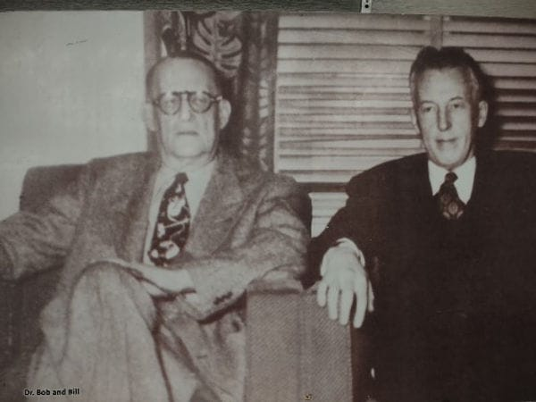
AA History – Bill and Bob
Foreword to Second Edition – (pp. xv-xxi)
“This seemed to prove that one alcoholic could affect another as no nonalcoholic could.”
Through the sharing of our story with a new person, we can affect them as no non-alcoholic could because we have immediate identification
about the physical allergy,
about the obsession of the mind,
about the way we think and the things that we do.
“It also indicated that strenuous work, one alcoholic with another, was vital to permanent recovery.”

Slide 24
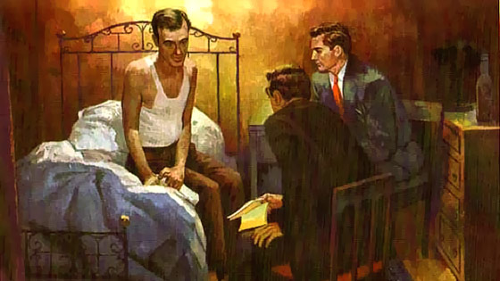
AA History – Spiritual Experience / Bill Dodson
..., one of the Oxford Group tenets was you got to give it away if you’re going to keep it. So immediately they made a decision that we’re going to have to find us another alcoholic to talk to.
So the next morning they go down to see this fellow. He’s named Bill Dobson, and you see the picture in AA rooms all over the world of the man on the bed. And this is Bill and Bob sitting there talking to Bill Dobson.
Two days later Bill Dobson said to his wife get my clothes out of the closet, I’m going home. And he gets up and he dresses and he goes home and he starts applying the program of action. And low and behold he had a vital spiritual experience and he recovered from alcoholism also.

Slide 25
AA History – Drunk Squad
Foreword to Second Edition – (pp. xv-xxi)
“When the broker returned to New York in the fall of 1935, the first A.A. group had actually been formed, though no one realized it at the time.”
You know this little group of alcoholics that was going to the Oxford Group; you know they were having troubles with the Oxford Group because the Oxford Groups had four absolutes. And the drunks were having trouble being absolutely anything, as we well know, they couldn’t practice that, and it seemed like that these drunks liked to stand off in the corner someplace and drink coffee and smoke cigarettes and tell stories, not necessarily mix in with the other Oxford Group meeting members, so they began to call them the Drunk Squad of the Oxford Group. And that’s what they liked, to separate themselves from the normal Oxford Group members.
“A second small group had promptly taken shape at New York.”
When Bill went back to New York City, he began to apply there what he had learned in Akron. Instead of talking about spirituality, he talked to the new people there about the exact nature of the illness and sure enough he got their attention. Some of them began to respond and a second little group started in New York City. And besides there were scattered alcoholics who had picked up the basic ideas in Akron or New York and were trying to form A.A. groups in other cities.
“By late 1937, the number of members having substantial sobriety time behind them was sufficient to convince the membership that a new light had entered the dark world of the Alcoholic.”
The Four Absolutes (Oxford Group)
Moral standards of
"Absolute honesty",
"Absolute purity",
"Absolute unselfishness", and
"Absolute love",
Link: Wikipedia

Slide 26
AA History – New York City
In the summer of 1937 Bill was back in Akron, again on a business venture, and he decided to go by and see Dr. Bob and see how things were going in Akron. And they sat down in Dr. Bob’s kitchen and they counted the number of people they knew that were staying sober, based on these three little pieces of information, and they found approximately 40 people sober.
And I think it’s the first time that they really began to realize; maybe we really have found the answer to this thing called alcoholism. If we’ve found the answer then we need to get it to as many alcoholics as we possibly can. The question immediately becomes well what's the best way to do that and maybe this is the beginning of the group conscious, cause Bill and Bob decided they didn’t want to make that decision themselves, it was too important.

Slide 27
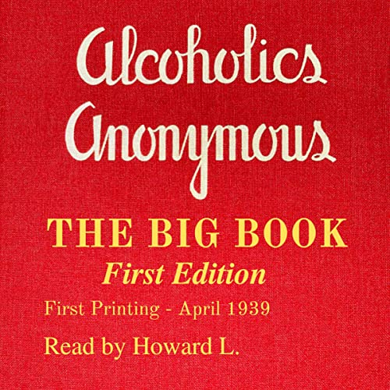
AA History – The Big Book
And they called a meeting of the Oxford Group there in Akron and at that meeting that night there was eighteen people there, some alcoholic, some non-alcoholic, and the topic of conversation was, how can we best carry this message of recovery to the greatest number of people.
Now they decided that night to do three things.
they decided what they needed to do was to build a chain of hospitals stretching all the way across the United States where any alcoholic that needed it would be able to have detoxification.
They also felt that this little message of recovery they had was so vital that not everybody could be entrusted with carrying it correctly. So they decided they needed to hire a group of individuals, train them and you know let them spread out across the United States more or less as missionaries to carry this message of recovery.
And then they said you know the Oxford Groups have written a lot of books, spiritual in natural and they’ve been very popular. Back in the 1930’s people read a lot of books, this was in the days before television. And they felt that if they could come up with a book on alcoholism, what it is, and the solution to it and a way to bring that about.
…they said what we really need to do is take these three pieces of information about the problem, the solution and a program of action put it down in a written form where it would no longer be changed, no longer be garbled, and any alcoholic anywhere in the world in the future would have this same information, it would be pure.
And they made the decision that night to write the Big Book, “Alcoholics Anonymous”.
Foreword to Second Edition – (pp. xv-xxi)
“This determination bore fruit in the spring of 1939 by the publication of this volume. The membership had then reached about 100 men and women.”

Slide 28
AA History – The Big Book
Foreword to Second Edition – (pp. xv-xxi)
“This determination bore fruit in the spring of 1939 by the publication of this volume. The membership had then reached about 100 men and women.”
And after they wrote the book they sat down one night at a meeting and they were trying to determine what they were going to call the book. And then one evening someone suggested, that we’re alcoholics and we want to remain anonymous, how about “Anonymous Alcoholics”, or “Alcoholics Anonymous”, that caught on. And that’s what they called the book, “Alcoholics Anonymous”. And the first “Alcoholics Anonymous” that the world had ever seen was a book called “Alcoholics Anonymous”.
Foreword to Second Edition – (pp. xv-xxi)
“ “The fledgling society (this drunk squad of the Oxford Group),... which had been nameless now began to be called Alcoholics Anonymous, from the title of its own book.”
So we have two Alcoholics Anonymous don’t we. We have a book entitled, “Alcoholics Anonymous”, and then we have a fellowship entitled “Alcoholics Anonymous”. Two A.A.’s and we still have that today. And I think this is very important for us to think about. This group of people who had been nameless, they had been known as the Drunk Squad of the Oxford Groups, wrote a book and in that book they put their program of recovery and they called the book, “Alcoholics Anonymous”. And after the book was published they then decided to call themselves “Alcoholics Anonymous”.

Slide 29
AA History – The Treatment Centers
… in 1939, the program in the book, “Alcoholics Anonymous” and the program in the fellowship
“Alcoholics Anonymous” were exactly the same.
The book then began to go out across the United States… and the first person… got a copy of this book: Read it, studied it, did what it said, recovered from alcoholism; started a group called “Alcoholics Anonymous” .
…as it grew and got bigger and bigger and bigger they began to experience the power of fellowship, they then began to question the need for the severity of the program in the book. And they said –
Do you mean that we really have to turn ALL of our will and our life over to the care of God, as we understand him? Can we give him the drinking and keep the rest?
Do you mean we are going to have to share ALL of our life story with another human being?Hell God already knows about it, we know about it, why tell somebody else?
They began to say you mean we have to have God remove ALL of our character defects? Hell we won’t have any personality left if He does!
And they began to talk about, do you mean we have to make amends to ALL those people we’ve harmed?
And they began to say such things as, well maybe we don’t need to do every bit of that. Maybe me could take some of it, and leave some of it?
Maybe we can do it cafeteria style? Pick what we want, and leave that that we don’t want?
And along about that time came the great advent of the treatment centers.
They begin to go into a group therapy thing and they begin to sit around the tables and talk about their problems and they begin to develop such terms as the dysfunctional family. And they begin to use such words as chemical dependency, and they began to talk about significant others, and they began to discuss meaningful relationships and they begin to talk about dysfunctional sex, and they begin to talk about this and they begin to talk about that. And the program in the treatment center wasn’t like the program in the book, “Alcoholics Anonymous”.

Slide 30
AA History – The Newcomer
Well naturally the new people from the treatment centers coming into A.A. wanted to talk about what they knew to talk about is what they had learned in other places.
And slowly, slowly, slowly, the program in the fellowship began to change. And as the years went by, it began to change more and more and more, until today sometimes you go to an A.A. meeting and if they didn’t read the preamble before the meeting, you wouldn’t know what kind of meeting you’re in, because they talk about everything except alcoholism and recovery there from it.
We're going to talk about the program in the book, "Alcoholics Anonymous," that the first one hundred used, which has never been changed.
The program in the fellowship has definitely changed.
The program in the book has never changed.

Slide 31
AA History – The Newcomer
Foreword to Second Edition – (pp. xv-xxi)
“While the internal difficulties of our adolescent period were being ironed out, public acceptance of A.A. grew by leaps and bounds. For this there were two principal reasons: the large numbers of recoveries, and reunited homes. These made their impressions everywhere. Of alcoholics who came to A.A. and really tried, 50 percent got sober at once and remained that way; 25 percent sobered up after some relapses, and among the remainder, those who stayed on with A.A. showed improvement. Other thousands came to a few A.A. meetings and at first decided they didn’t want the program. But great numbers of these—about two out of three—began to return as time passed.”

Slide 32
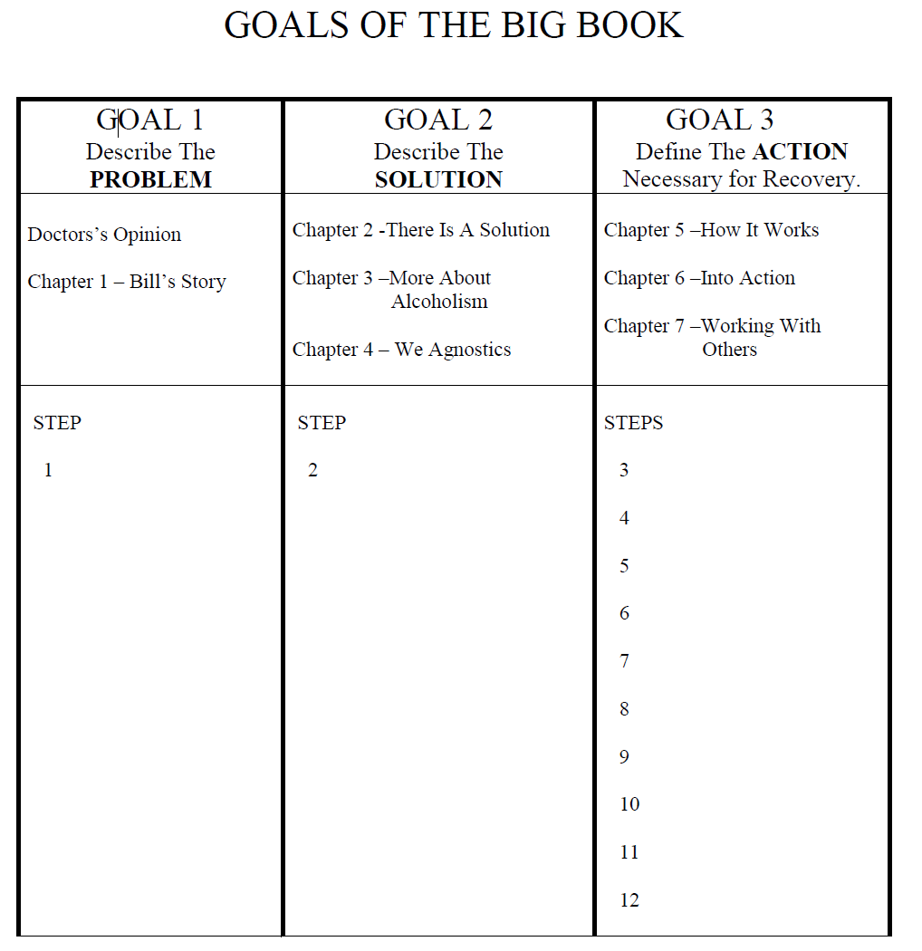
AA History – Lay out a Book
GOALS OF THE BIG BOOK:
1st GOAL - THE PROBLEM
The Dr.’s Opinion
Chapter 1 - Bill’s Story
2nd GOAL - THE SOLUTION
Chapter 2: There Is A Solution
Chapter 3: More About Alcoholism
Chapter 4: We Agnostics
3rd GOAL – ACTION
Chapter 5: How It Works
Chapter 6: Into Action
Chapter 7: Working with Others

Slide 33
AA History – The Steps
What is the problem? *POWERLESS* | Step 1 | (The Doctor’s Opinion ) (Chapter 1 - Bill’s Story)
What is the solution? *POWER* | Step 2 | (Solution) (Chapter 3 - More About Alcoholism) (Chapter 4 - We Agnostics) *POWER*
What is the program of action necessary to find it? *FIND THE POWER* | Steps 3-12 | (Chapter 5 - How It Works) (Chapter 6 - Into Action) (Chapter 7 - Working with Others)

Slide 34
RECAP - AA History – Links to recording
Introduction (Bill W.)
The Vital Spiritual Experience
Dr. Silkworth
Oxford Group
Spiritual Matters
The Bar
Mothers Day
Bill and Bob
Spiritual Experience
Bill Dodson
The Drunk Squad
New York City
The Big Book
The Treatment Centers
The Newcomer
Laying out the Book
The Steps
Preface (We will not cover)
Algebra Problem (We will not cover)
Recovery Section (We will not cover)

Slide 36
SERENITY PRAYER
God grant me the serenity to accept the things I can not change, the courage to change the things I can and the wisdom to know the difference.

Slide 37
Moderator, please stop the recording
Surrender School Closing Announcements

Slide 38
Questions

